Slide 1
Getting recombinant plasmids in bacteria
Lab 5A

Slide 2
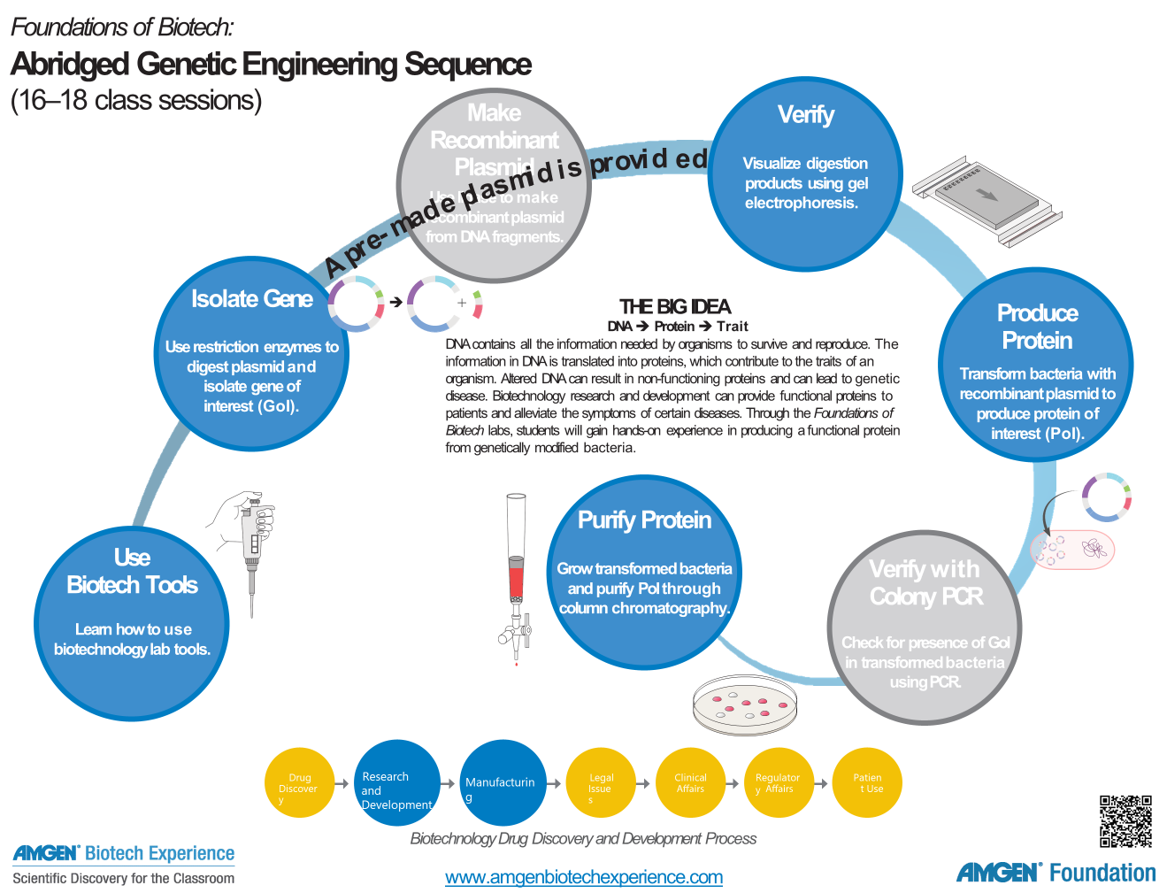
We are here

Slide 3
Chapter 5a: Overview
During laboratory 5a students will use changes in temperature to get their bacterial cells to take up the desired plasmid, thereby transforming the cells.
Those cells with the correct plasmids will carry the antibiotic resistance gene along with the red fluorescent protein, allowing for selection by using antibiotics in the growth media.

Slide 4
Chapter 5a: Learning Goals
  Describe the role of transformation in the gene cloning process
  Explain the purpose of each control in the transformation experiment
  Explain how the information encoded in a gene is expressed as a trait

Slide 5
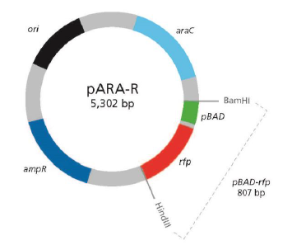
Chapter 5a: Objectives
Transform E. coli with pARA-R containing the rfp gene of interest
Notes:
Plasmid is a double-helix of DNA. Ori region = beginning of DNA replication; ampR = protects bacteria from ampicillin plate (a selective media to identify transformed cells) by producing beta lactamase and breaking down the ampicillin; araC = on/off switch in the presence of arabinose, similar to the lac operon; pBAD = promoter to allow RNA polymerase to dock; rfp = gene for protein of interest (in our case, red fluorescent protein)

Slide 6
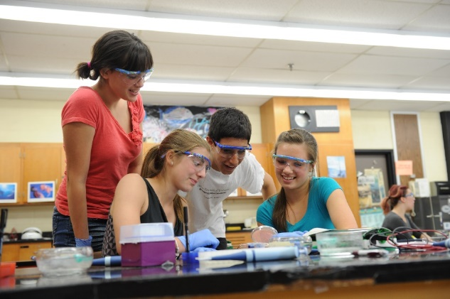
Chapter 5a: Key Ideas
By changing their environment, you can encourage the bacterial cells to undergo the transformation, with about 1 in 1000 cells taking up the plasmids.
Transformed cells will replicate and express the genes for the desired protein and antibiotic resistance.

Slide 7
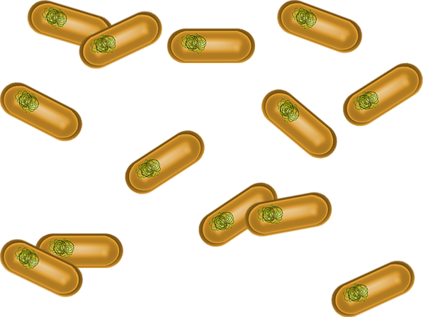
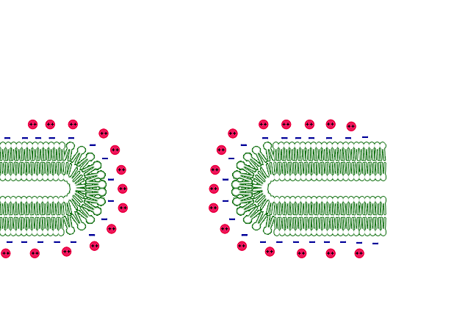

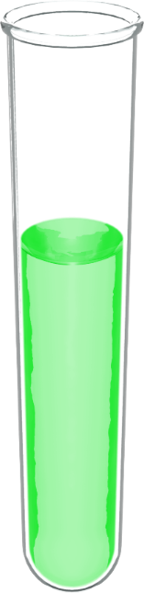
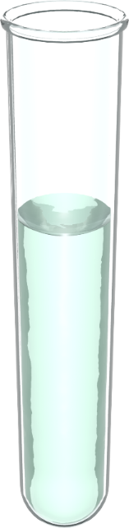
Preparing Competent Cells for Transformation
Lipid bilayer
(inner)
Adhesion zone
Peptidoglycan
layer
Lipid bilayer
(outer)
Calcium ions

Slide 8
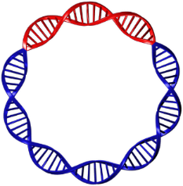
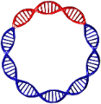
Transforming E. coli with pARA-R plasmid
Competent Cells
pARA-R
Recombinant Plasmids

Slide 9
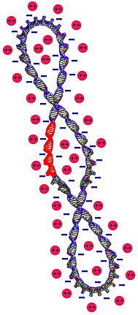
Transforming E. coli with pARA-R (cont)
Lipid bilayer
(inner)
Adhesion zone
Peptidoglycan
layer
Lipid bilayer
(outer)
Calcium ions
pARA-R

Slide 10
guides ( 2019 Guide)
Teacher Guide Page 105
Student Guide: page 65
Since we provide the plasmid the tube of culture is RP not LIG.

Slide 11
Student guides ( 2015 manual)
Tab C- abridged sequence
Starts on page C-35
Student
  Introduction
  Goals
  What do you already know?
  Transforming bacteria with recombinant plasmids
  Laboratory 5a: Transforming bacteria with the para-R plasmid
  Questions
  Glossary

Slide 12
Teacher guide ( 2015 manual)
Tab C- abridged sequence
Starts on page C-39
  Assumptions of prior knowledge
  Goals and outcomes
  Suggested sequence
  Preparation
  Flowcharts

Slide 13
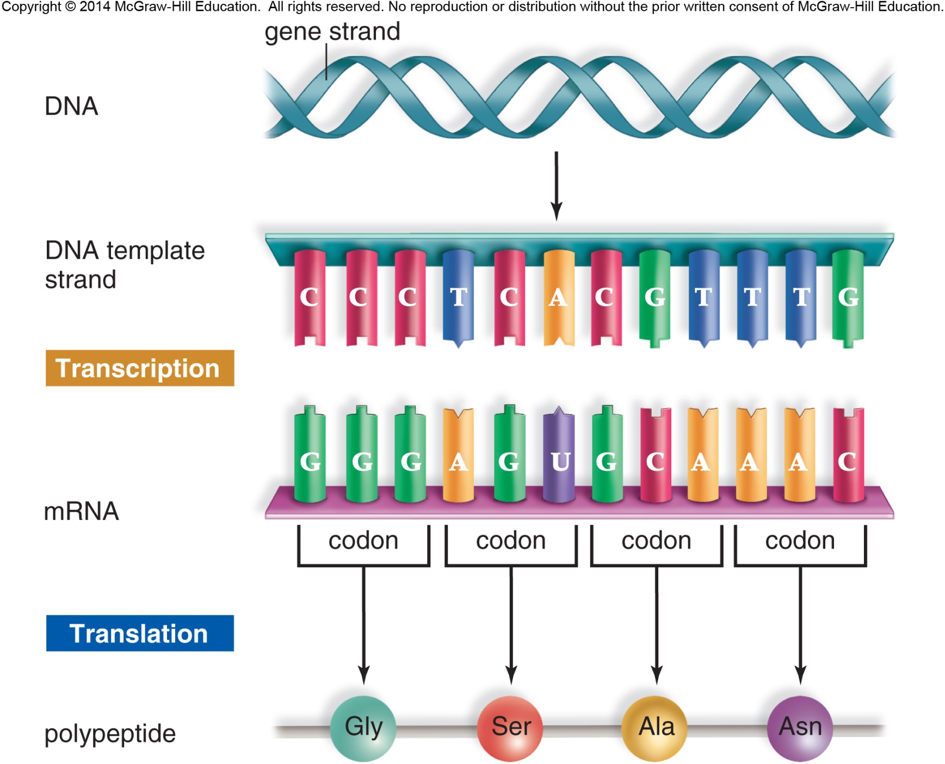
Previous knowledge and skills
Relationship between DNA, genes, proteins, and traits
DNA is double-stranded molecule with nucleotides
Transcription
Translation

Slide 14
Laboratory 5a: Procedures
Students learn to employ basic microbiology methods including aseptic technique and plating their bacterial cells.
Students make predictions about growing their bacteria under different media conditions and compare their predictions with results.

Slide 15
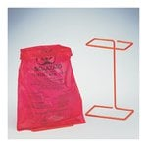
Chapter 5a: Safety
Use caution when handling E. coli bacteria and use aseptic technique
Aseptic technique ensures protection of the lab worker and protection of the bacterial sample
  Do not touch anything that has been or will be in contact with E. coli bacteria. Wear gloves when handling equipment that comes into contact with bacteria.
  Avoid spills or contamination or surfaces with anything that has been in contact with E. coli. Immediately inform your demonstrator if a spill occurs.
  When you have finished using tubes, pipette tips and cell spreaders, immediately place them into the biohazard bag or waste container.
  When directed to do so, place your Petri dishes in the autoclave bag.
  Wash your hands well with soap after completing the lab.

Slide 16
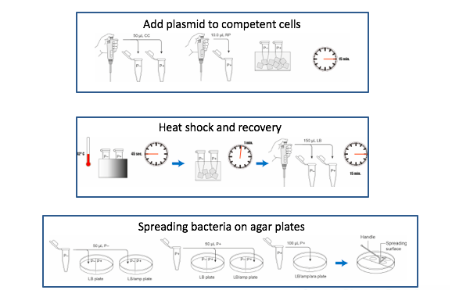
Chapter 5a: Overview of Lab

Slide 17
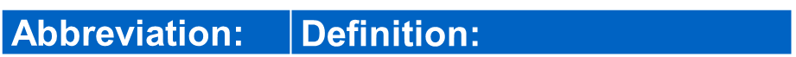
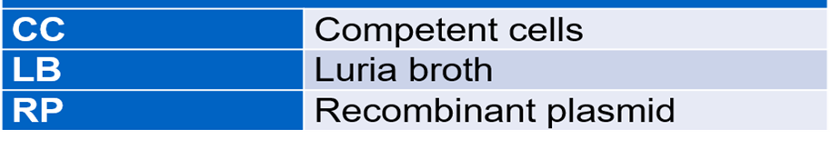
Teacher Preparation
Pages 109-110 (2019)
Pages C-43 through C-44 (2015)
Copy handouts
  Bacterial growth predictions(RM5)
  Flowcharts
Calibrate water bath
Aliquot reagents****
Discuss proper aseptic techniques!!!
  Refer to Workshop materials
Sterile techniques!

Slide 18
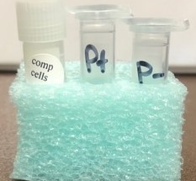
Teacher Preparation
KEEP COMPETENT CELLS FROZEN UNTIL TRANSFORMATION DAY
At least 1 day before the lab; freeze the gray cryovial rack.
Day of the lab:
  Take out number of tubes need for transformation
    Each group will need 100 µL of competent cells
    Place tubes in wet ice to defrost
      Will take about 10-15 minutes
  Return any unused tubes with cells immediately to conical tube and place into freezer

Slide 19
Purpose of controls
Control group
  No plasmid added
  P- tube
Treatment group
  Add the pARA-R plasmid
  P+ tube
  Keep this tube after!

Slide 20
Using various conditions to assess outcomes
Control group
  Grown in Luria Broth (LB)
  Grown in presence of LB and ampicillin (disrupt formation of CW)
Treatment group
  Grown in Luria Broth (LB)
  Grown in presence of LB and ampicillin
  Grown in presence of LB, ampicillin, and arabinose

Slide 21
Growing bacteria for Proten Purification
On the day of transformation, take out (prior to each class) only the number of tubes your class will need for transformation - each group will need 100µL of cells; each tube contains approximately 500µl or 1000µL of cells, depending upon the size of the tube.
Place these tubes in wet ice (a mixture of cold water and mostly crushed ice) to defrost.
Store tubes in the Cryovial cool rack provided.

Slide 22
Growing bacteria for Proten Purification
Cells will defrost in 10-15 minutes. Be certain to re-suspend the cells before aliquoting. This is accomplished by gently pumping in and out with the P-200 pipette.
After aliquoting the cells, place the aliquots in wet ice. For efficient transformation, it is important that the cells remain cold until the heat shock step.
Allowing the cells to warm up causes the lipids in the cell wall to redistribute thereby closing the adhesion zones so the plasmids will not be able to get into the cells

Slide 23
Materials - Students

Slide 24
Tips for a successful transformation
It is important that these cells remain frozen until transformation day.
Allowing the cells to warm up causes the lipids in the cell wall to redistribute thereby closing the adhesion zones so the plasmids will not be able to get into the cells.
If possible, place the plastic bag with ice pack and contents into your freezer. The Ice pack will act to buffer to the changes in freezer temperatures found in frost-free freezers.
If limited in space, place competent cell vial in a cup of crushed ice and place in the deepest part of your freezer.

Slide 25
Laboratory 5A Flow Chart
If shortened period, you can stop after adding LB and then refrigerate.

Slide 26
Laboratory 5A Flow Chart (cont.)

Slide 27
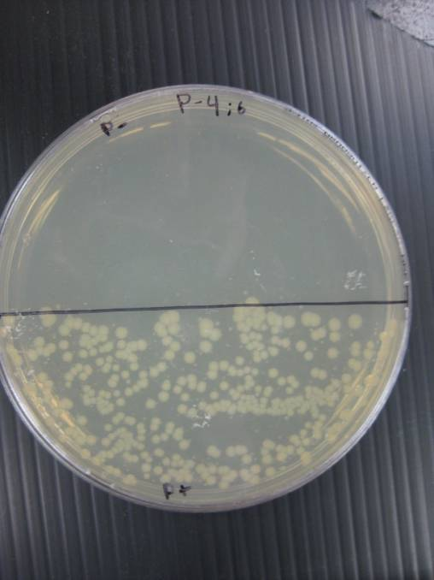
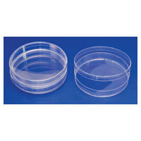
Reminders - students
2 clean microfuge tubes – KEEP PIPETTE TIPS SEPARATE!!!!
  P+
  P-
Label BOTTOM of plates (agar side) near edges
Note the plate markings: I=LB (blue); II=LB/Amp (green); III=LB/Amp/Ara (red)
When spreading:
  Clamshell opening
  GLIDE spreader, do not dig
Be sure to invert the plates when incubate
  Decrease condensation and skewed results

Slide 28
Results

Slide 29
Plate Predictions

Slide 30
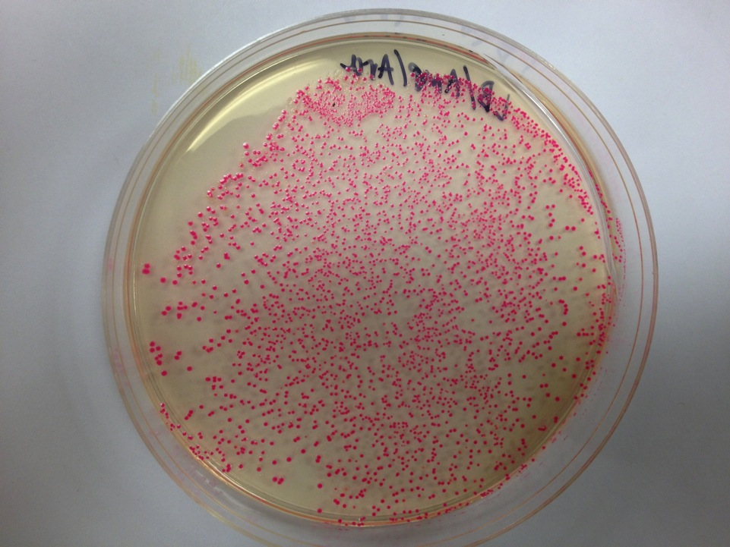
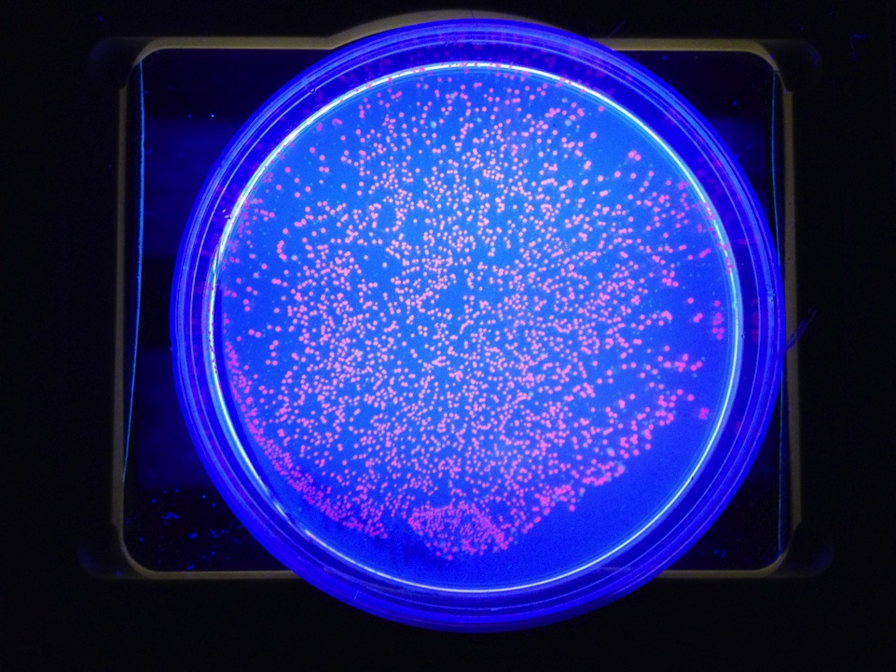

Slide 31
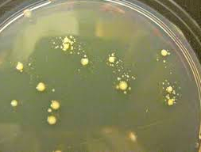
Laboratory 5a: Troubleshooting
Satellite colonies – small colonies around larger colonies that do not have the plasmid but can grow because of the beta-lactamase that diffuses into agar surrounding transformed cells.
Could increase ampicillin concentration if recurring issue.
Researchgate.net

Slide 32
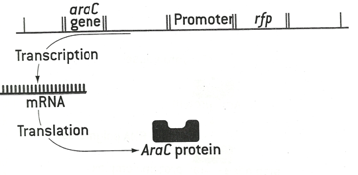
What is happening?
pARA-R major control elements:
  Required to express the rfp gene
  1. araC gene
    Codes for AraC protein
      Regulatory protein
      which helps turn rfp gene on and off
      Acts as a repressor by blocking promoter
  2. promoter region (PBAD)
    Portion of DNA where regulation of rfp expression occurs
    RNA polymerase binds
  3. rfp location

Slide 33
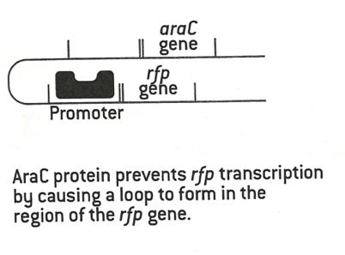
What is happening?
2. promoter region (PBAD)
  If no arabinose:
    AraC protein physically bind to plasmid
      At promoter site
      At region near the araC gene
    DNA bends around and blocks transcription cannot occur
    RNA polymerase cannot bind to promoter site
      mRNA transcription cannot occur
    Bacterium cannot produce mFP

Slide 34
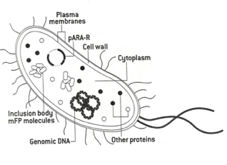
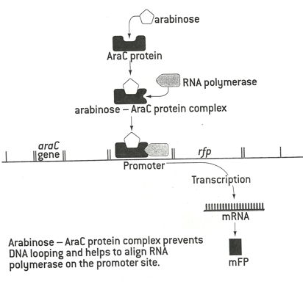
What is happening?
2. promoter region (PBAD)
  If arabinose present: (i.e. LB/amp/ara plate)
    Arabinose binds with AraC protein
      Combo needed to help align RNA pol on promoter site for transcription
    Prevents DNA loop from forming
    RNA polymerase can join complex after conformational change
    Three molecule complex binds promoter site on DNA
    DNA transcribes rfp gene to produce mRNA
      Translates to RFP!!
      Stored as inclusion bodies
        HOW do we get them out then??

Slide 35

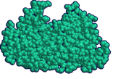
RFP expression
araC gene
P_{BAD}
rfp gene
Transcription
mRNA
Translation
araC protein

Slide 36
RFP expression
araC protein prevents RFP transcription by causing
a loop to form in the region of the fp gene
r
araC gene
araC protein
P_{BAD}
rfp gene

Slide 37
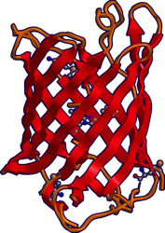


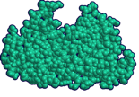
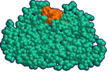
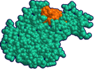
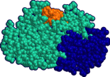

Rfp expression
RFP expression
Arabinose – araC protein complex prevents DNA looping
and helps to align RNA polymerase
on the promoter site (P_{BAD}).
arabinose
RFP
(red fluorescent
protein)
Translation
RNA polymerase
araC protein
arabinose – araC protein
complex
mRNA
Transcription
araC gene
P_{BAD}
rfp gene

Slide 38
Why are there some white colonies?
LB/amp/ara plate
When there is a mixed culture of red and white (nonexpressing) cells, the white cells will grow faster than those that are using their resources producing red fluorescent protein (rFP)
  = less rFP produced for purification
Some transformed cells stop expressing rfp fairly early

Slide 39
Lab 5 Video Resources
Tips for Teaching Lab 5
Transforming Bacteria

