Slide 1
Intro to LabXchange for ABE
Adapted from Maia Binding
SF/Bay Area abe director

Slide 2
LabXchange Platform
Explore
Library
Dashboards
People
Notes:
There are four main pages: explore, library, dashboard, and people. Just looking at the first three.

Slide 3
Creating a LabXchange Account
https://www.labxchange.org/library/pathway/lx-pathway:0c014f7f-089c-4f50-b304-48a4b6a39469/items/lx-pb:0c014f7f-089c-4f50-b304-48a4b6a39469:lx_image:998e8696
https://labxchange.zendesk.com/hc/en-us/articles/360035736354-Creating-Your-LabXchange-Account
https://labxchange.zendesk.com/hc/en-us/articles/360041183114-Understanding-LabXchange-Roles

Slide 4
Creating an ABE Profile
The video shows ABE teachers how to:
add ABE to their LabXchange profiles,
search for other ABE members on the platform.
https://www.labxchange.org/library/pathway/lx-pathway:0c014f7f-089c-4f50-b304-48a4b6a39469/items/lx-pb:0c014f7f-089c-4f50-b304-48a4b6a39469:video:901a90f5

Slide 5
Resource types
LXC Content:
Library
Pathways
Clusters
Notes:
Resources are arranged in different ways:

Slide 6
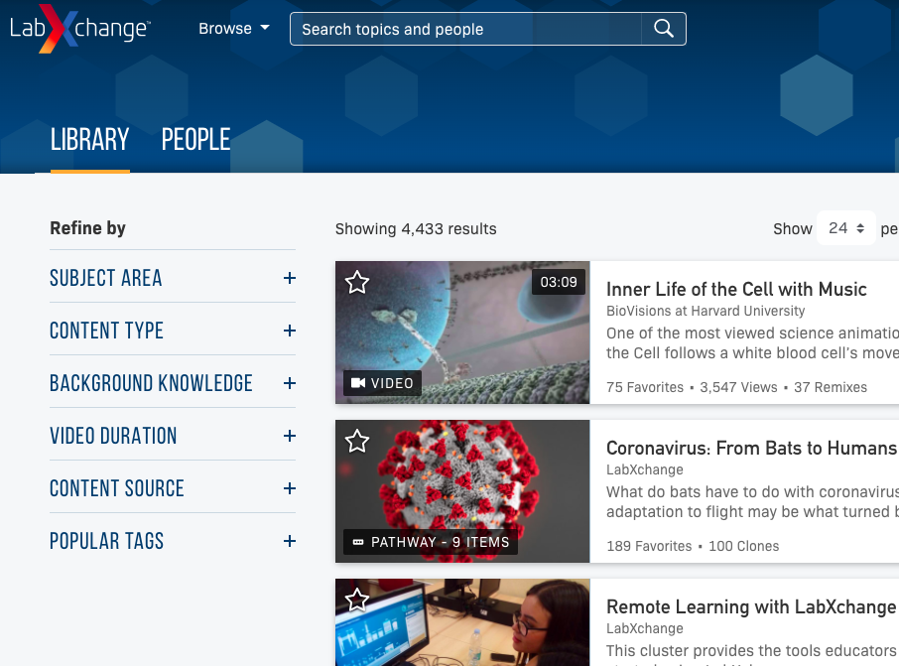
content
All pieces of LXC content are stored in the library
Use “favorites” function to keep track
Notes:
Video clips, readings, interactives, simulations, images, etc
Use “favorites” function to keep track of ones you like.
No account/sign in necessary to access the library content

Slide 7
Using the LabXchange Library
The video demonstrates to ABE teachers how to use the LabXchange library. It shows them how to:
search through available resources
filter them by type, language, subject area, and more
https://www.labxchange.org/library/items/lb:LabXchange:62ff5161:video:1

Slide 8
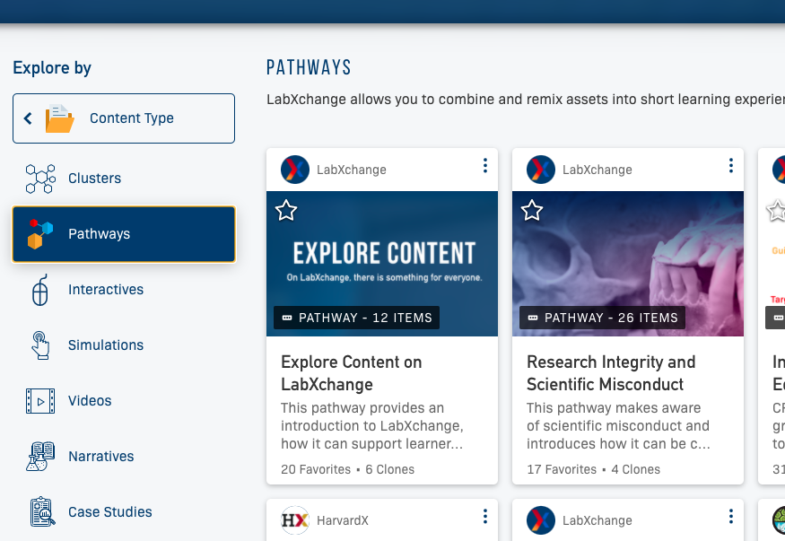
pathways
Pathways can be found in the library and under the “explore” function.

Slide 9
pathways
Pathways are content pieces grouped sequentially about a particular topic.
Notes:
You can use preexisting pathways as is, clone and modify them, or make your own.

Slide 10
clusters
Clusters are groups of pathways by topic (also in library or explore)

Slide 11
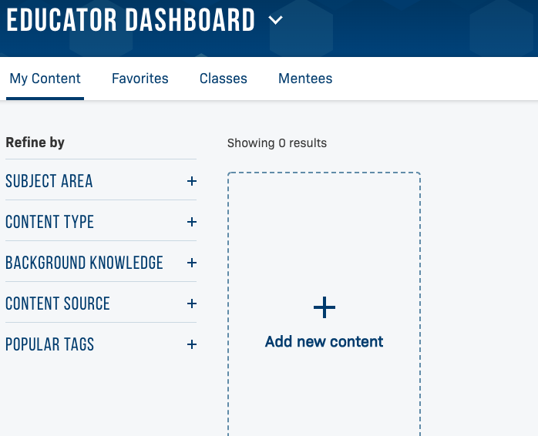
Create/add your own content
From the Educator Dashboard
Notes:
Remains private, you can share with your own classes but will not be housed in the public library

Slide 12
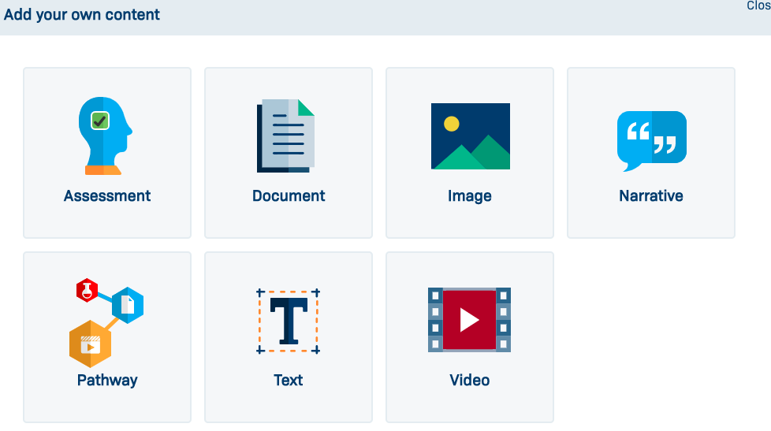
Create/add your own content
From the Educator Dashboard

Slide 13
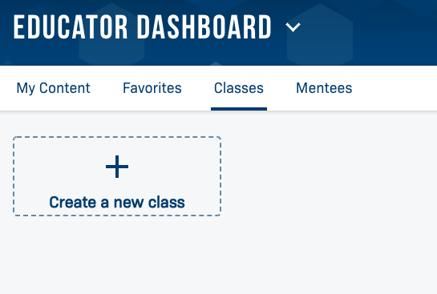
Classes
Also from the Educator Dashboard, click the “Classes” tab
Notes:
sequence of pathways and/or lessons that would be covered in a class; allows you to track learners’ progress, add assessments, etc.

Slide 14
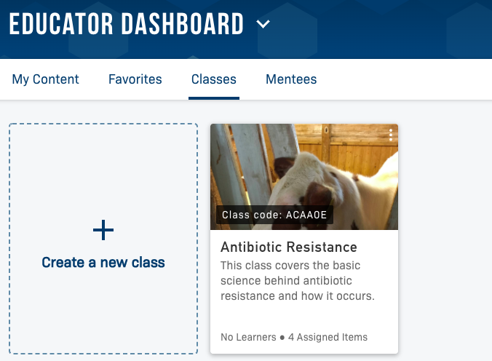
Creating a class
Create Class
Add Content
Students Register (class code)
Monitor Progress
Discussion Boards

Slide 15
ABE Related Content on LabXchange
Cluster: Foundational Concepts and Techniques in Biotechnology
Notes:
Go to the cluster, Foundational Concepts and Techniques in Biotechnology, then click “Tours”

Slide 16
ABE LANDING PAGE/

Slide 17
Creating a Class on LabXchange
how ABE teachers can create a LabXchange class for their students.
https://www.labxchange.org/library/items/lb:LabXchange:f6bdc5f0:video:1

Slide 18
Creating and Adding Content to LabXchange
creating and adding content to LabXchange. It also shows teachers how to create the various types of assets as well as how to "clone" a pathway and adapt it for their learners’ needs.
https://www.labxchange.org/library/items/lb:LabXchange:840b4ec9:video:1
The ABE-focused cluster (named Foundational Concepts and Techniques in Biotechnology) contains some of the most valuable resources, since it allows for the greatest ease in browsing carefully curated assets and pathways.
https://www.labxchange.org/library/items/lb:LabXchange:ede83a61:video:1

Slide 19
Colony PCR
https://www.labxchange.org/library/pathway/lx-pathway:9d767909-26ba-4430-9f60-3830284bc31f

