Slide 1
AMGEN BIOTECH EXPERIENCE

Slide 2
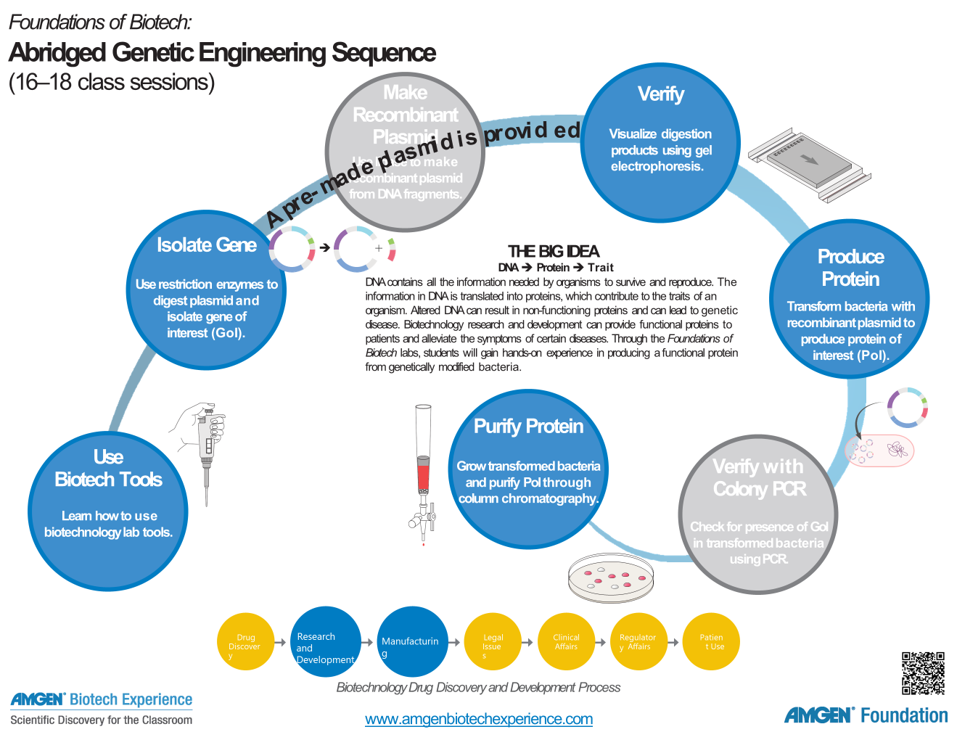
We are here

Slide 3
CHAPTER 1: OVERVIEW
Cloning a gene requires being able to dispense small and accurate volumes of enzymes, plasmids and media.
In order to fully mimic the processes used by industry professionals, students should become proficient in these techniques during this first laboratory.
This proficiency will help ensure that they can perform the remaining laboratories with confidence and accuracy.
CHAPTER 1: SOME TOOLS OF THE TRADE

Slide 4
CHAPTER 1: LEARNING GOALS
Use micropipettes and technique of gel electrophoresis correctly
Explain importance of micropipettes and gel electrophoresis in genetic engineering
Describe how gel electrophoresis separates DNA
Explain how genetic engineering can be used to treat some genetic diseases

Slide 5
CHAPTER 1: KEY IDEAS
Core of genetic engineering: carefully planned changes to DNA lead to production of specific proteins.
Genetic disease can be treated using proteins produced by bacteria whose DNA has been changed by the addition of the corresponding human gene.
Those who carry out genetic engineering use very specific tools and have well-honed laboratory skills.
Micropipettes are used to measure and transfer very small volumes of liquids.

Slide 6
CHAPTER 1: CONNECTIONS TO INDUSTRY
The tools and techniques learned in this laboratory are fundamental to molecular biology and the biotechnology industry.
Creating recombinant DNA relies on research and development teams employing these tools and techniques on a daily basis.

Slide 7
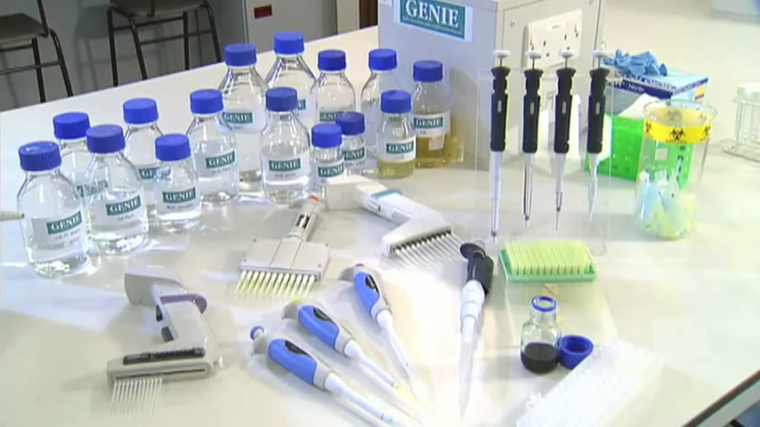
USING THE MICROPIPETTE
Instruct students on the proper use of pipettes by employing a variety of available curriculum resources including hands-on practice laboratories and videos.
Video 1 Video 2

Slide 8
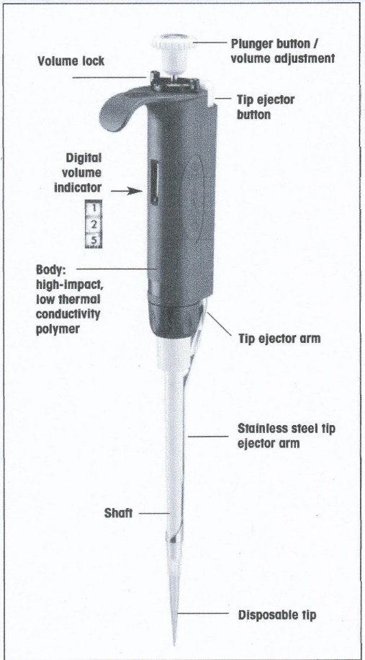
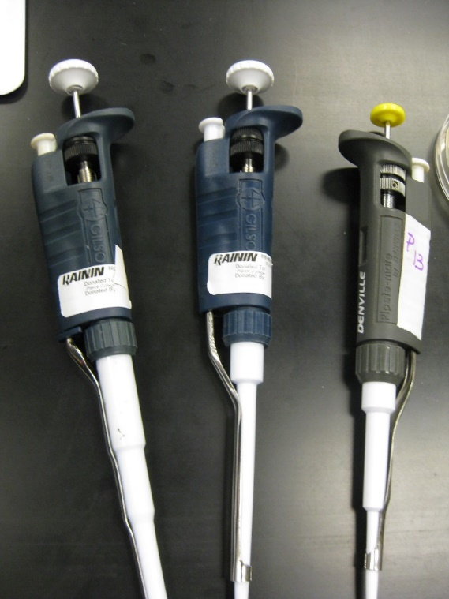
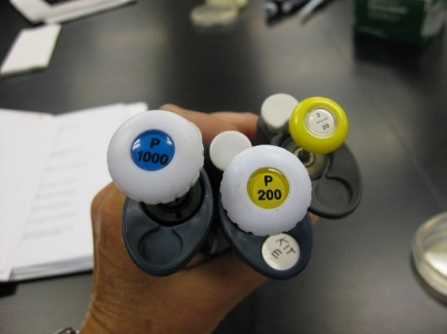
TYPES OF MICROPIPETTES
Notes:
The type of micropipettes may differ between sites.

Slide 9
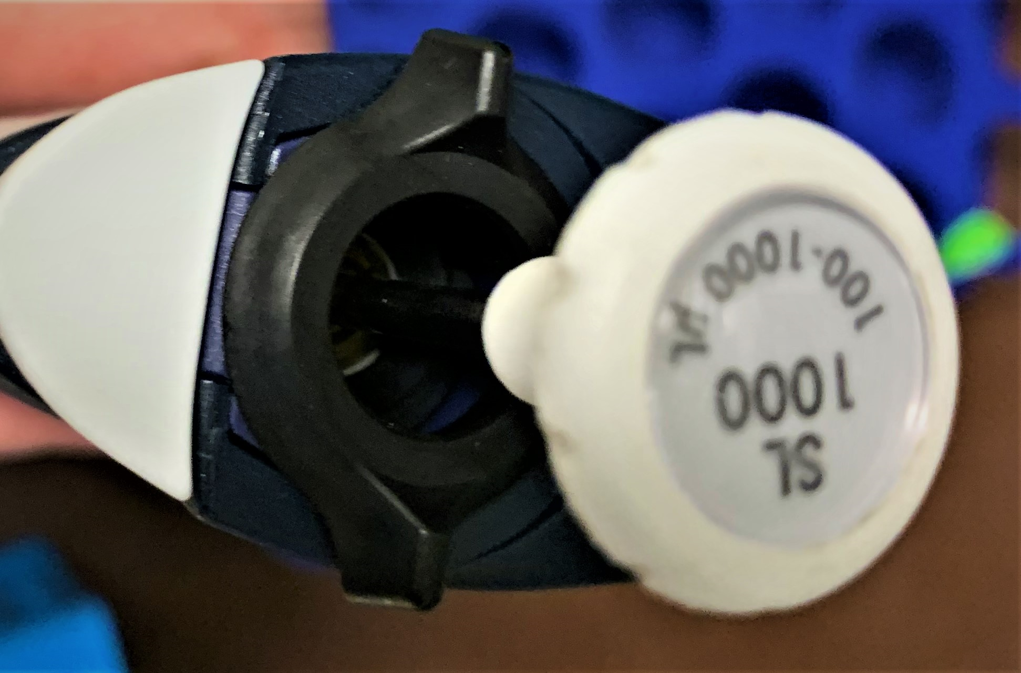
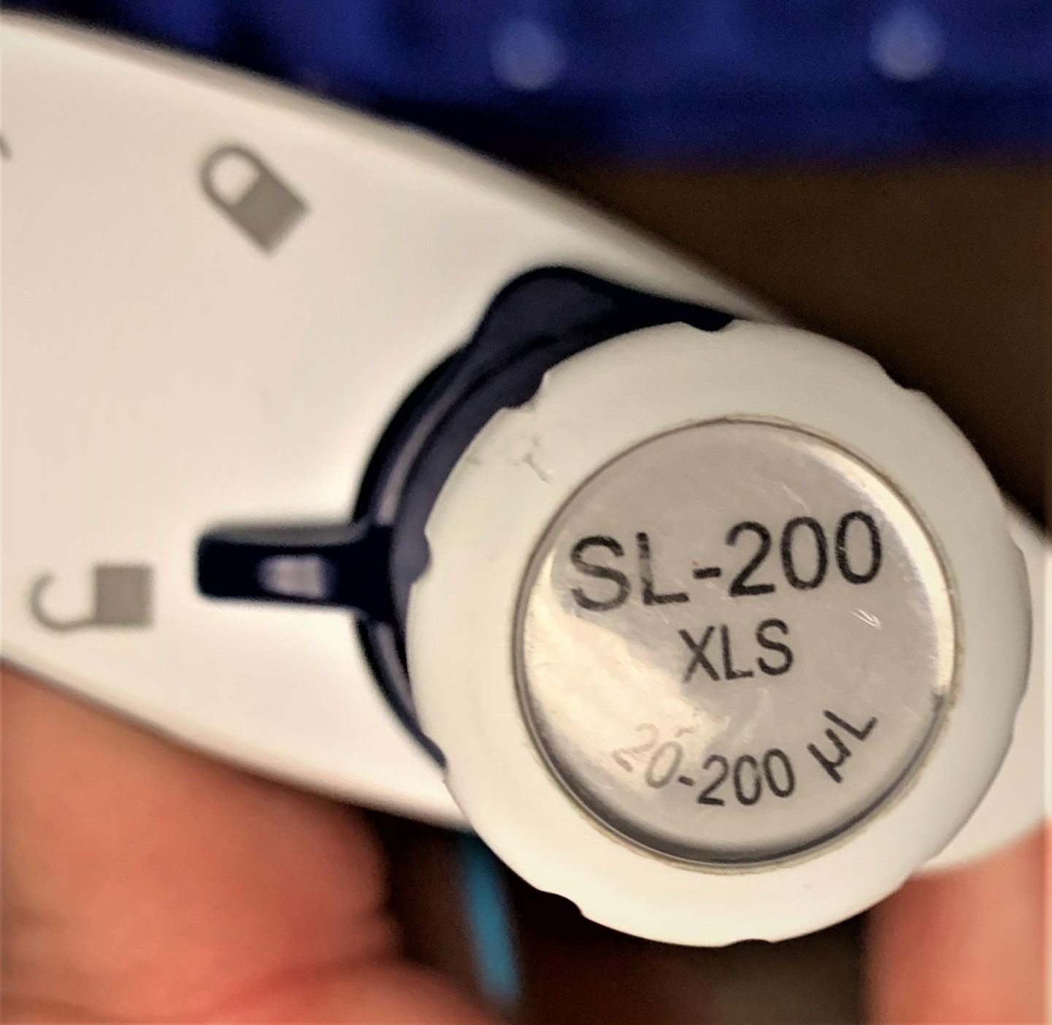
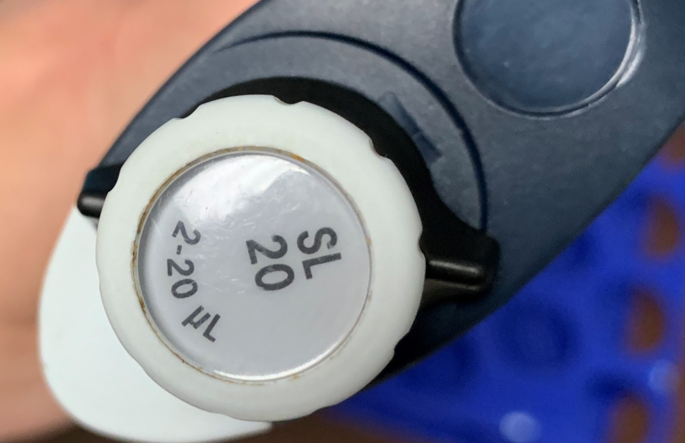
THE DIGITAL MICROPIPETTE
Micropipettes
  Variable small quantities of liquid
  Use with proper tip
    Firm connection!
  Do not lay down or point tip upward with fluid inside
P-20
  Dispense liquid only between 2 and 20 μL
  Too much quantity can contaminate the barrel
Locked
Unlocked

Slide 10


READING A PIPETTE
P-20
P-200
P-1000
Different pipette sizes measure different amounts even though the window on the pipette reads the same (“0-5-0” in this example)
5.0 µL
50 µL
500 µL
Uses the same tips!

Slide 11
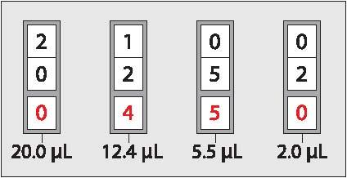
SETTING A PIPETTE
Some volumes on a typical P20. NOTE: Some P20s have four boxes.
Notes:
Some pipettors have more than 3 boxes on their display windows. Be sure to draw your particular style of piper on the board to clarify.

Slide 12
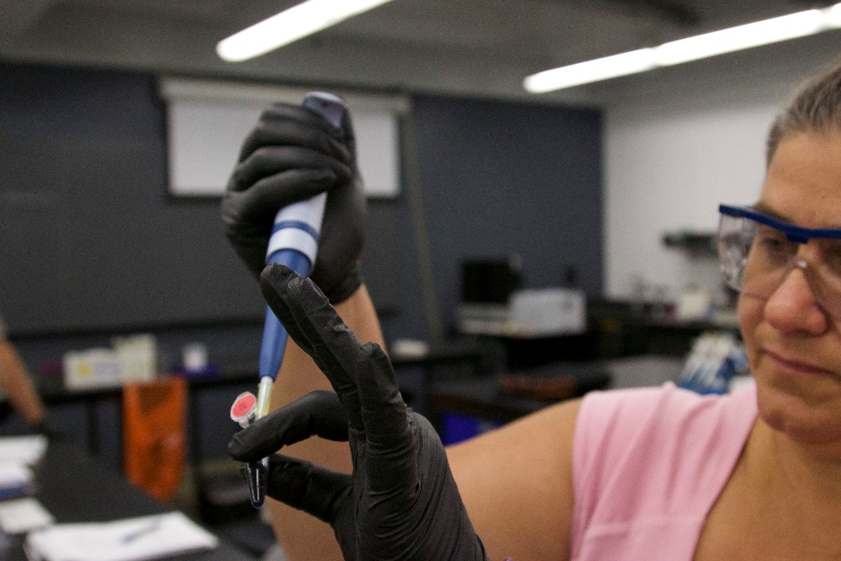
PIPETTING TECHNIQUES
Hold the micropipette and microfuge tubes at eye level when loading or dispensing samples

Slide 13
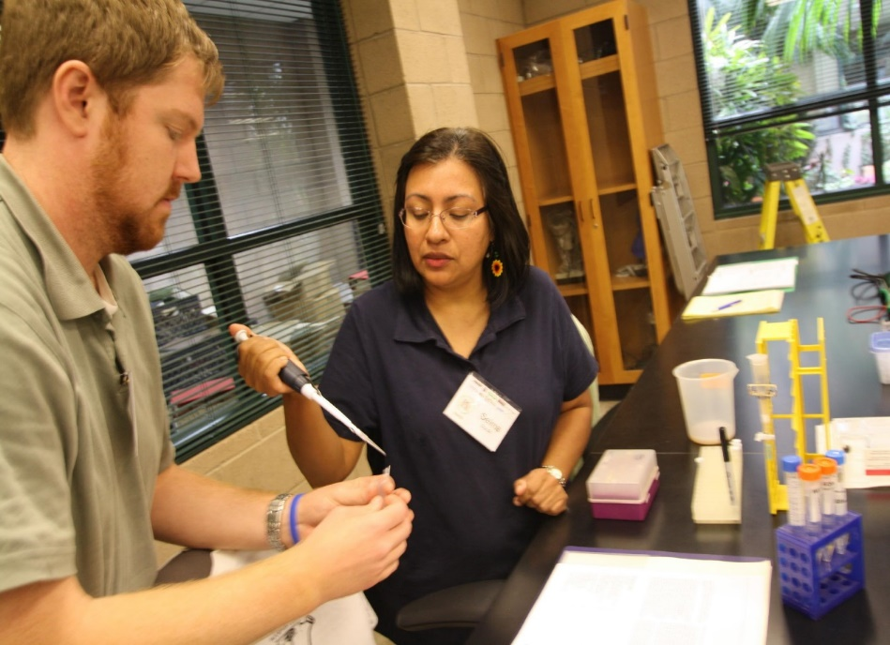
PIPETTING TECHNIQUES CONT.
If you are pipetting, you should be holding the tube.
Common mistake!
Notes:
Be sure that the student or teacher pipetting is holding the tube, not the laboratory partner.

Slide 14
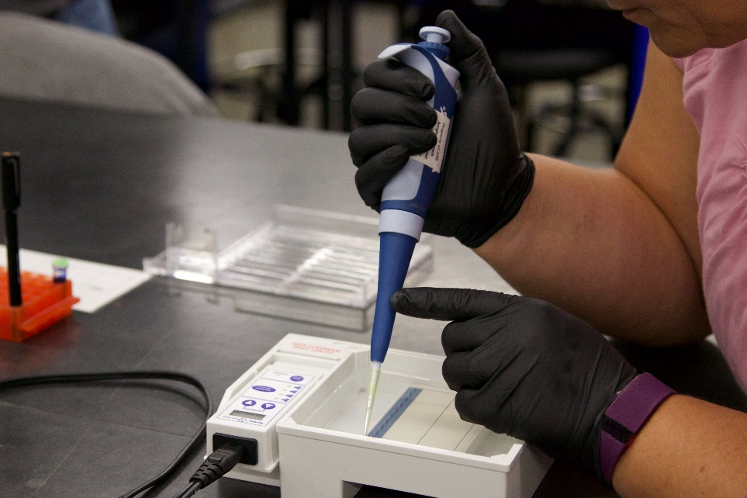
PIPETTING TECHNIQUES CONT.
With both elbows on the table, use your other hand to stabilize the bottom of the pipette above the pipette tip.

Slide 15
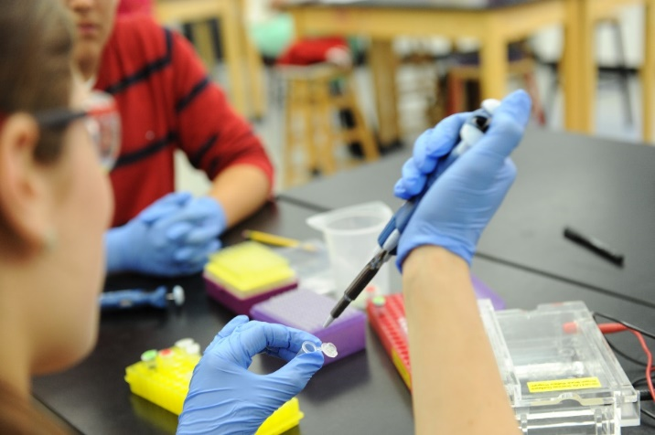
CRITICAL PIPETTING RULES
NEVER…use without a tip in place
NEVER…lay pipette down with sample in the tip
NEVER…let the “plunger” button snap back

Slide 16
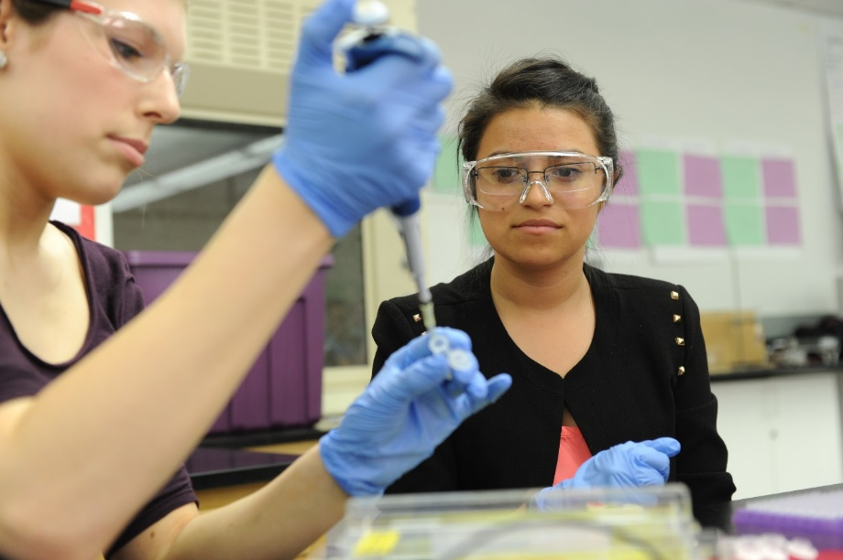
PROCEED TO STUDENT GUIDE ( pg 13 in 2019 guide) AND COMPLETE LAB 1.1
Notes:
Student Guide pg 20 in standard manual
May differ in other versions

Slide 17
PIPETTING – EXERCISE 1
Load 20μL of red dye (RD) and dispense onto paper towel / laminated sheet
15μL of RD
10μL of RD
5μL of RD
2μL of RD

Slide 18
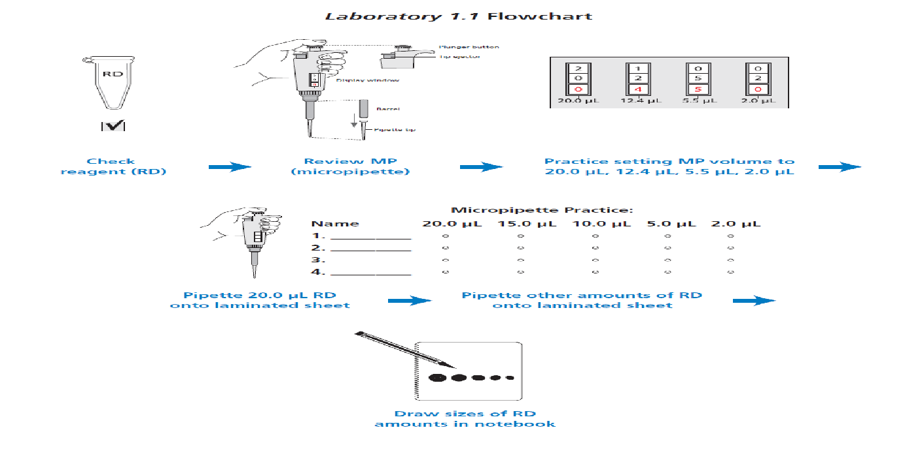
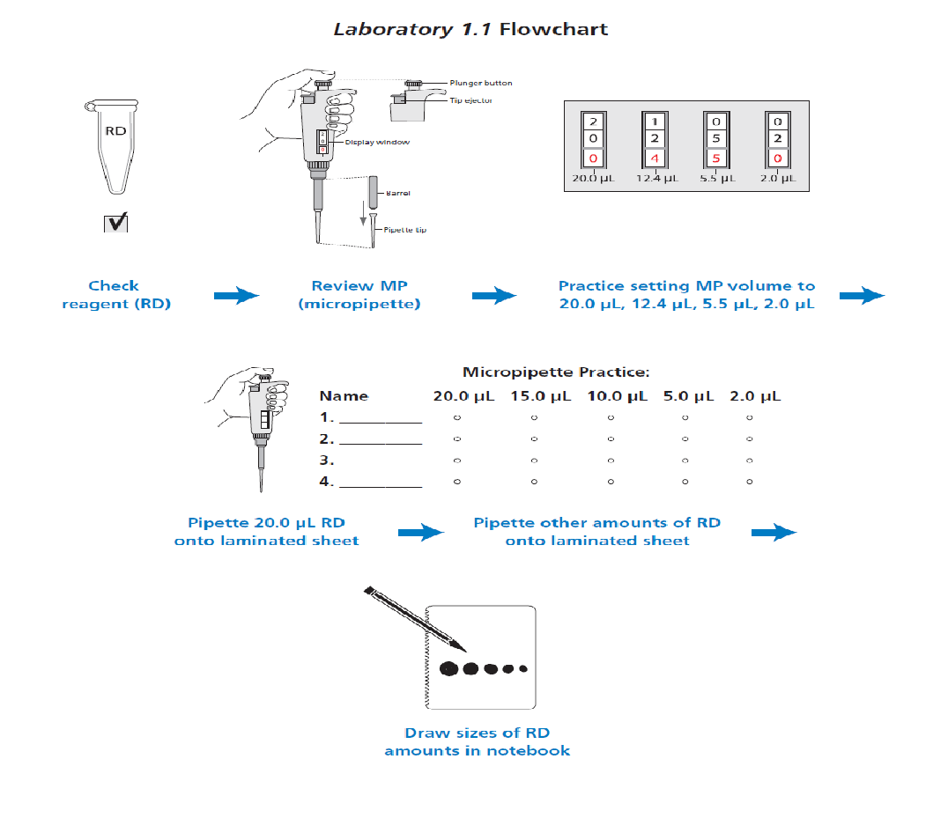

Slide 19
LAB 1.2
Gel Electrophoresis

Slide 20
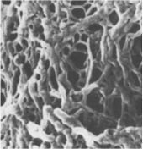
LAB 1.2 – GEL ELECTROPHORESIS
Become familiar with gel electrophoresis
Practice using the micropipette to load wells in practice plates
Practice running an electrophoresis gel using three dyes

Slide 21
WHAT WILL YOU NEED TO DO?
Prepare double-combed 0.8% agarose gel
  Do this several days prior to lab
  Can store in plastic Ziplock bags with buffer
  **Store “wells up” for orientation
Locate dyes
  One rack per group
  Each group given 1 tube of solutions 1, 2 and 3
    (S1, S2, S3)
Get the 20X SB (sodium borate) to 1X SB

Slide 22
SB BUFFER SOLUTION
1X SB buffer used in agarose gel solution
1X SB buffer used in electrophoresis box
Materials include 20x SB buffer solution
Dilute 20x SB buffer solution with dH₂0 to make the 1x SB buffer solution: C₁V₁ = C₂V₂ i.e. 900mL of dH₂0 to 50mL of 20X SB.

Slide 23
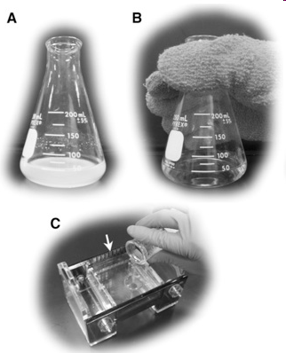
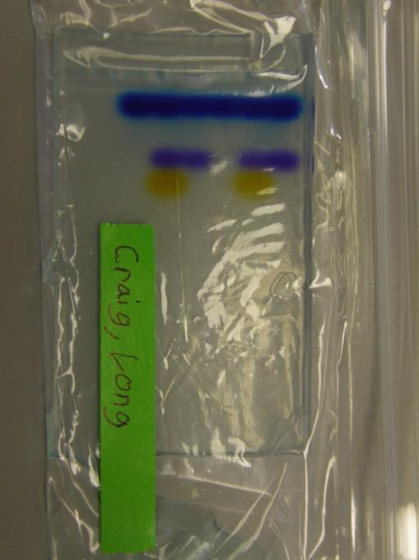
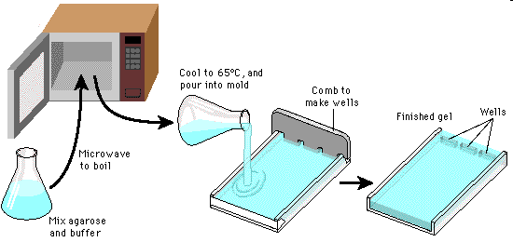
MAKING GELS
Estimate that each gel tray holds 30mL of agarose gel
  6 gels = 180 mL (let's estimate for 6 gels)
  .008 x 150mL = 1.44 grams agarose
  A 0.8% gel for a volume of 180mL is :
1.44 grams of agarose in 180 mL of 1X Buffer.
Alternatively; 1.2 grams of agarose in 150 mL of 1X Buffer = 5 gels ( 5 gels=150mL ); or 1.6 grams of agarose in 200mL of 1X Buffer.
Melt agarose in microwave ( or hot plate) until all “flecks” are dissolved
Let cool until you can “handle” it (~60°C)
Pour gels, let cool, then store in one or more zip lock bags or plastic container
***When returning gel to electrophoresis box, make sure wells are facing up

Slide 24
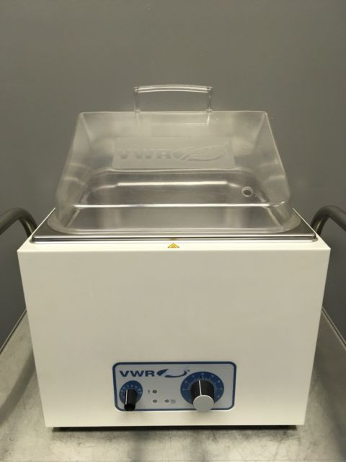
MAKING GELS
Leave in water bath @ 60°C until your students are ready to pour them
  This is after you melt it in an Erlenmeyer flask, in the microwave at a boil
  A hot water bath is not hot enough to dissolve agarose.
Students can gently slide it into ziplock bag for lab the next day.

Slide 25
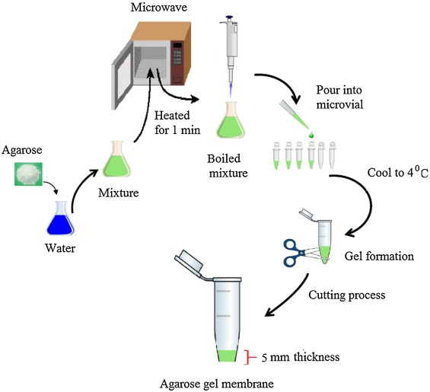
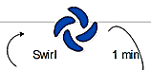
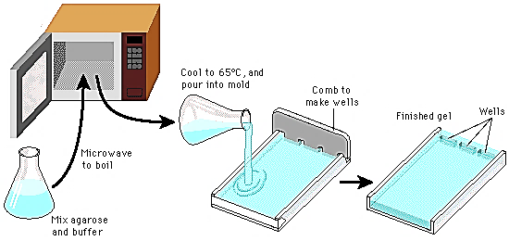

Making Agarose Gels
Lab 1.2: no SyberSafe®
Lab 4A and Colony PCR: add SyberSafe®
Lab 1.2: Step A 0.8% gels
Lab 4A and Colony: Step A 0.8 % gels
Add 18µL SyberSafe® to 180mL of 1X SB or 1µL to 10mL of 1X SB
Gently swirl
Lab 4A, Colony PCR
Step B
1.44g
Back in microwave
Lab 4A/Colony PCR: Step C
180mL
1X Sodium Borate buffer
Lab 1.2:
Step B
Let the solution cool down to about 60 °C at room temperature.
Running Buffer for all labs: 1X Sodium Borate;
ie:10 mL 20X SB to 190 mL dH₂0
(30mLs of agarose per plate; ~ 6 gels per flask for lab 1.2 and 4A and Colony PCR.

Slide 26
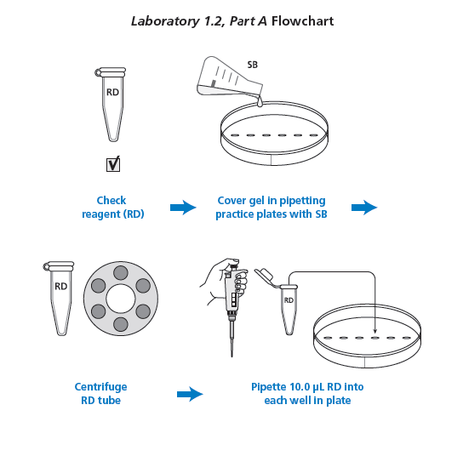
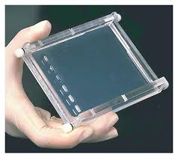
PART A – PIPETTING INTO WELLS
Load RD into pipettes
Dispense into practice gels/plates

Slide 27
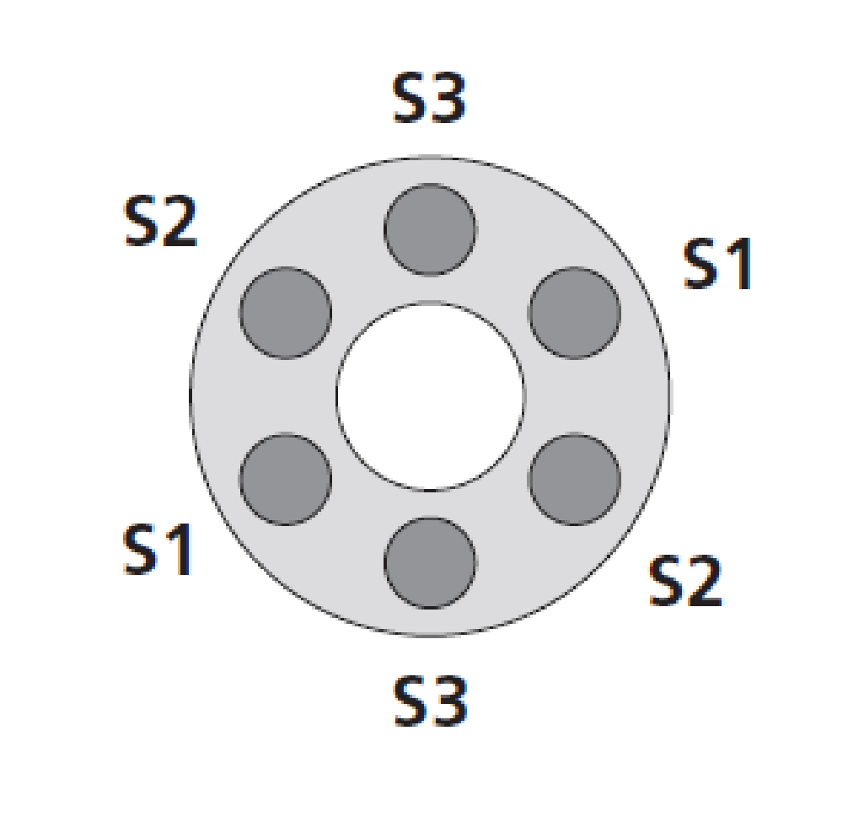
PART B – SEPARATING DYES WITH GEL ELECTROPHORESIS
Centrifuge solutions
Set pipette to 10 μL, fresh tip, and check volume of each tube
  Load into pipette
Dispense into corresponding and labeled well
Run gel electrophoresis

Slide 28
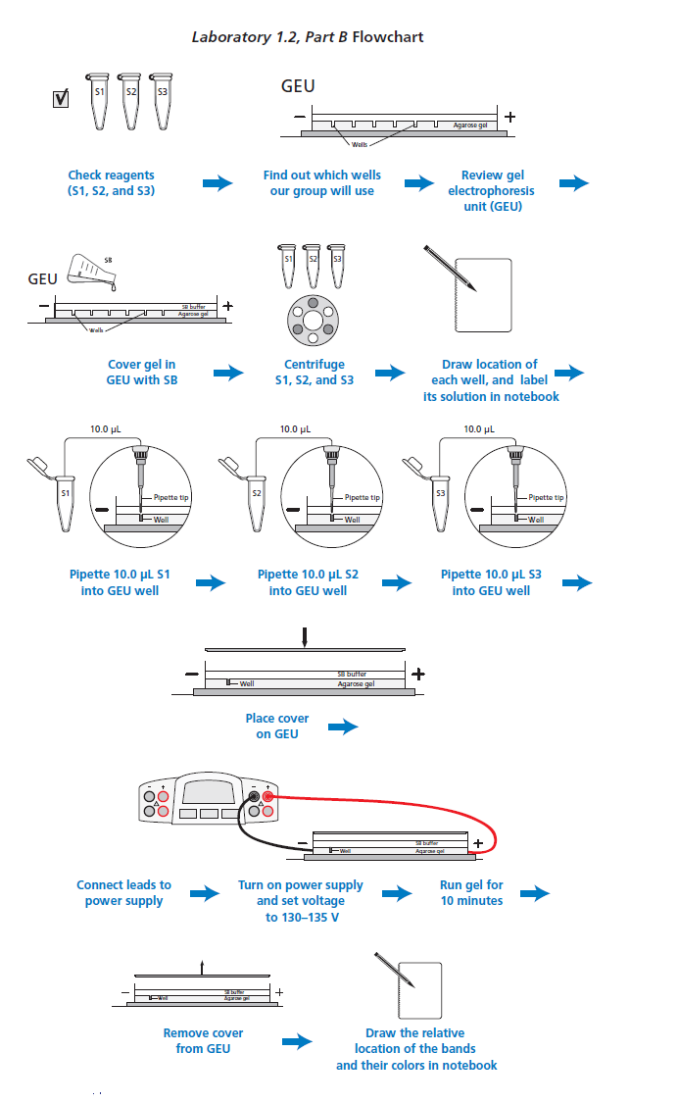

Slide 30
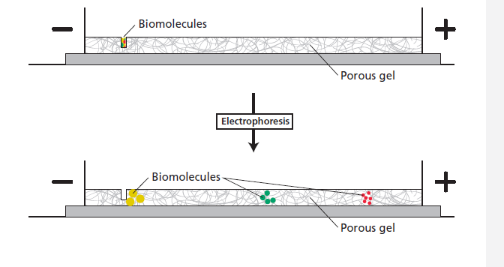
GEL ELECTROPHORESIS
Method uses an electrical current and gel matrix to separate DNA
  Molecules are negatively charged
    Move towards positive (red) electrode
    More negative = move faster
    How does this relate to DNA??
  Sort out according to size
    Shape
    Degree of electro-negativity

Slide 31
SETTING UP THE GEL BOX
Remove tape before placing in the gel box (if needed)
Wells should be at the negative (black) end (run to red)
Buffer should just cover the gel – no dimples
  Cover with 1X SB buffer
    Sodium borate
Put the gel box in position before loading the wells

Slide 32

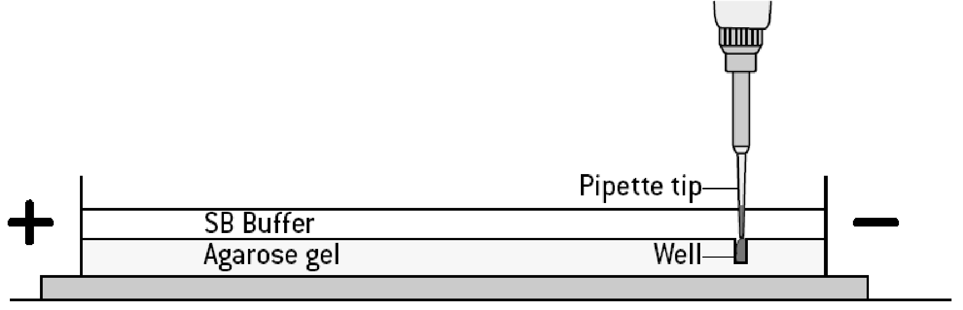
USING GEL ELECTROPHORESIS TO SEPARATE MOLECULES
Set micropipette to 10 μL and load each sample
  Record the wells and what is put into each well:
Loading samples:
  Center pipette
  Depress plunger slowly
  Use two hands!
  Under buffer level, above gel well
May be able to skip lanes

Slide 33
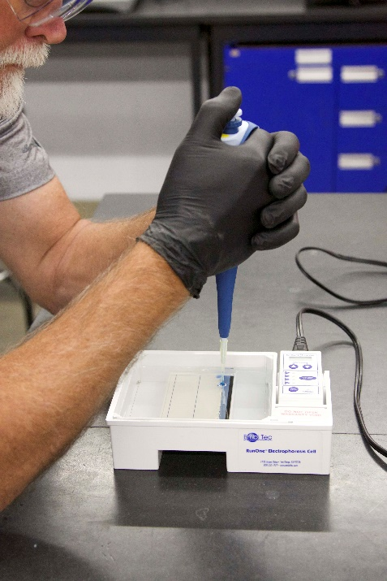
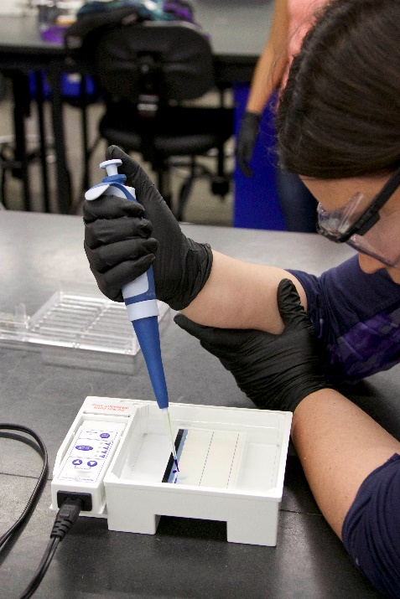
PIPETTING TECHNIQUE
Stability is the key to loading gels:

Slide 34
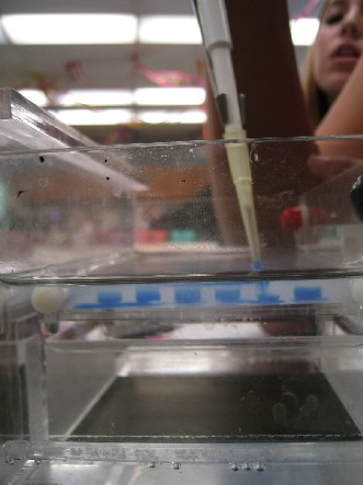
COMMON LOADING ERRORS
Tip should be above, not in well
Do NOT punch the tip through gel
Dye spreading under well = punctured well
Photo Courtesy: K. Schramm

Slide 35
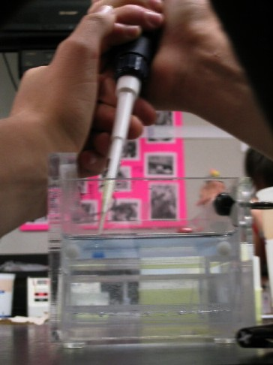
PROPER LOADING OF THE GEL
Tip in buffer, above well
Sample in well
Photo Courtesy: K. Schramm

Slide 36
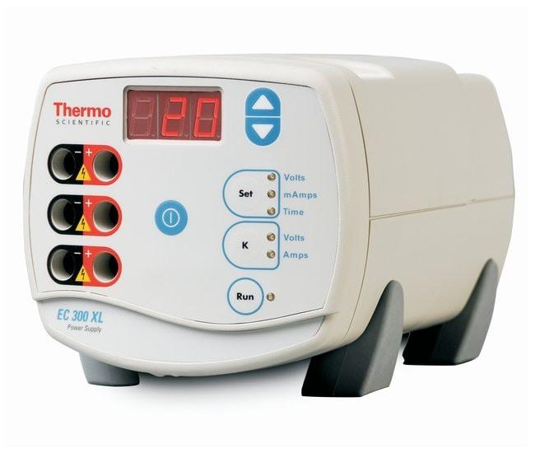
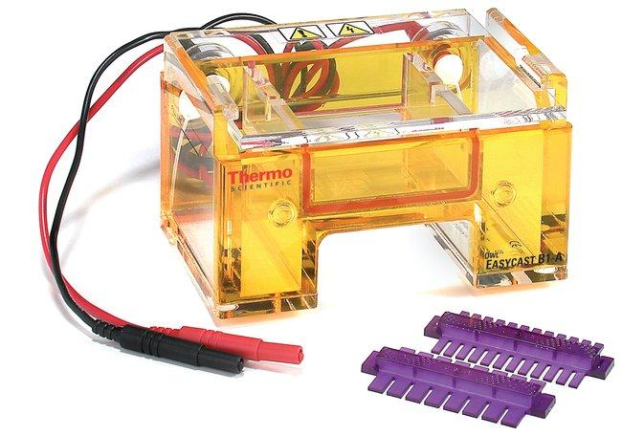
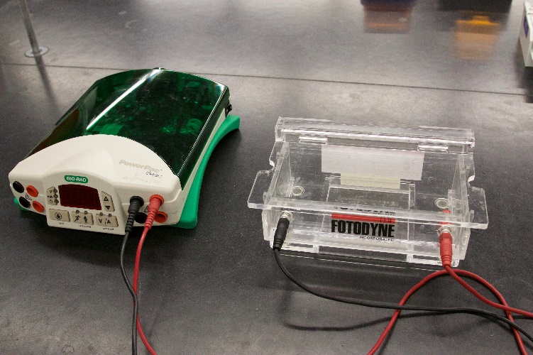
SETTING UP GEL BOX
Different sites may use different gel boxes
Wells should be at the negative (black) end
Buffer should just cover the gel–no dimples.
Put the gel box in position before loading the wells.
Power supplies set to instructions from site
Always turn power supply off before opening gel box

Slide 37
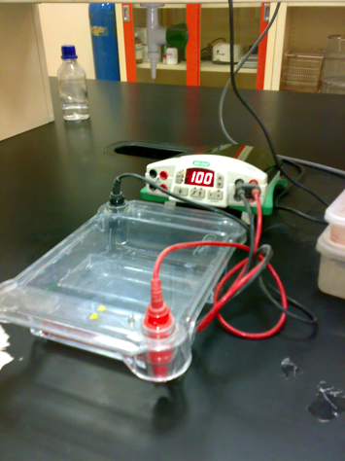
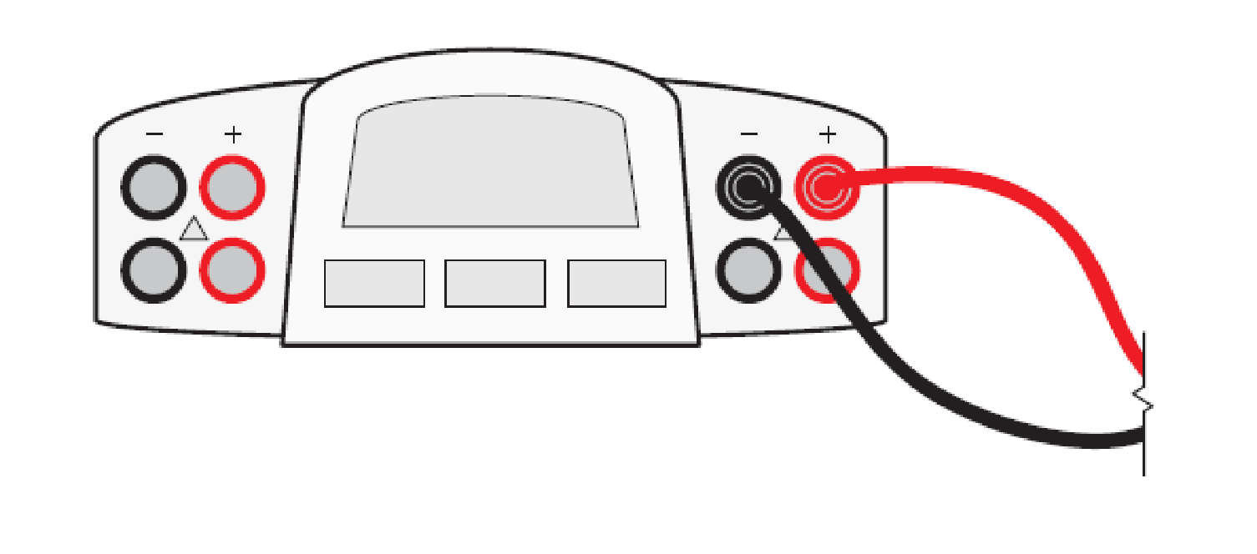
USING GEL ELECTROPHORESIS TO SEPARATE MOLECULES
Close cover
Connect electrical leads
  Negative – black
  Positive - red
Turn on power and set voltage to
130-135v
  Check for bubbles
  After 3 minutes, check that dyes are moving
  Turn off after roughly 10-15 minutes
    Should see all three dyes
Turn off power and record results

Slide 38
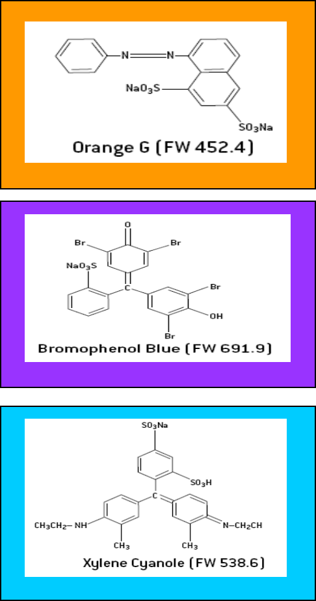
SOLUTIONS
Dyes
  Orange G = 408.40 atomic units (au)
  Bromophenol blue = 669.98 au
  Xylene cyanole = 538.62 au
Heavier molecules move slower
Molecules with more negative electric charge will move faster
Solution 1:
  bromophenol blue, xylene cyanole, glycerin, water
Solution 2:
  bromophenol blue, xylene cyanole, orange G, glycerin, water
Solution 3:
  xylene cyanole, glycerin, water
K. Schramm

Slide 39
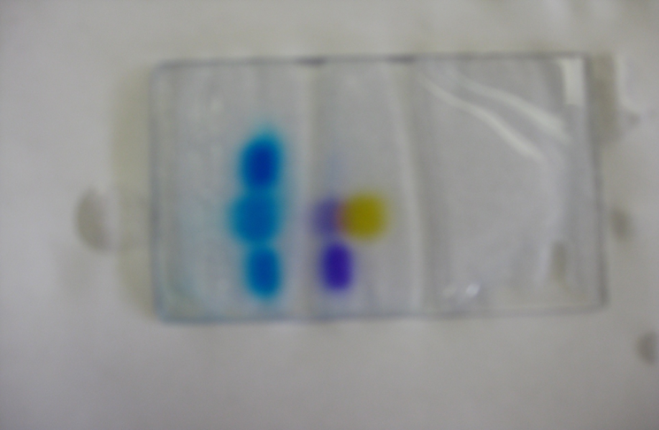
LET’S PLAY
Which dye do you predict has the largest molecular weight?
Orange G
Bromophenol blue
Xylene cyanole
A
3
2
1
Notes:
Things separate by size AND by charge (size is the biggest factor).

Slide 40
SOLUTIONS
Dyes
  Orange G = 408.40 atomic units (au)
  Bromophenol blue = 669.98 au
  Xylene cyanole = 538.62 au
Heavier molecules move slower
Molecules with more negative electric charge will move faster
Solution 1:
  bromophenol blue, xylene cyanole, glycerin, water
Solution 2:
  bromophenol blue, xylene cyanole, orange G, glycerin, water
Solution 3:
  xylene cyanole, glycerin, water
K. Schramm

Slide 41
SOLUTION
  Bromophenol blue (purple) is more negatively charged than xylene cyanole (blue) due to negatively charged bromine ions. Therefore, it travels farther than the smaller xylene cyanole.
A
3
2
1
Notes:
Solution Tube 1 = blue + purple
SolutionTube 2 = blue + purple + yellow
SolutionTube 3 = blue

Slide 42
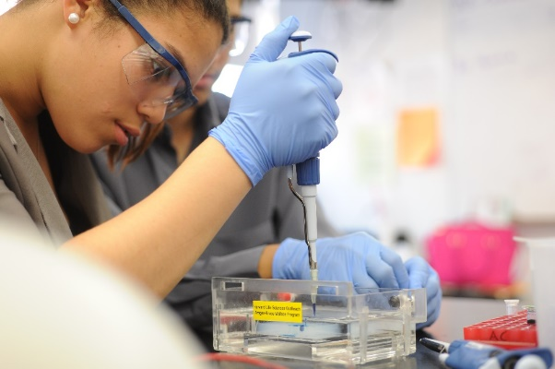
VIDEO RESOURCES
A variety of video resources are available to help explain the finer points of the techniques used by both teachers and students during this laboratory.
Pouring a Gel
Using an Electrophoresis Box
Loading a Gel

