Slide 1
LAB 6
GETTING WHAT WE NEED

Slide 2
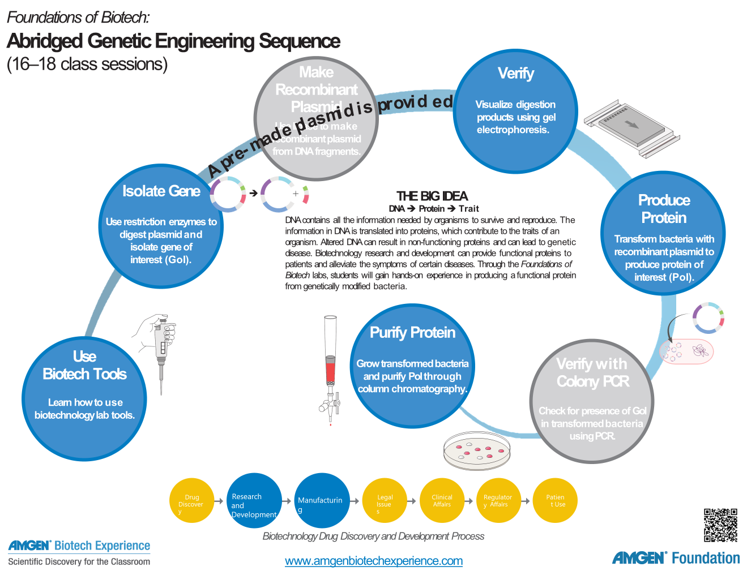
We are here

Slide 3
LAB SEQUENCES
Sequence | Complete Genetic Engineering | Abridged Genetic Engineering | Focus on Bacteria | Intro to Biotech
1. Practice Pipetting and Gel Electrophoresis | X | X | X | X
2. Restriction Digest | X | X
3. Ligation | X
4. Confirmation | X | X
5. Transformation (with or w/o colony PCR) | X | X | X
6. Culture of E. coli / Purification | X | * | *
X = included; * = optional
Notes:
Change this slide to match your PDI offering

Slide 4
TEACHER GUIDES
2019: Page 123
2015 : Tab E
  Starts on page E-1
  Both Guides:
    Assumptions of prior knowledge
    Goals and outcomes
    Suggested sequence
    Preparation
    Flowcharts

Slide 5
STUDENT GUIDES
2019 Guide: page 85
2015 Guide
  Tab E: Start E1
Both guides
  Introduction
  Goals
  What do you already know?
  Bacterial multiplication and protein purification
  Laboratory 6: purifying the fluorescent protein
    Part A – lyse cells
    Part B – column chromatography
  Questions
  Glossary

Slide 6

CHAPTER 6: OVERVIEW
Three-dimensional Shape of RFP
During laboratory 6 students isolate the desired red fluorescent protein from the transformed cells.
Using column chromatography, they purify the protein of interest, mimicking the last step in the production of therapeutic proteins
Notes:
The fluorescent proteins assume similar 3D shape. The protein is in the shape of a cylinder, comprising 11 strands of beta-sheet with an alpha-helix inside and short helical segments on the ends of the cylinder.
The chain forms a cylindrical can, with one portion of the strand threading straight through the middle. The specific part responsible for fluorescence, called the chromophore, is shielded in the middle of the can. Jostling water molecules would normally rob the chromophore of its energy once it absorbs a photon. But it is protected inside the protein, releasing the energy instead as a slightly less energetic photon of light. The chromophore forms spontaneously from three amino acids in the protein chain: a glycine, a tyrosine and a threonine (or serine).

Slide 7
CHAPTER 6: LEARNING GOALS
  Describe the conditions that are favorable to bacterial growth
  Explain how a protein’s conformation (3D shape) relates to its function
  Explain how protein folding occurs
  Explain how column chromatography separates proteins

Slide 8
CHAPTER 6: KEY IDEAS
  Employ a reagent called lysis buffer to “lyse” or break open transformed cells, releasing the red fluorescent protein
  Employ the technique of column chromatography to purify the protein of interest from the multitude of other proteins within the bacteria
  Capitalize on the hydrophobic nature of red fluorescent protein to separate it from other proteins and purify it.

Slide 9
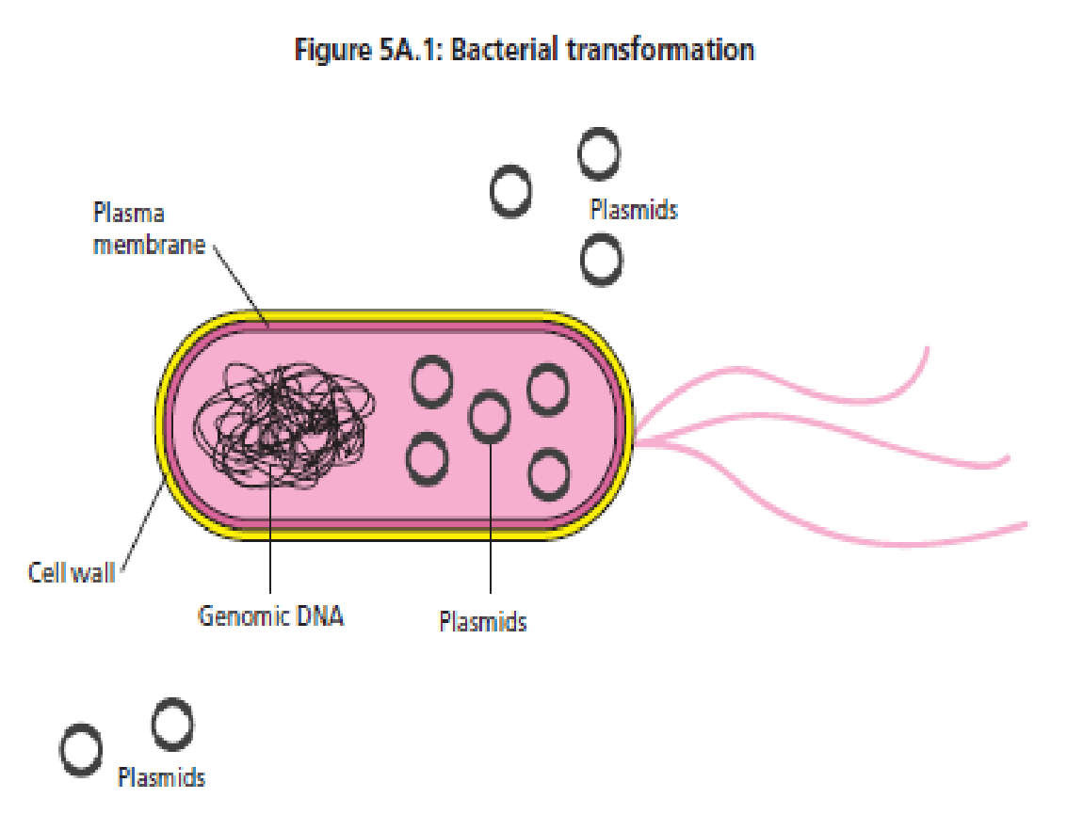
WHY LYSE?
Remember the inclusion bodies?!
Soluble proteins made by cell, including red fluorescent protein, are dissolved in cell cytoplasm
Only way to access soluble proteins is to lyse (break open) cell
After lysis, soluble proteins can be easily separated from insoluble structural proteins
Bacteria

Slide 10
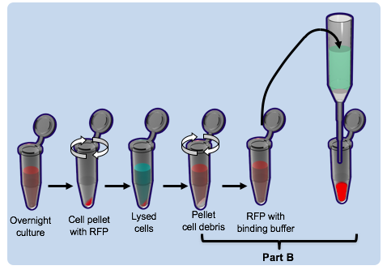
PURIFICATION OF RFP FROM OVERNIGHT CULTURE

Slide 11
BACKGROUND INFO

Slide 12
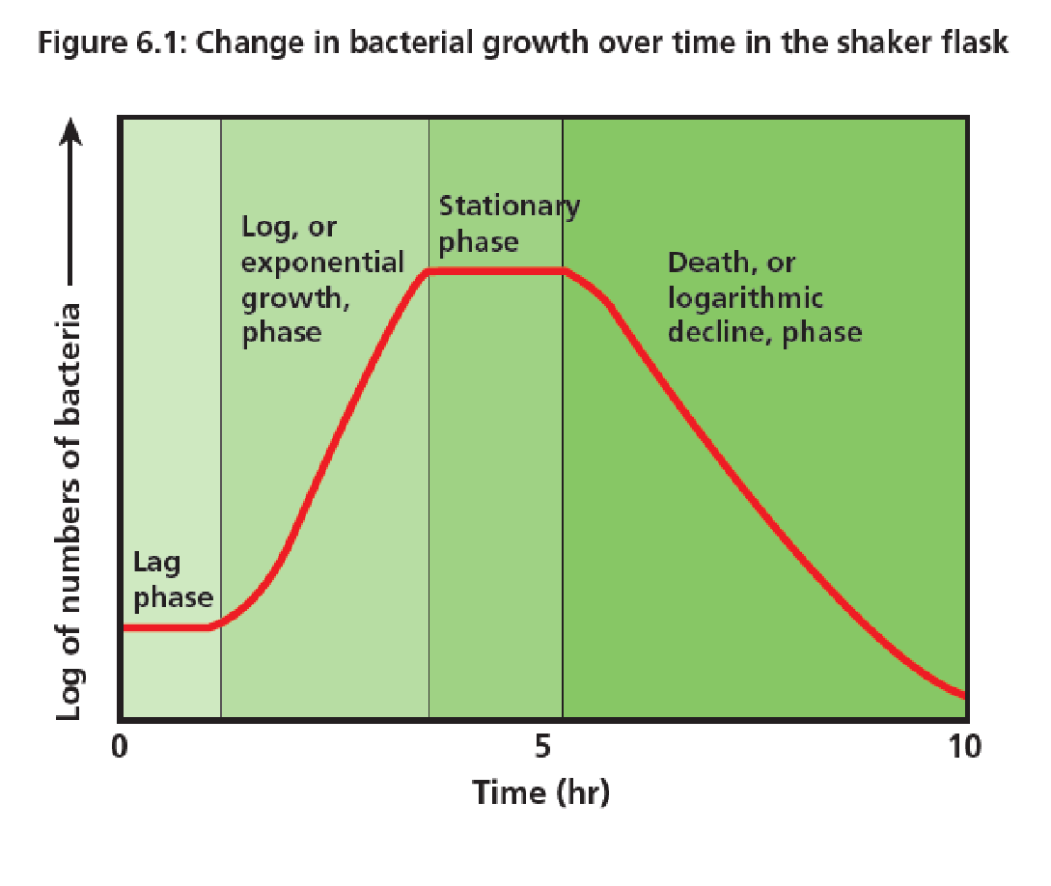
BACTERIAL GROWTH
Lag phase
  Zero growth
  Cells adjust and prepare for division
Log phase
  News cells outnumber cells dying
  Doubling time occurs
Stationary phase
  Zero growth rate
  New cells = dying cells
Death phase
  Negative growth rate
  New cells less than cells dying
When would you expect to see the most protein production?

Slide 13
WHY LYSE?
Remember the inclusion bodies?!
Soluble proteins made by cell, including red fluorescent protein, are dissolved in cell cytoplasm
Only way to access soluble proteins is to lyse (break open) cell
After lysis, soluble proteins can be easily separated from insoluble structural proteins
Bacteria

Slide 14

PROTEINS
Made from amino acids
  20 various kinds
Amino acids linked to one another by peptide bonds
  Two amino acids bound by a peptide bond is a dipeptide
  Three or more is a polypeptide chain
Amino Acid

Slide 15
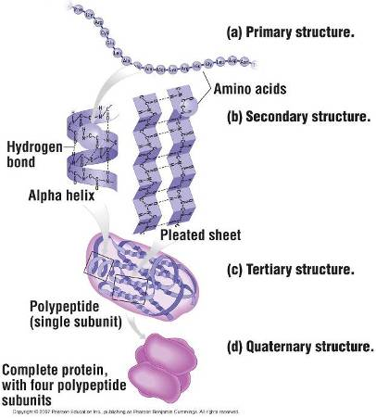
SHAPE OF A PROTEIN IS NECESSARY TO ITS FUNCTION
Levels of Organization
  Primary – sequence of amino acids
  Secondary – takes on orientation in space
  Tertiary – final 3D shape for a single polypeptide
  Quaternary – arrangement of two or more polypeptides in a protein

Slide 16
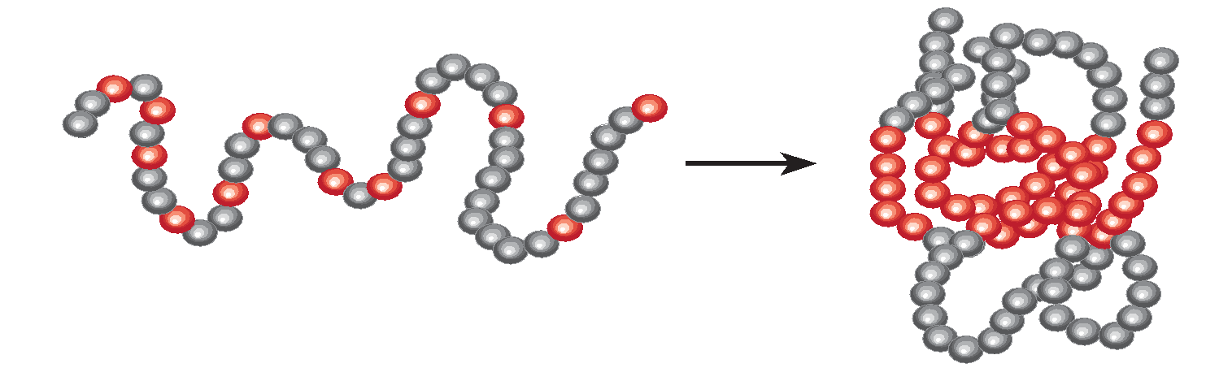
PROTEIN FOLDING
Dependent on properties of amino acids
  Formation of weak bonds between + and – charges side chains of amino acids
  Tendency of hydrophobic amino acids to be buried inside protein
  Tendency of hydrophilic amino acids to be on outside exposed surface
  Formation of covalent bonds (disulfide bridges) that occur between amino acids
Protein folds

Slide 17
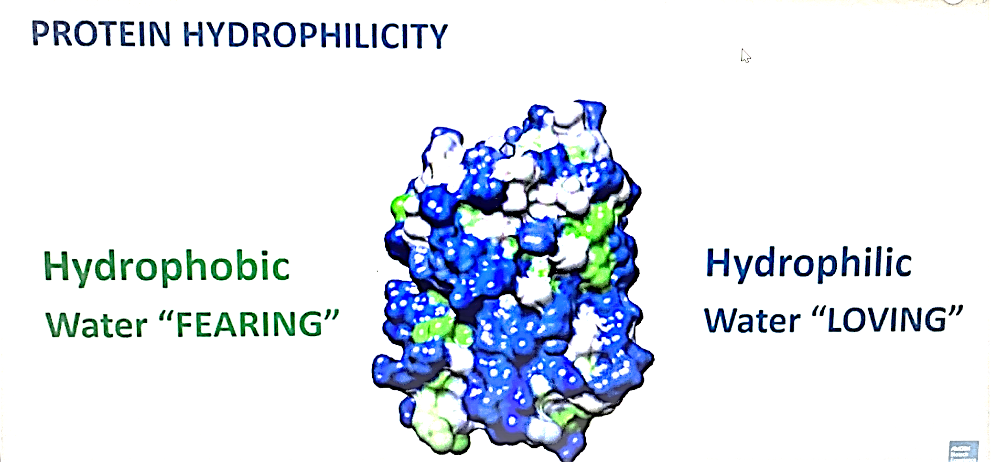
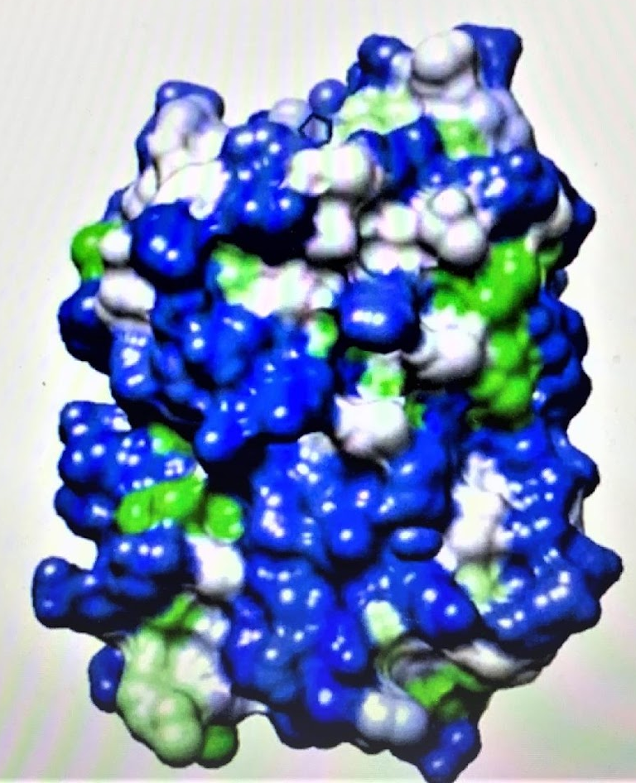
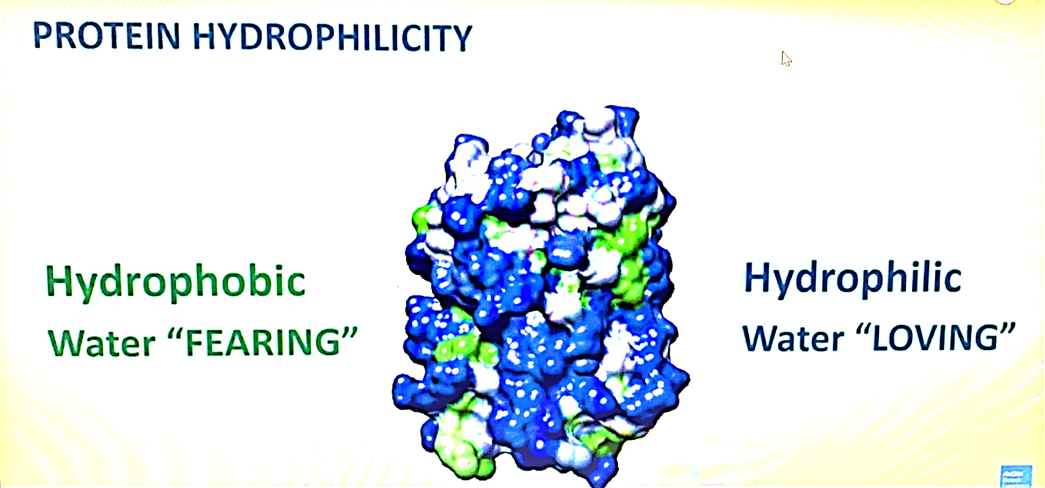
PROTEIN PURIFICATION
Transformed bacteria make protein… is it ready for immediate use?
Purification
  Requires separating it from other cellular elements
  Done via column chromatography
  Look for differences in hydrophobicity
    Hydrophobic versus hydrophilic
    Some have regions that are both (amphipathic)
  How to isolate a single protein?
    E. coli we are using produces HIGH concentrations of rfp

Slide 18
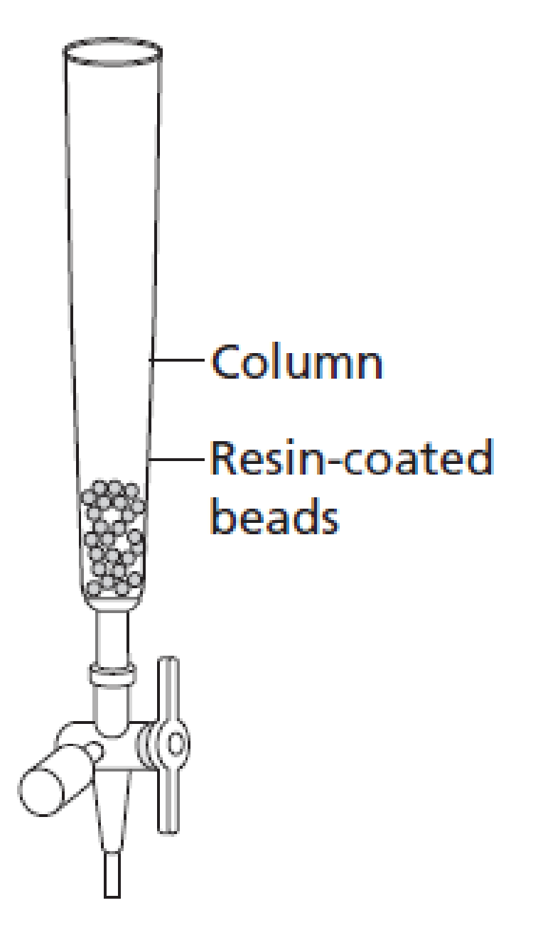
COLUMN CHROMATOGRAPHY
Plastic cylinder with resin
  Separating medium
  Attracts hydrophobic amino acids
    Must unfold proteins first to expose amino acids
  Proteins passed over the beads
Buffers
  Salt solution
  Will unfold proteins to varying degrees
  Unfolded hydrophobic proteins adhere to the hydrophobic column resin
  Folded hydrophilic proteins never adhere to the column

Slide 19
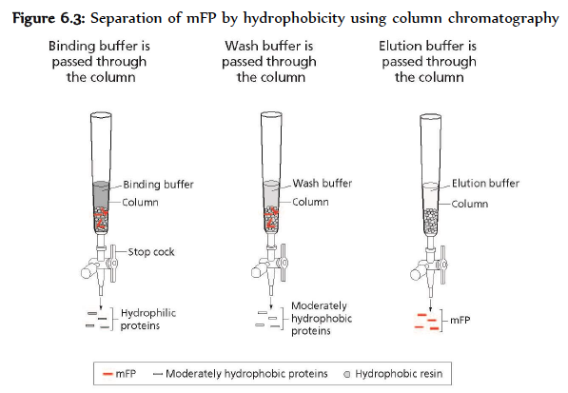
BUFFERS FOR SEPARATION
Binding buffer (4M salt solution)
  hydrophobic proteins unfold
  Unfolded hydrophobic proteins adhere to the hydrophobic column resin
  Folded hydrophilic proteins never adhere to the column
Wash buffer (1.3M)
  moderately hydrophobic proteins fold
  Highly hydrophobic proteins, including RFP, stay unfolded
  Folded moderately hydrophobic proteins are released from the column
Elution buffer (10mM)
  highly hydrophobic proteins, including RFP, fold
  Folded highly hydrophobic proteins, including RFP, are released from the column
  RFP can be collected
Equilibration buffer (2 M)
  Column is stored in Equilibration buffer to keep the resin at the correct molarity for use.
  After draining this, column is ready for use

Slide 20
ABBREVIATION TABLE
Abbreviation: | Definition:
EC | Transformed E. coli
CEB | Column Equilibration Buffer
LyB | Lysozyme
EB | Elute buffer
WB | Wash buffer
BB | Binding Buffer
WARNING!
LOTS of teacher preparation needed!!!

Slide 21
TEACHER PREPARATION
Chromatography columns
  Placed upright (check 2 days prior)
  Stopcock in correct position
  If resin on sides
    Add CEB to column
    Let drain until a 2mm layer above resin bed
  **After lab CEB ( Column Equilibration Buffer) to resin with stopcock closed

Slide 22
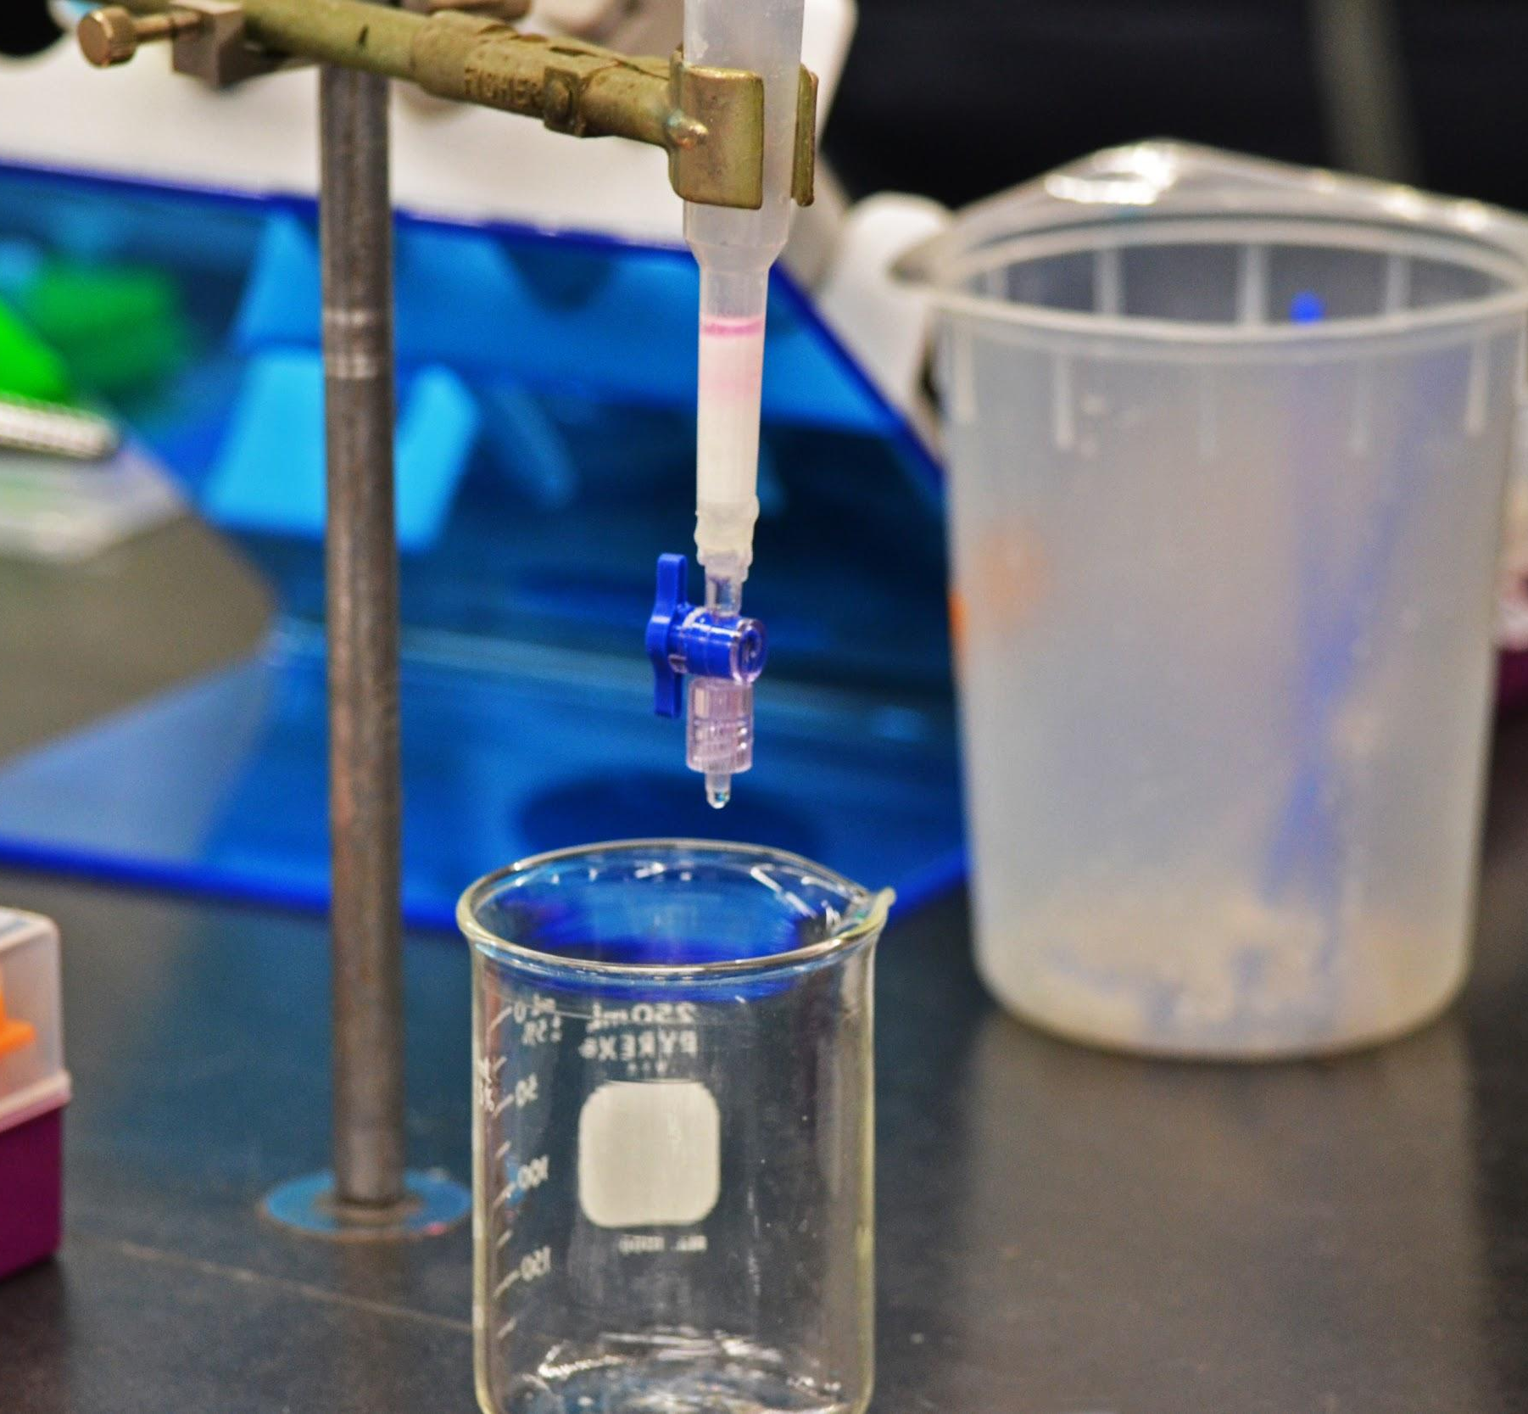
INSTRUCTIONS
Wash the column by adding 1–2 mLs of equilibrium buffer (CEB) and letting it run through.
Fill column with 1–2 mLs CEB for storage. Attach tip and end caps and store securely in an upright position. Placing all of the completed columns into a plastic beaker so that they cannot fall over is one way to ensure they will be ready for distribution.
Resin

Slide 23
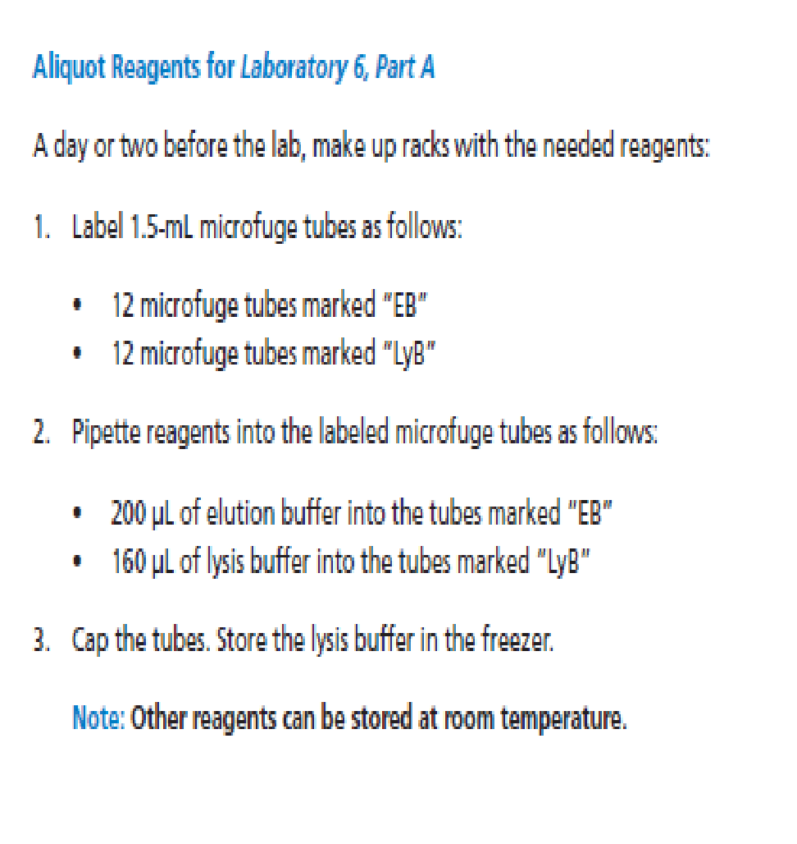
TEACHER PREPARATION PART A
Session/ Laboratory | Preparation Step | Action | Material | Amount Needed per Group
Chapter 6, Session 2, Laboratory 6, Part A | Aliquot reagents for Laboratory 6, Part A (can be done a day or two before the lab) | Label three 1.5- mL microfuge tubes as follows: | a. Microfuge tube marked “EB” | 1
 |  |  | b. Microfuge tubes marked “LyB” | 1
 |  |  | c. Microfuge tube marked “EC” | 1
 |  | Pipette reagents into the microfuge tubes as follows: | a. Elution buffer into tube marked “EB” | 200 µL
 |  |  | b. Lysis buffer into each tube marked “LyB” | 160 µL
 |  | Pipette LB/amp/ ara suspension culture of E. coli into microfuge tube as follows: | LB/amp/ara suspension culture of E. coli | 1,000 µL (1 mL)
 | Gather materials for Laboratory 6, Part A | Prepare sets of materials that each include the following: | Plastic microfuge tube rack with: Microfuge tube of E. coli (EC) Microfuge tube of EB Microfuge tube of LyB | 1
 |  |  | b. Liquid waste collection container, such as a small beaker | 1
 |  |  | c. P-200 micropipette | 1
 |  |  | d. Tip box of disposable pipette tips | 1
 |  |  | e. Permanent marker | 1
 |  |  | f. Biohazard bag (for materials that come into contact with E. coli cells) | 1 for every two groups
Note : pg 128;manual States each group will bring you the EC tube so you can additional solution. My want 2 @ 1mL aliquots for each group

Slide 24
OPTIONAL TEACHER PREPARATION: Grow bacteria for protein purification
4-5 days prior to Laboratory 6 prepare suspension culture:
    Use transformed cells given in the kit
  Secure cap( slightly loosen), shake and incubate (37ºC) for 2-3 hours or until cloudy
  Add sterile arabinose (entire vial) (~5mL)
  Shake overnight. We have enclosed an additional tube of Arabinose; you can add before you go home for the night.
  If your culture is not bright pink the next morning, add the other tube of arabinose and let it continue to shake through the next day. pare the suspension culture:
  Add another vial of arabinose (~5mL) early in the morning.
  Culture should be bright red !

Slide 25
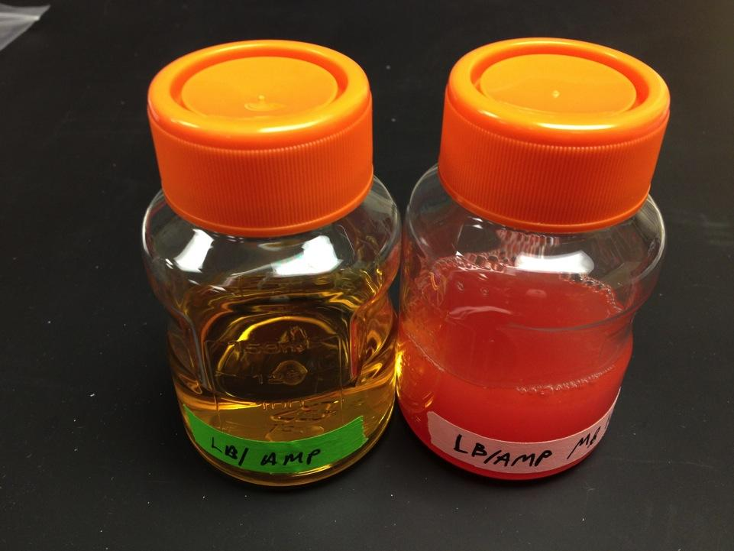
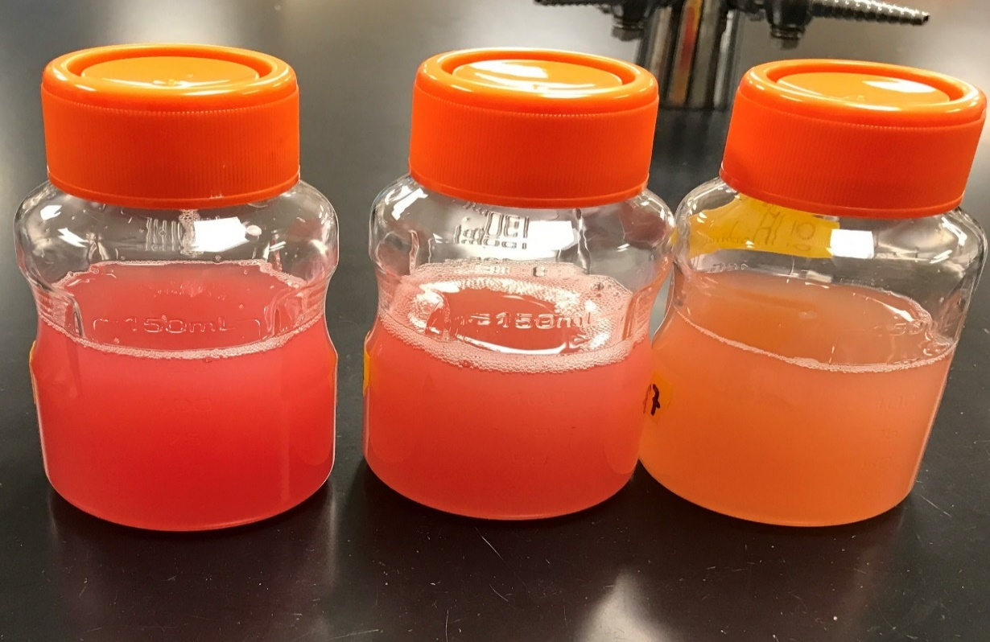

Optimal
Ok to use
Not optimal

Slide 26


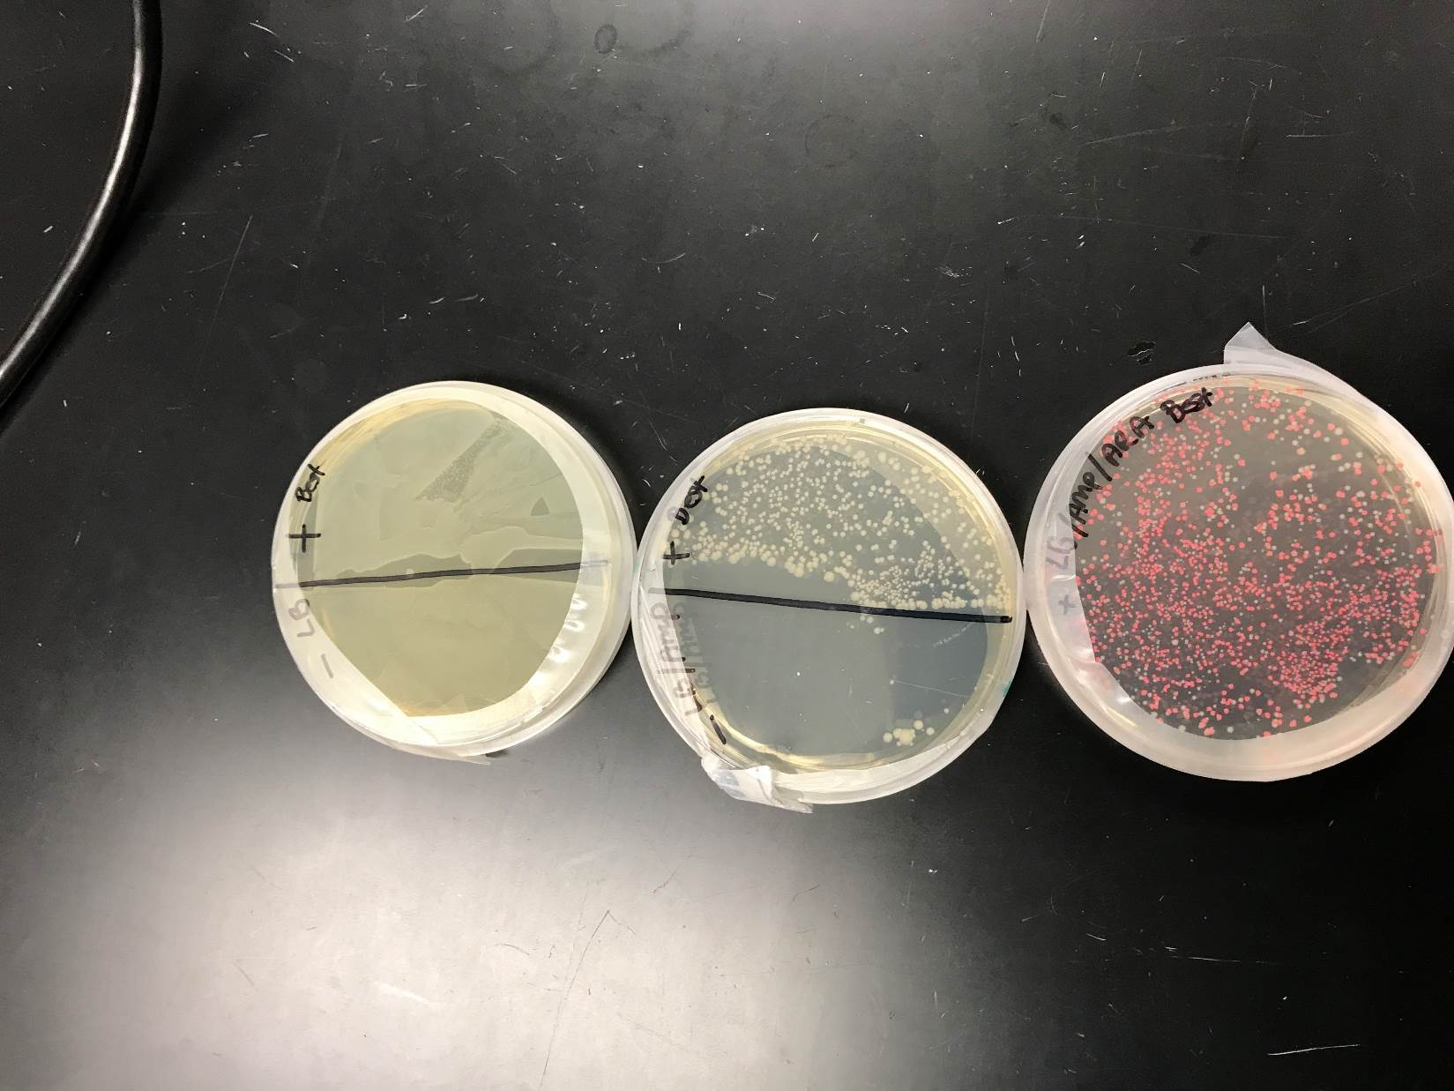
RESULTS
preparing an overnight culture of E. Coli for RFP expression
Colony isolation and culture

Slide 27
TEACHER PREPARATION
Incubate cells with lysis buffer overnight
  At end of Part A
  Have groups give you their labeled EC tubes
  Freeze overnight.
  At least two Freeze / thaw cycles facilitate lysing of the cells.

Slide 28
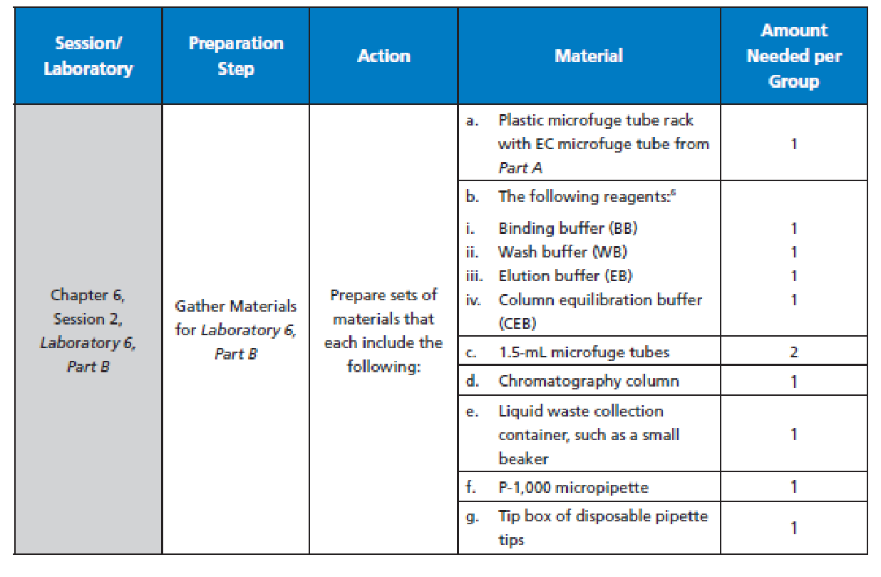
TEACHER PREPARATION PART B
Pg27: Manual Staes add 20% ethanol to resin after lab. Just use CEB buffer
Pg 129: Note: We provide 6 @ 12mL of each buffer.

Slide 29
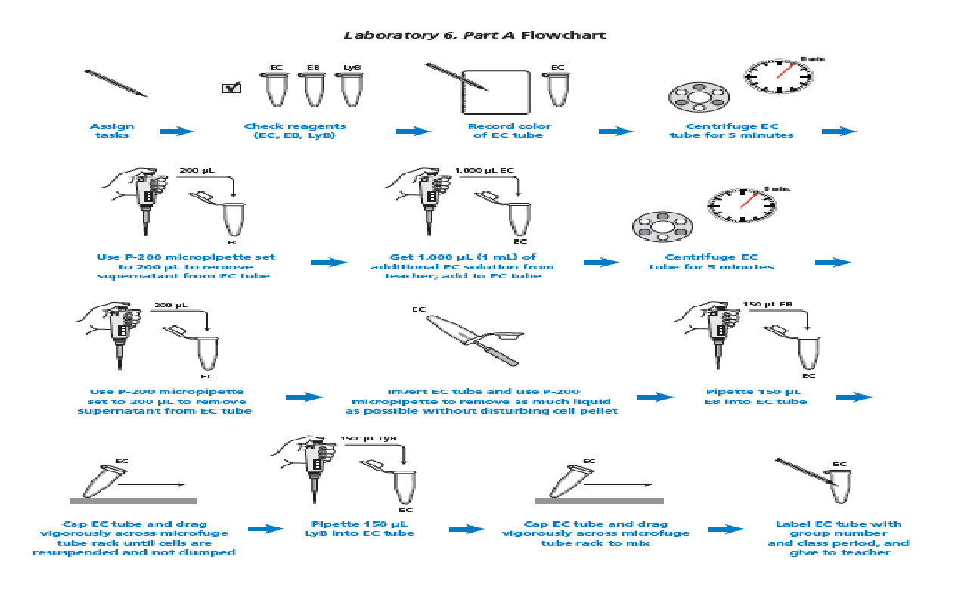

LABORATORY 6A FLOWCHART

Slide 30
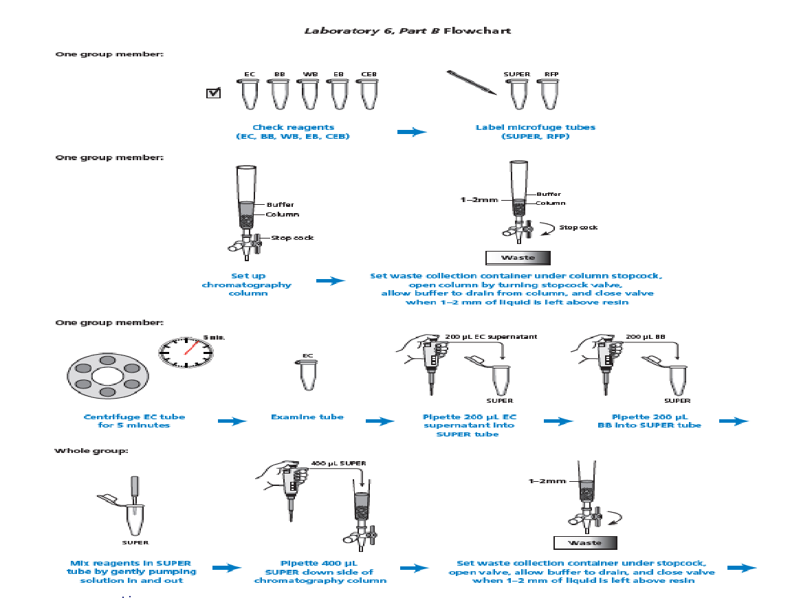

LABORATORY 6B FLOWCHART

Slide 31
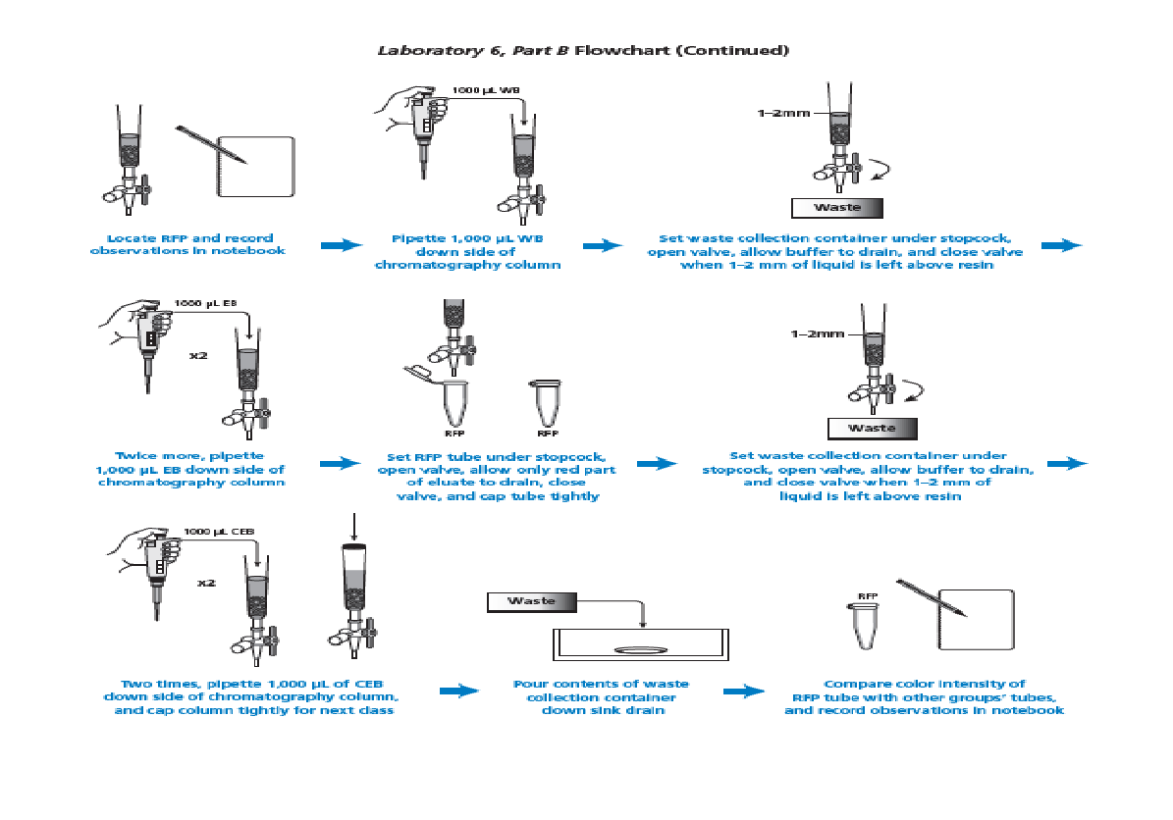

LABORATORY 6B FLOWCHART

Slide 32
CHAPTER 6: TIPS
Columns drip SLOWLY, can’t force it (pay attention to time)
Make sure the lid is off the top of the column
Do not pipette directly into resin: run buffer down side of the column
Do not let air touch resin: liquid meniscus above resin should be about 2mm
    Wait until each solution has drained to this point before adding another solution
As soon as the red hits the first level of the chromatography column tip, get the 1.5 mL tube ready…collect when the red drips!!

Slide 33
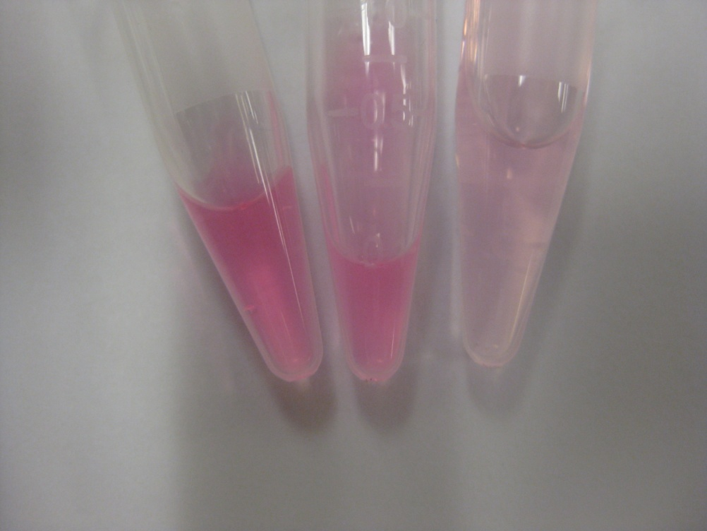
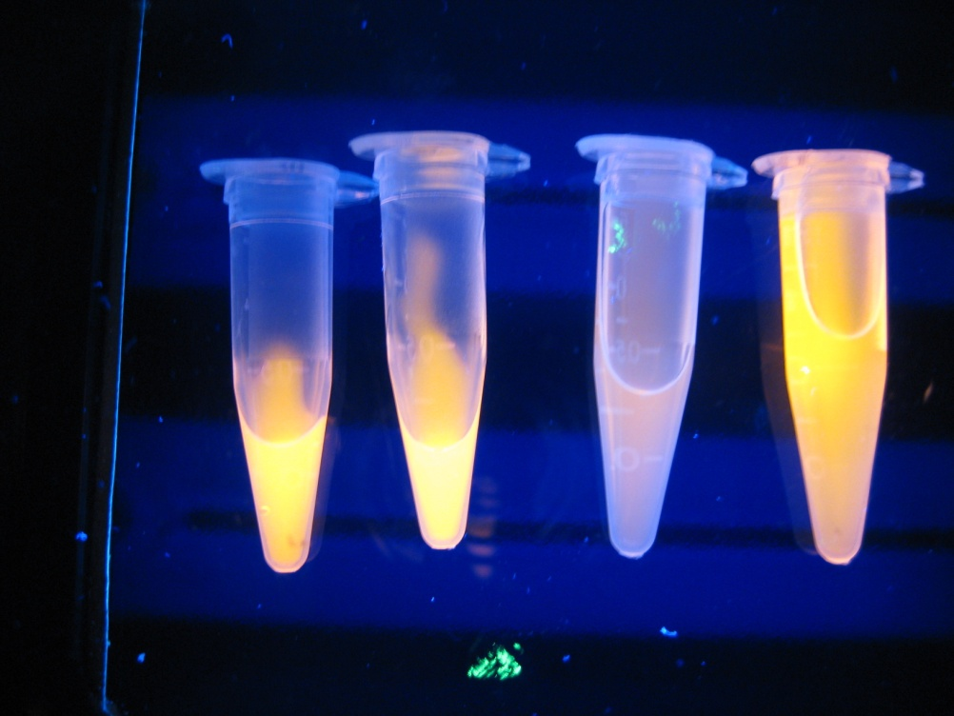
RESULTS

Slide 34
CHAPTER 6: CONNECTIONS TO INDUSTRY
Laboratory 6 represents the final steps in the overall process of genetic engineering that would result in producing large quantities of the therapeutic protein of interest, isolated from the other components of the bacterial cell.
Although students carry out this process on a small scale, it is important to help them understand that industry would use large bioreactors to produce amounts sufficient for widespread medical treatments.

Slide 35
VIDEO RESOURCES
Lab 6 Detailed Review video
Lysing (note: we use 150µL of EB and 150µL of LYB)
Preparing a Column
  https://youtu.be/iTyP_GzyrUg
Unclogging a Column
  https://youtu.be/rsRghD12Z4E
Eluting Red Flourescent Protein from a Column
  https://youtu.be/YDhQUDluLPY
Isolating rfp by Exploiting its Properties
  https://youtu.be/AkllY9_4rhA

