Slide 1
AMGEN BIOTECH EXPERIENCE
CHAPTER 2A HOW DO YOU BEGIN TO CLONE A GENE?

Slide 2
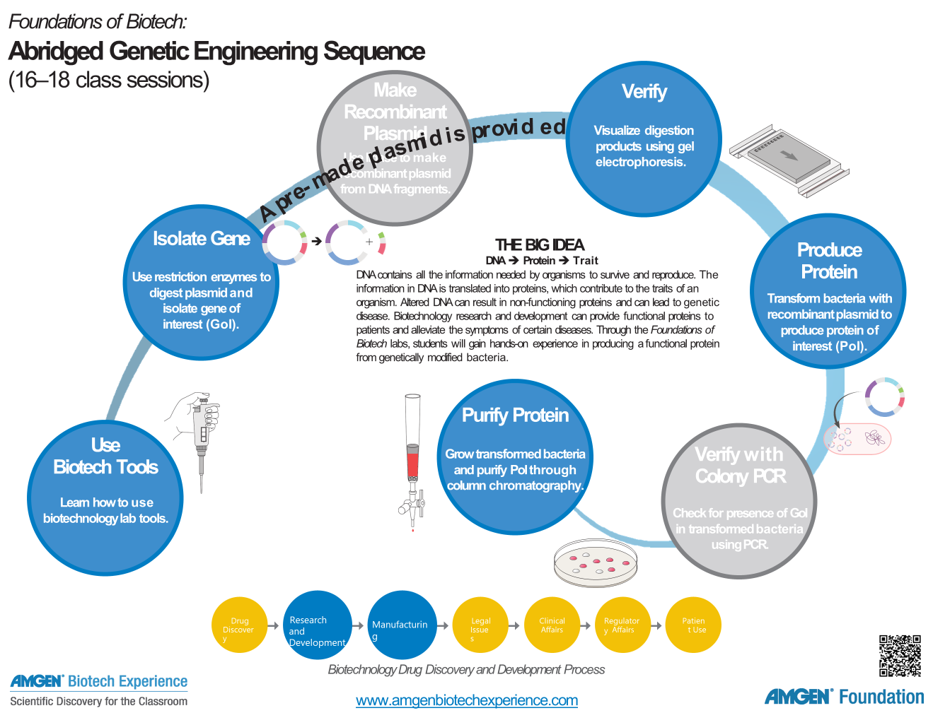
We are here

Slide 3
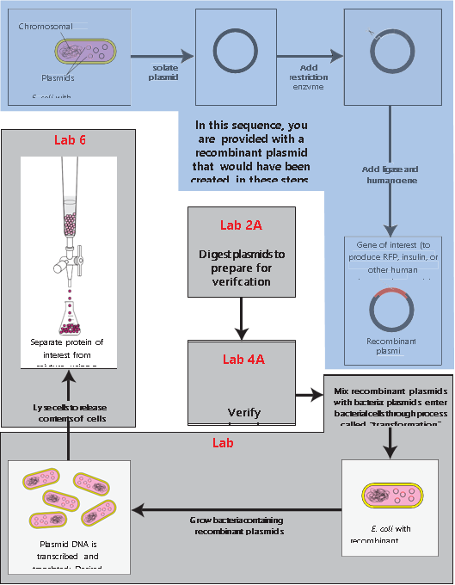
5

Slide 4
CHAPTER 2A: OVERVIEW
During chapter 2a, students will use learn how to manipulate plasmids using restriction enzymes.
These two key tools in biotechnology: plasmids and restriction enzymes are used to isolate the gene of interest.

Slide 5
CHAPTER 2A: LEARNING GOALS
Describe the characteristics of plasmids
Explain how plasmids are used in cloning a gene
Describe the function of restriction enzymes
Explain how to use a restriction enzyme to manipulate a recombinant plasmid

Slide 6
CHAPTER 2A: KEY IDEAS
Genetic engineering or gene cloning is made possible by employing two key scientific discoveries: plasmids and restriction enzymes.
Plasmids are small circular pieces of DNA that can replicate within bacterial cells; restriction enzymes cut DNA at specific locations and can thus be used as molecular scissors.

Slide 7
CHAPTER 2A: OBJECTIVES
To ensure that the recombinant plasmid, pARA-R, you have been given is the correct one for making the red fluorescent protein in bacteria
Use restriction enzymes to cut the plasmid to generate fragments that are characteristic of the pARA-R plasmid

Slide 8
CHAPTER 2A: CONNECTIONS TO INDUSTRY
In industry these techniques would be used to modify a prokaryotic genome to insert a gene for a therapeutic protein such as insulin. Instead of isolating the eukaryotic gene for insulin, students will work with the gene for a red fluorescent protein.
Plasmids have a crucial role in biotechnology as vectors for eukaryotic genes to enter prokaryotic cells.

Slide 9
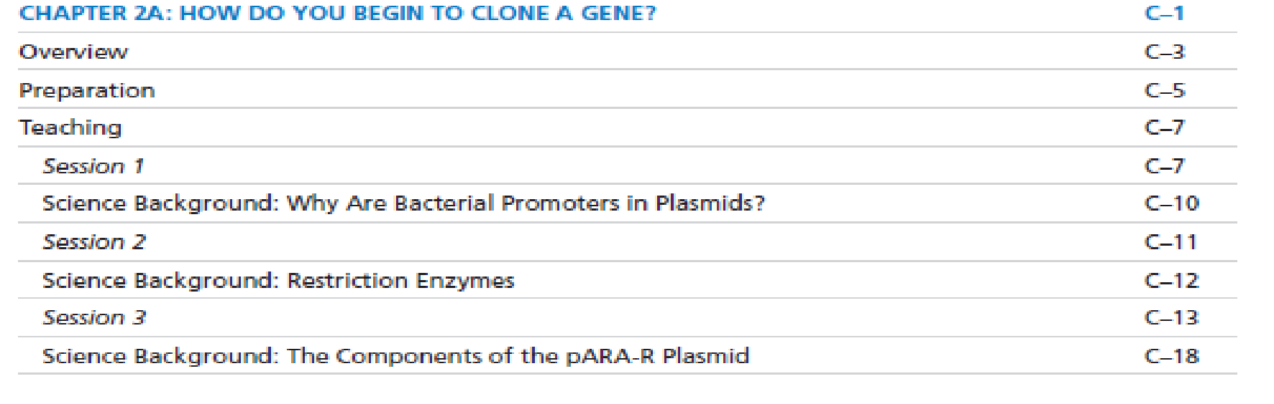
2019/2015 TEACHER GUIDE
2019 page 65
2015
Tab C: abridged sequence
Starts on page C-1

Slide 10
PROPOSED SEQUENCE OF ACTIVITIES PG 68 2019 GUIDE
Session 1 – 45 minutes
  Review chapter goals
  Answer the What do you already know questions
  Have students read Beginning to clone a gene and answer the CONSIDER questions
  Lead a discussion on student answers
Session 2 – 45 minutes optional
  Internet searches on a pharmaceutical made using a recombinant process
Session 3 – 45 minutes optional
  Students complete Clone that gene exercise
  Answer the Stop and Think questions
Session 4 – 45 minutes
  Students complete Laboratory 2a
  Answer all of the corresponding questions

Slide 11
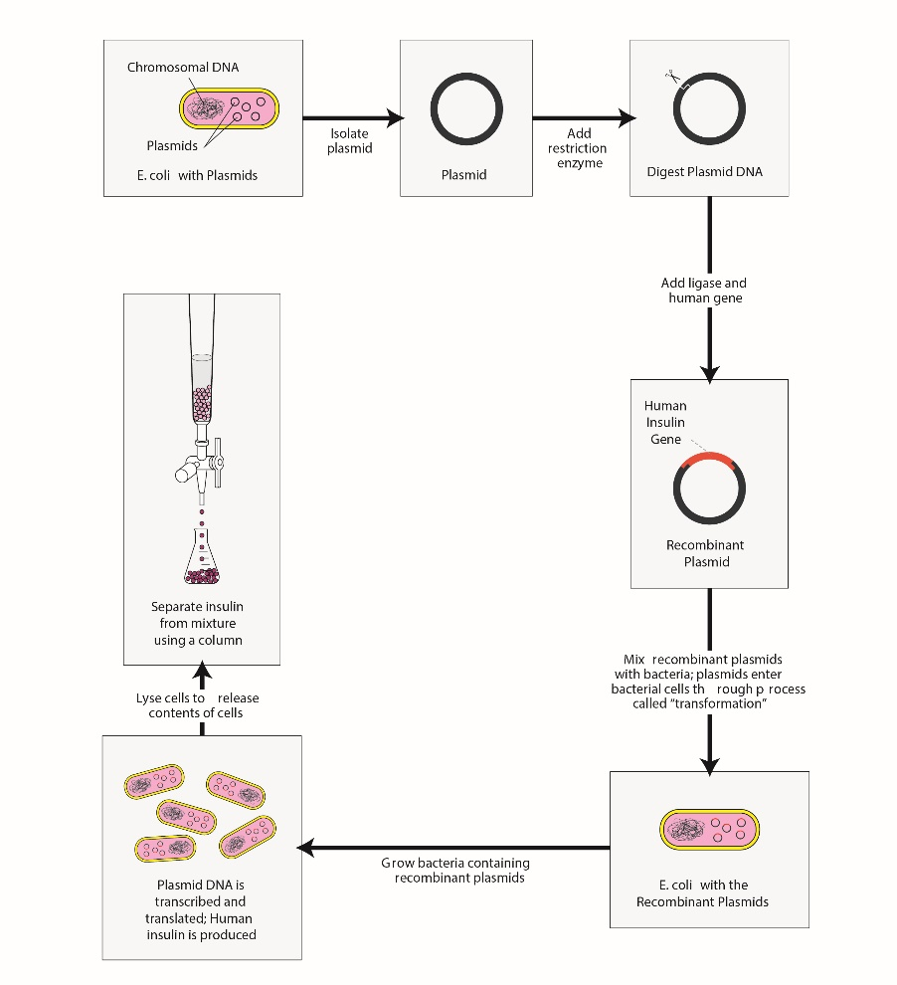
Optional: Review with students where laboratory 2A fits into the ABE storyline of creating insulin.

Slide 12
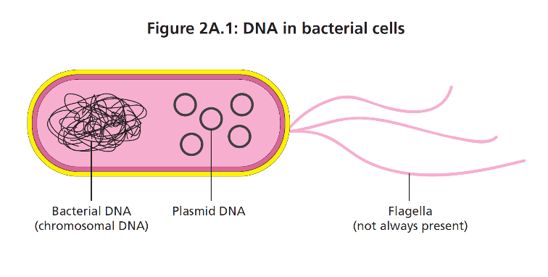
BACTERIAL DNA
Bacteria CAN have 2 forms of DNA:
  Chromosome
    Single loop of DNA
    Condensed and segregated into a region called nucleoid
    Contains all information necessary for life
  Plasmid
    Small loop of DNA
    Nonessential
    Extrachromosomal – “outside” the chromosome
    Vectors
    Replicate autonomously
QUESTION: Why is circular better?!?!

Slide 13
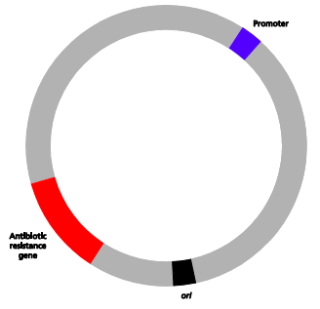
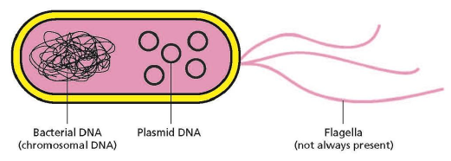
PLASMID FEATURES
Plasmids features include origin, promoter and restriction sites.
Antibiotic resistance genes are key components to plasmids as they allow students to select for those bacteria that have the plasmid versus those which do not in laboratory 5a.

Slide 14
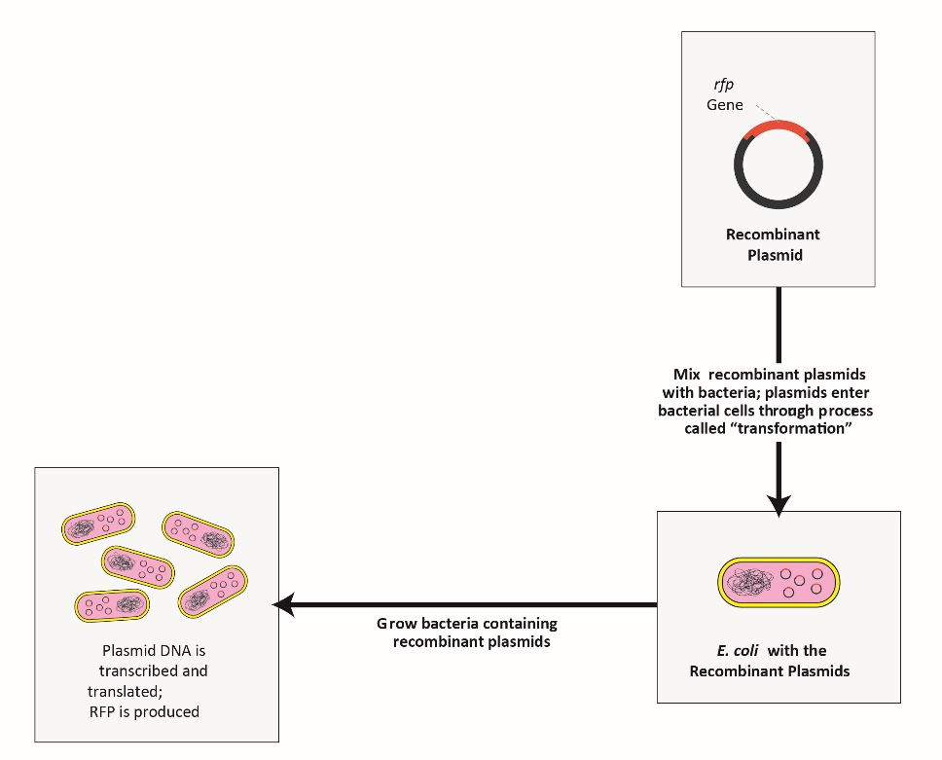
Remind students that plasmid being used contains gene for rfp which represent insulin in this laboratory sequence.
Lab 2A: digesting pARA-R plasmid to check that it has the rfp gene

Slide 15
RESTRICTION ENZYMES “CUT & PASTE” DNA
Restriction enzymes…
are used by bacteria to destroy phage DNA in nature.
can recognize and bind to specific nucleotide sequences (e.g., cut the phosphodiester backbone of DNA).
can make off-center cuts to produce single-stranded ends of DNA (sticky ends).
allow DNA from various sources to be cut so they have complementary sticky ends which will pair up to create recombinant DNA.

Slide 16
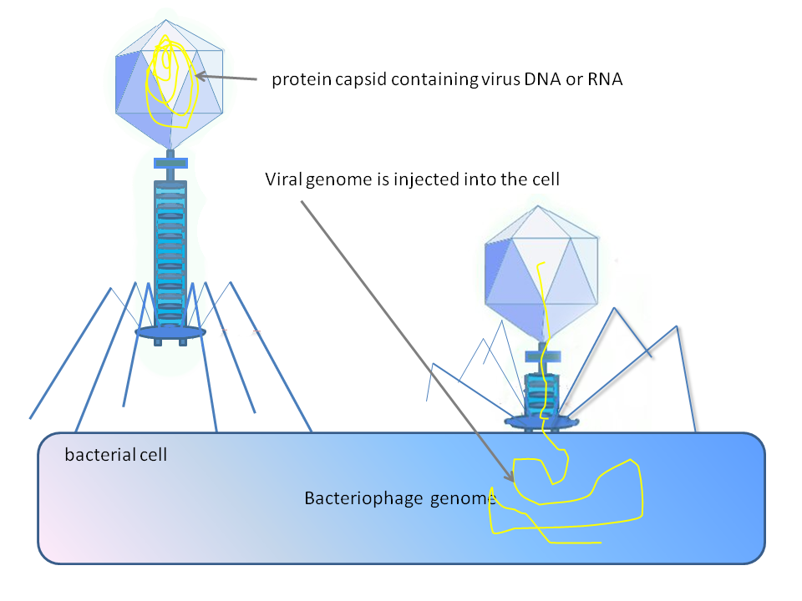
WHERE DO WE GET RESTRICTION ENZYMES?
Bacteria produce restriction enzymes as a defense against bacteriophages
BamHI: Bacillus amyloliquefaciens
HindIII: Haemophilus influenza
Notes:
Names represent genus/species (Bam), strain (H), and what order the enzyme was discovered in in that strain (1 = first). So BamHI is from Bacillus amyloliquefaciens strain H, first one discovered.

Slide 17
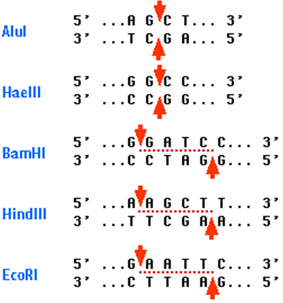
WHAT DOES A RESTRICTION ENZYME DO?
Cuts DNA at a specific reaction site (sequence)
Examples:
Blunt Ends
“Sticky” Ends
Notes:
There are two types of restriction enzymes: ones that make blunt ends (Alu & Hae, used by the bacterial immune system for bacteria to cut viral or bacteriophage DNA to prevent infections, good for DNA fingerprinting) and ones that make sticky ends (good for genetic engineering because you can glue them back together in specific orientations

Slide 18
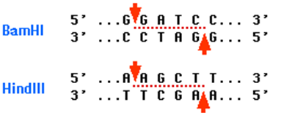
HOW DO RESTRICTION ENZYMES CUT?
Cuts DNA at palindromes: the complementary DNA is a palindrome to the original DNA strand
Palindrome examples:
  A nut for a jar of tuna
  Radar
  Kayak
Notes:
Complementary strand is the same forward as the original strand backward. Simple examples “race car” and “noon”.

Slide 19
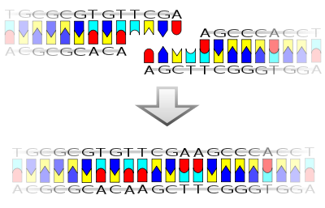
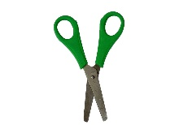

WHY ARE STICKY ENDS IMPORTANT?
Sticky ends form hydrogen bonds
Hydrogen bonds form easily

Slide 20
WHY USE RESTRICTION ENZYMES IN BIOTECHNOLOGY?
Scientists can build plasmids that contain specific restriction enzyme sites.
They can also cut out and recombine genes to allow for cloning and gene expression.
They can choose sticky or blunt ends depending on what they are doing (making plasmids vs DNA for forensics).

Slide 21
CLONE THAT GENE
Activity:
Identify “parts” of the plasmid and the human DNA
Cut the plasmid and the human DNA with the appropriate restriction enzyme
Insert the insulin gene into the plasmid DNA

Slide 22
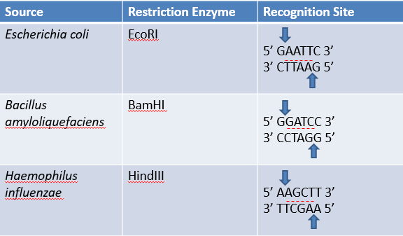
RESTRICTION ENZYME CUTS

Slide 23
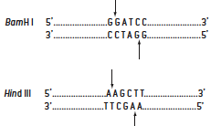

RESTRICTION ENZYMES BamHI AND HindIII

Slide 24
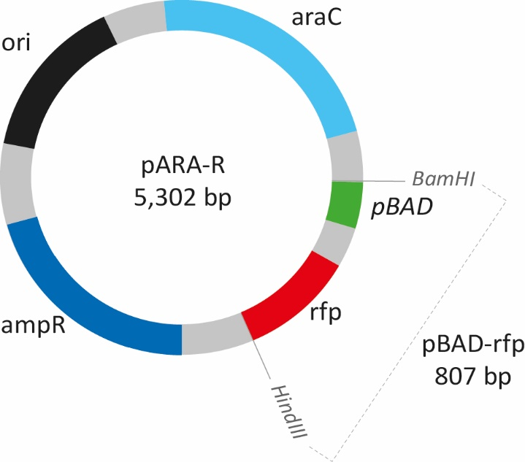
RESTRICTION ANALYSIS OF pARA-R PLASMID
Important features
Digest (cut) with BamHI and HindIII
What sizes of DNA fragments do we expect?
Notes:
Plasmid is a double-helix of DNA. Ori region = beginning of DNA replication; ampR = protects bacteria from ampicillin plate (a selective media to identify transformed cells) by producing beta lactamase and breaking down the ampicillin; araC = on/off switch in the presence of arabinose, similar to the lac operon; pBAD = promoter to allow RNA polymerase to dock; rfp = gene for protein of interest (in our case, red fluorescent protein)

Slide 25
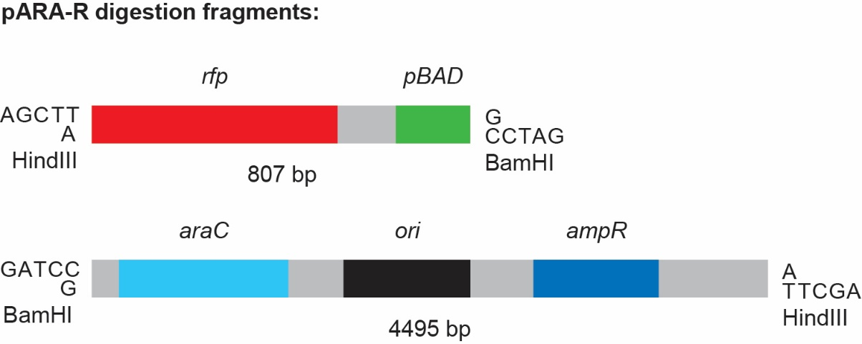
pARA-R PLASMID DIGESTED WITH BamHI AND HindIII
Laboratory 2A: digest DNA
Laboratory 4A: check size of two resulting fragments using gel electrophoresis

Slide 26

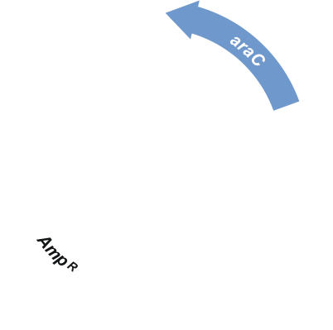
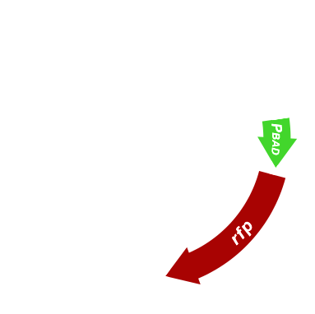

RESTRICTION DIGEST OF pARA-R
Recombinant plasmid of interest
BamH I
BamH I
pARA-R
5,302 bp
PBAD-rfp
807 bp
Hind III
Hind III
Notes:
Restriction enzyme sites: 2 enzymes = 2 restriction sites (with GFP labs they only cut with EcoR1, so they cut at the same site)

Slide 27

RESTRICTION DIGEST OF pARA-R
Restriction fragments after digest with HindIII and BamHI
BamH I
Hind III
4,496 bp
Hind III
BamH I
806 bp

Slide 28



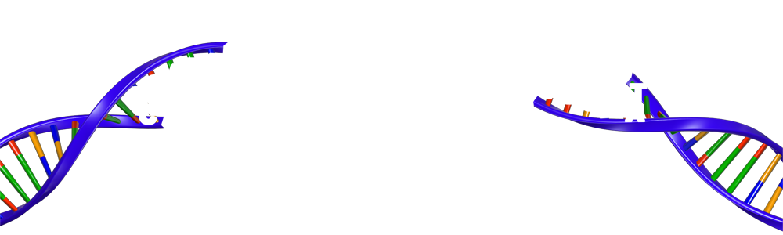
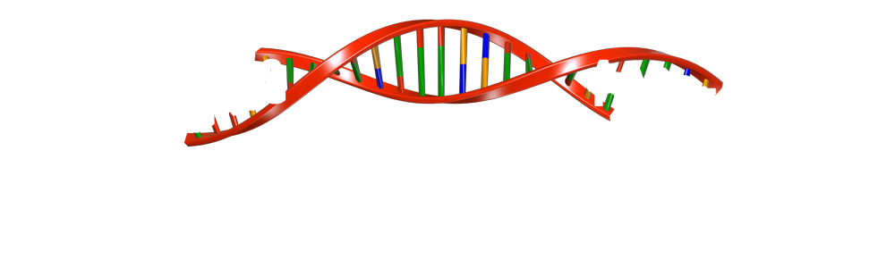
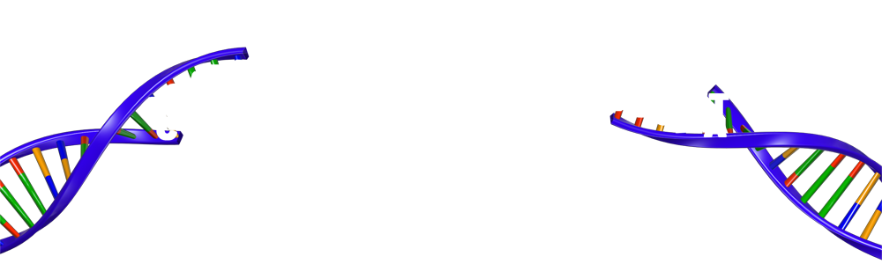


LIGATION OF RFP GENE
BamH I
sticky end
Hind III
sticky end
Hind III
sticky end
BamH I
sticky end
Why use two restriction enzymes?
So that the insert can only go in one direction.

Slide 29
CHAPTER 2A TIPS AND VIDEOS
Reagents should be stored in a freezer until you are ready to prepare them for students. Allow to defrost for 15 minutes before using.
The reagents can be aliquoted up to several days before the lab, then stored in the freezer.
Equilibrate water bath to 37˚C the day before.
Vortex and spin enzyme mix and 2.5x RB before aliquoting
Lab 2/2A Flow and Safety Considerations

Slide 30
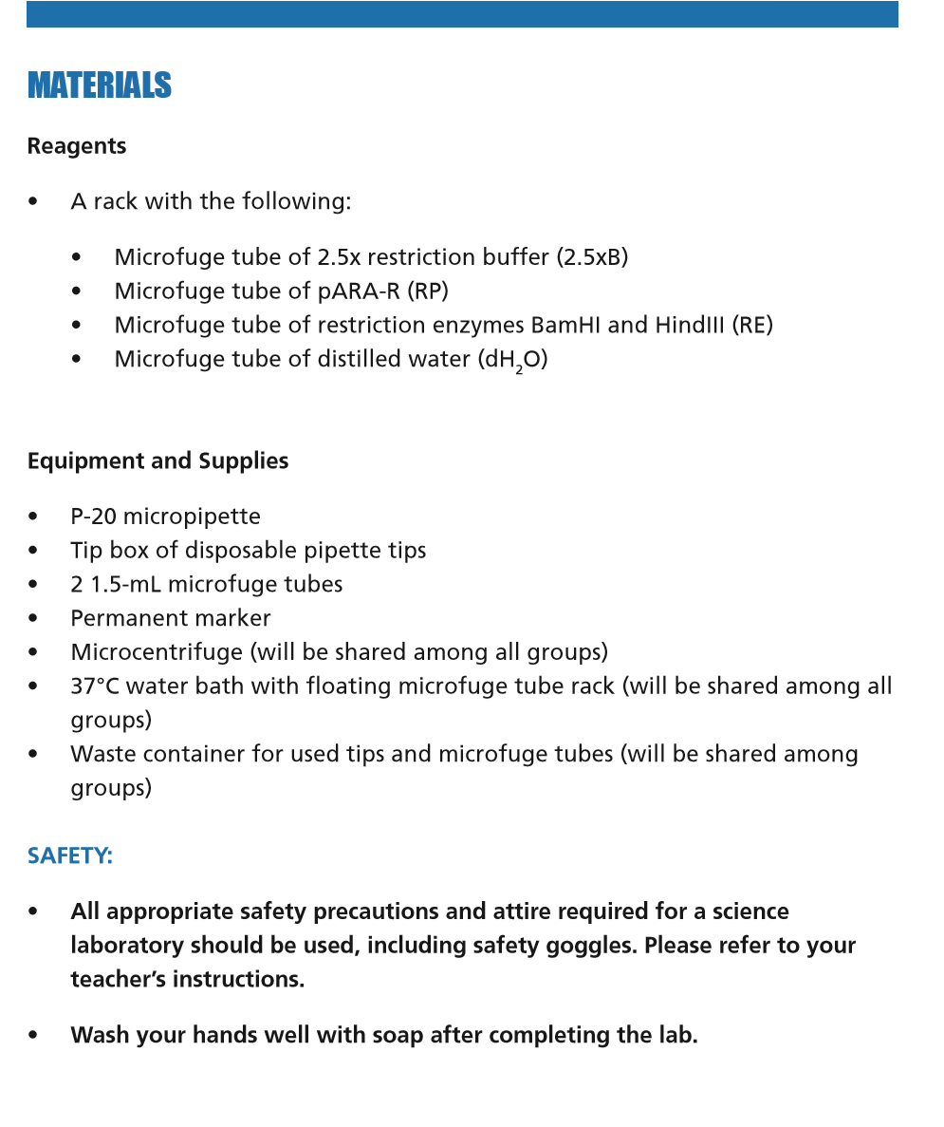
MATERIALS - STUDENTS
Lab 2A

Slide 31
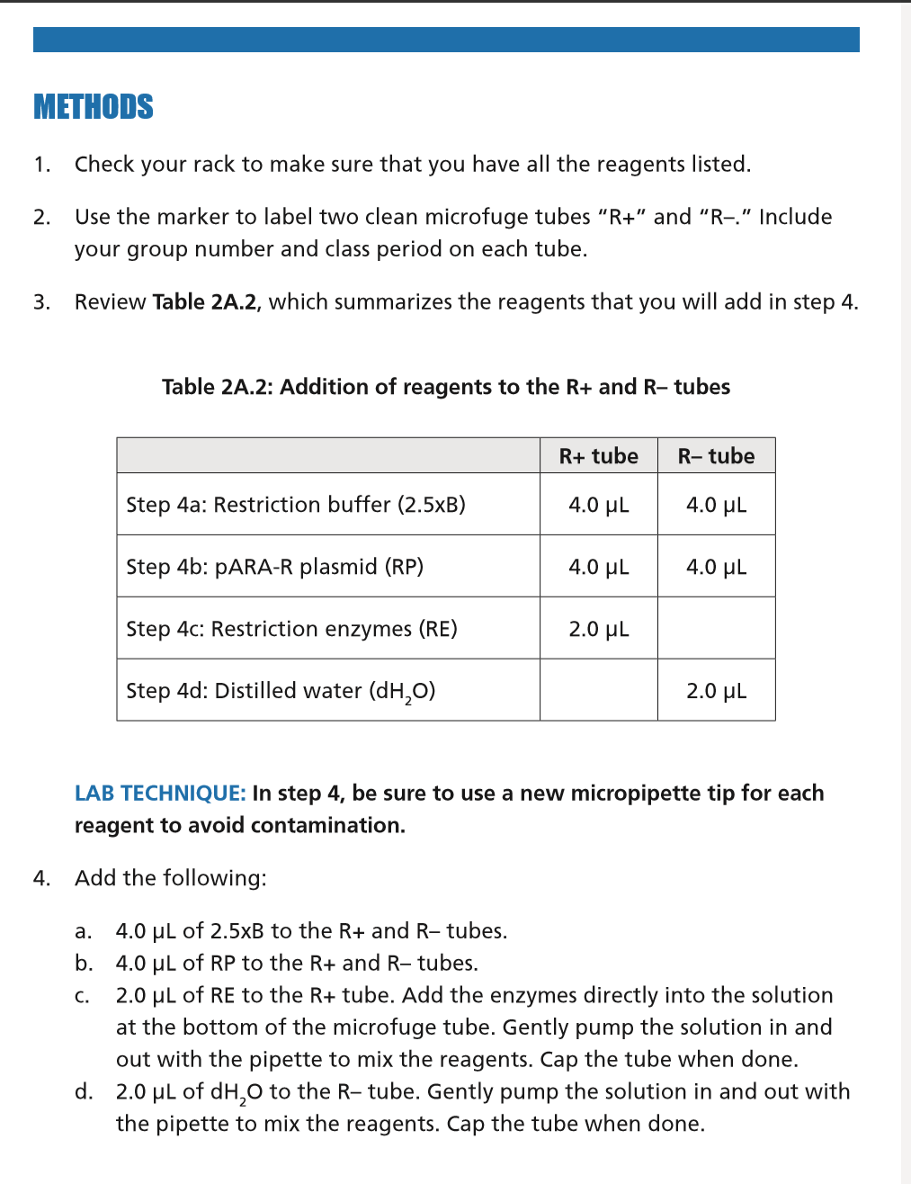
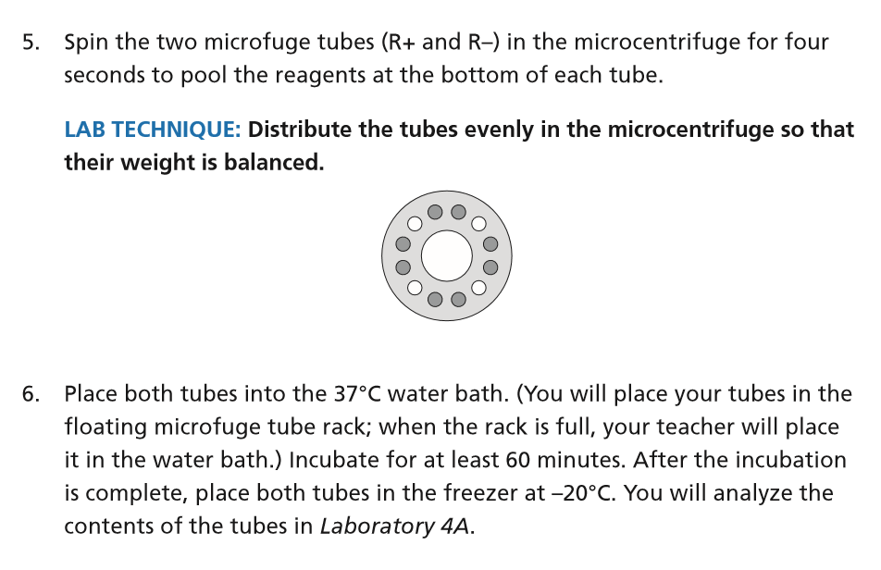
METHODS - STUDENTS

Slide 32
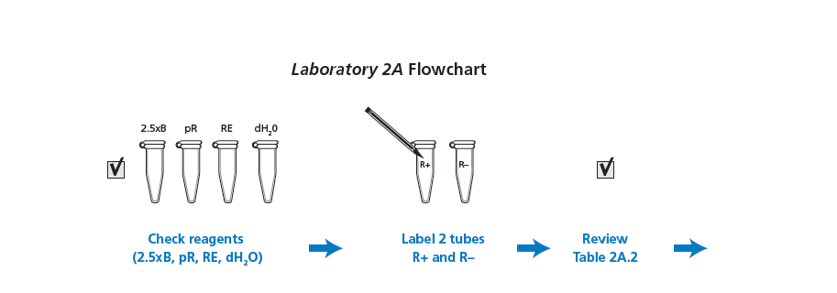
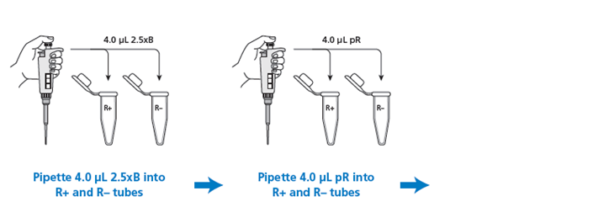
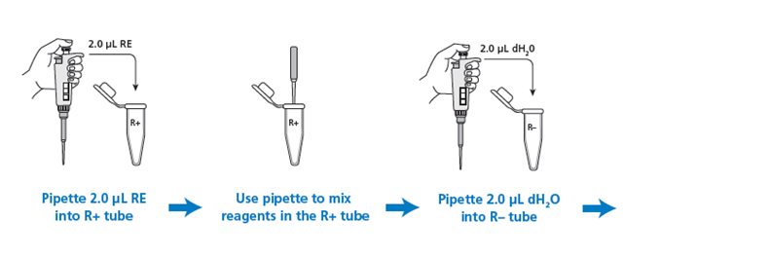
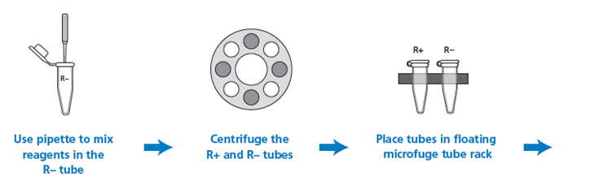


Slide 33
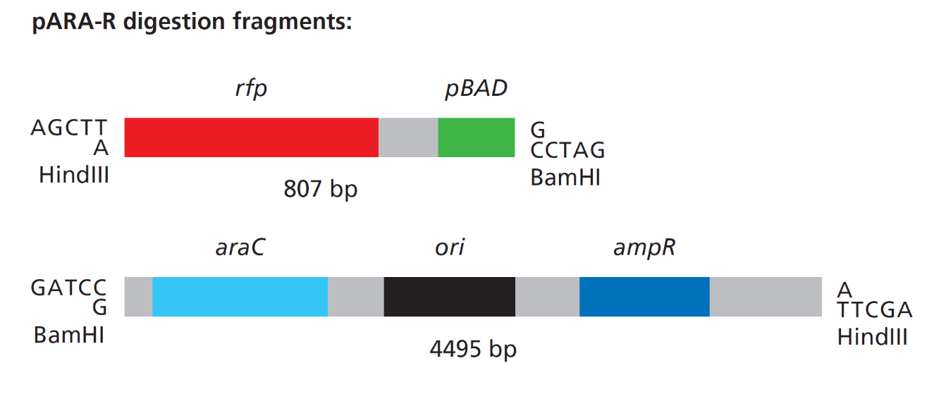
WHAT SHOULD THEY GET?
Nothing visible!!
Either go directly to Lab 4a or freeze until ready to complete

