Slide 1
Laboratory
Safety

Slide 2

General Laboratory Safety
Important to understand how to appropriately work in a lab
What if there is an accident?
What if there is a spill?
How do I know if the equipment or reagents that I am using could be potentially harmful?
Proper Personal Protection Equipment PPE

Slide 3
ABE Safety
All chemicals are covered under SDS (formally MSDS)
Microorganisms adhere to biosafety levels and policies for handling
  Working with E. coli
  Non-pathogenic strain
  No potential safety issues if handled and disposed of properly

Slide 4
Safety and Data Sheet
Safety and Data Sheet (SDS)
Provides workers, personnel, students with information on safety procedures when handling and working with substances in a laboratory setting
Provides physical data (melting point, boiling point, flash point, etc.), toxicity, health effects, first aid, reactivity, storage, disposal, protective equipment, and spill-handling procedures

Slide 5
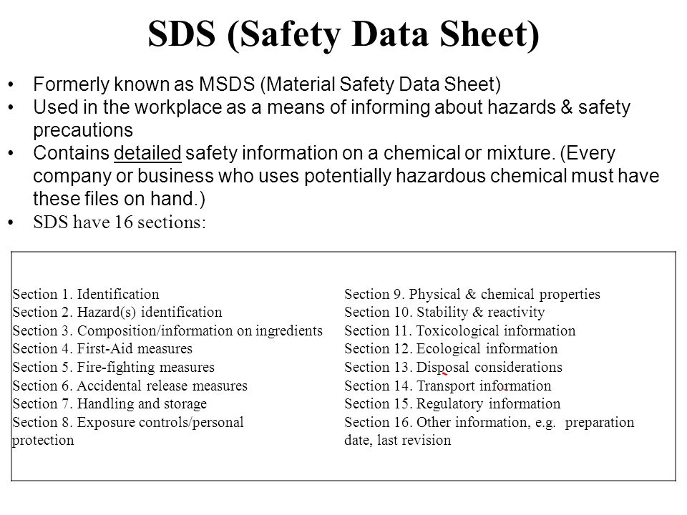

Slide 6
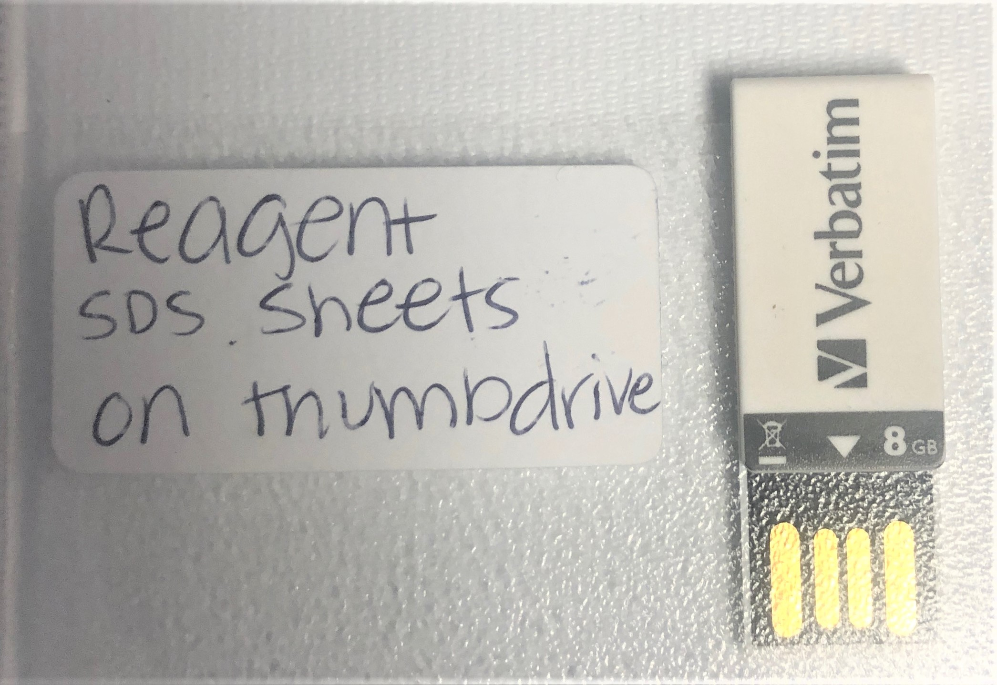
ABE Safety documents
Safety travel drive
  Will go with each kit
  Important to relay to students when certain portions of the lab require special attention

Slide 7
 | Master MSDS List for Kit Notebooks
Name | Purpose | Labs |  |  |  |  |  |  | URL
 |  | 1/1a | 2/2a | 3/3a | 4/4a | 5/5a | 6/6a | PCR
1kb DNA marker | Marker |  |  |  | √ |  |  |  | https://www.amgenbiotechexperience.com/sites/default/files/1kb_ladder.pdf
Agarose | Gels | √ |  |  | √ |  | √ |  | https://www.amgenbiotechexperience.com/sites/default/files/agarose.pdf
Ammonium Sulfate | BB, WB, CEB |  |  |  |  |  | √ |  | https://www.amgenbiotechexperience.com/sites/default/files/ammonium_sulfate.pdf
Ammonium Sulfate 3.2M | BB, WB, CEB |  |  |  |  |  | √ |  | https://www.amgenbiotechexperience.com/sites/default/files/ammsulf_3.2m_soln.pdf
Ampicillin | LB Plates, Cultures |  |  |  |  | √ | √ |  | https://www.amgenbiotechexperience.com/sites/default/files/ampicillin.pdf
L-Arabinose | LB Plates, Cultures |  |  |  |  | √ | √ |  | https://www.amgenbiotechexperience.com/sites/default/files/arabinose.pdf
Bam HI-HF | RE Mix |  | √ |  |  |  |  |  | https://www.amgenbiotechexperience.com/sites/default/files/bamhi-hf.pdf
20x Borate buffer | Gel Running Buffer | √ |  |  | √ |  |  |  | https://www.amgenbiotechexperience.com/sites/default/files/20x_borate_buffer.pdf
Borate Buffer | Gel Running Buffer | √ |  |  | √ |  |  |  | https://www.amgenbiotechexperience.com/sites/default/files/borate_buffer_tbe.pdf
Boric Acid | Gel Running Buffer | √ |  |  | √ |  |  |  | https://www.amgenbiotechexperience.com/sites/default/files/boric_acid.pdf
B-PER | Lysis Buffer |  |  |  |  |  | √ |  | https://www.amgenbiotechexperience.com/sites/default/files/b-per.pdf
Bromophenol blue | Dyes S1/S2/LD | √ |  |  | √ |  |  |  | https://www.amgenbiotechexperience.com/sites/default/files/bromothymol_blue.pdf
Calcium Chloride | Competent Cell Production |  |  |  |  | √ | √ |  | https://www.amgenbiotechexperience.com/sites/default/files/calcium_chloride.pdf
CutSmart Buffer | RE Buffer |  | √ |  |  |  |  |  | https://www.amgenbiotechexperience.com/sites/default/files/cutsmart_buffer.pdf
dATP | PCR |  |  |  |  |  |  | √ | https://www.amgenbiotechexperience.com/sites/default/files/datp.pdf
dCTP | PCR |  |  |  |  |  |  | √ | https://www.amgenbiotechexperience.com/sites/default/files/dctp.pdf
dGTP | PCR |  |  |  |  |  |  | √ | https://www.amgenbiotechexperience.com/sites/default/files/dgtp.pdf
dNTP | PCR |  |  |  |  |  |  | √ | https://www.amgenbiotechexperience.com/sites/default/files/dntp.pdf
dTTP | PCR |  |  |  |  |  |  | √ | https://www.amgenbiotechexperience.com/sites/default/files/dttp.pdf
Diluent A | RE Dilution |  | √ |  |  |  |  |  | https://www.amgenbiotechexperience.com/sites/default/files/diluent_a.pdf
Diluent B | RE Dilution |  | √ |  |  |  |  |  | https://www.amgenbiotechexperience.com/sites/default/files/diluent_b.pdf
E. Coli | Cell Transformation |  |  |  |  | √ | √ |  | https://www.amgenbiotechexperience.com/sites/default/files/ecoli.pdf
20% Ethanol | Resin Storage |  |  |  |  |  | √ |  | https://www.amgenbiotechexperience.com/sites/default/files/20_etoh.pdf
EDTA | Buffers |  |  |  | √ |  | √ |  | https://www.amgenbiotechexperience.com/sites/default/files/edta.pdf
Ethidium bromide | DNA Stain |  |  |  | √ |  |  |  | https://www.amgenbiotechexperience.com/sites/default/files/etbr_usage_concentration.pdf
Gel Green | DNA Stain |  |  |  | √ |  |  |  | https://www.amgenbiotechexperience.com/sites/default/files/gelgreen.pdf
Gel Red | DNA Stain |  |  |  | √ |  |  |  | https://www.amgenbiotechexperience.com/sites/default/files/gelred.pdf
Glycerin | Dyes RD/S1/S2/S3/LD | √ |  |  | √ |  |  |  | https://www.amgenbiotechexperience.com/sites/default/files/glycerin.pdf
Glycerol | Dyes RD/S1/S2/S3/LD | √ |  |  | √ |  |  |  | https://www.amgenbiotechexperience.com/sites/default/files/glycerol.pdf
Hind III-HF | RE Mix |  | √ |  |  |  |  |  | https://www.amgenbiotechexperience.com/sites/default/files/hindiii-hf.pdf
Hydrochloric Acid | Buffer pH | √ | √ | √ | √ | √ | √ |  | https://www.amgenbiotechexperience.com/sites/default/files/hydrochloric_acid.pdf
LB agar and broth | Culture growth |  |  |  |  | √ | √ |  | https://www.amgenbiotechexperience.com/sites/default/files/lb_agar_broth.pdf
Macro-Prep Methyl HIC Resin | Protein Column |  |  |  |  |  | √ |  | https://www.amgenbiotechexperience.com/sites/default/files/methyl_hic_bead_resin.pdf
NEBuffer 4 | RE Buffer |  | √ |  |  |  |  |  | https://www.amgenbiotechexperience.com/sites/default/files/neb_buffer_4.pdf
Nuclease | Lysis Buffer |  |  |  |  |  | √ |  | https://www.amgenbiotechexperience.com/sites/default/files/nuclease.pdf
Orange G | Dyes RD/S1 | √ |  |  |  |  |  |  | https://www.amgenbiotechexperience.com/sites/default/files/orange_g.pdf
PCR DNA marker | PCR |  |  |  |  |  |  | √ | https://www.amgenbiotechexperience.com/sites/default/files/pcr_dna_marker_0.pdf
Sybersafe Lab4a and Colony PCR

Slide 8
Plasmid DNA | Culture growth |  |  |  |  | √ | √ |  | https://www.amgenbiotechexperience.com/sites/default/files/plasmid_dna.pdf
QuickLigase Buffer | 5xB |  |  | √ |  |  |  |  | https://www.amgenbiotechexperience.com/sites/default/files/quickligase_buffer.pdf
Sodium Borate | Running Buffer | √ |  |  | √ |  |  |  | https://www.amgenbiotechexperience.com/sites/default/files/sodium_borate.pdf
Sodium Hydroxide | Buffer pH | √ | √ | √ | √ | √ | √ | √ | https://www.amgenbiotechexperience.com/sites/default/files/sodium_hydroxide.pdf
T4 Ligase Buffer | 5xB |  |  | √ |  |  |  |  | https://www.amgenbiotechexperience.com/sites/default/files/t4_ligase_buffer.pdf
T4 DNA Ligase | LIG |  |  | √ |  |  |  |  | https://www.amgenbiotechexperience.com/sites/default/files/t4_ligase.pdf
Taq/Taq buffer | PCR |  |  |  |  |  |  | √ | https://www.amgenbiotechexperience.com/sites/default/files/taq_polymerase_buffer.pdf
TE buffer | Protein Buffer |  |  |  |  | √ | √ |  | https://www.amgenbiotechexperience.com/sites/default/files/te_buffer.pdf
Tris Base | DNA/Protein Buffer |  | √ | √ | √ | √ | √ |  | https://www.amgenbiotechexperience.com/sites/default/files/tris_base.pdf
Water | Reaction Dilutions |  | √ | √ | √ | √ |  |  | https://www.amgenbiotechexperience.com/sites/default/files/water.pdf
Xylene cyanol | Dyes S2/LD | √ |  |  | √ |  |  |  | https://www.amgenbiotechexperience.com/sites/default/files/xylene_cyanol_ff.pdf
Full Set |  |  |  |  |  |  |  |  | https://www.amgenbiotechexperience.com/sites/default/files/msds_set_0.zip

Slide 9
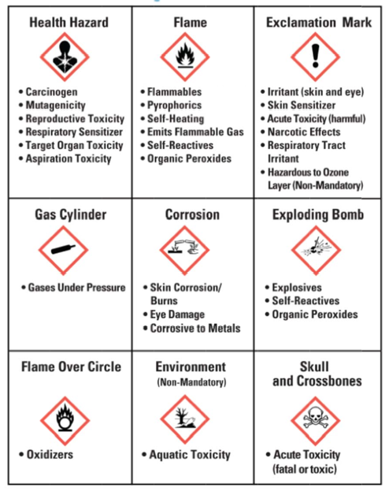
Globally Harmonized System
A system for standardizing and harmonizing the classification and labeling of chemicals
Defines health, physical and environmental hazards of chemicals
Communicates hazard information, as well as protective measures, on labels and Safety Data Sheets (SDS).

Slide 10
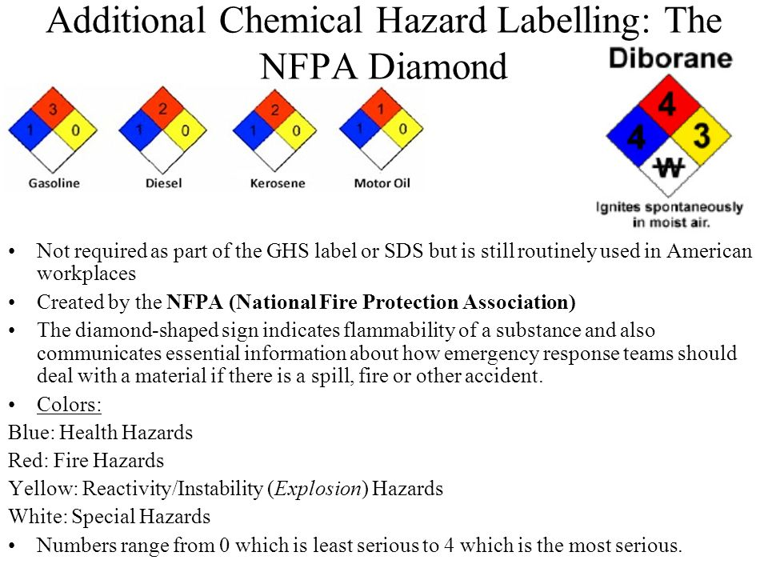

Slide 11
Biosafety Levels
Biosafety levels
  Levels are designated in ascending order, by degree of protection provided to personnel, the environment, and the community
  Standard microbiological practices are common to all laboratories
  Special microbiological practices enhance worker safety, environmental protection, and address the risk of handling agents requiring increasing levels of containment
  BSL – 1-4
    ABE = BSL – 1
http://www.cdc.gov/biosafety/publications/bmbl5/BMBL5_sect_IV.pdf

Slide 12
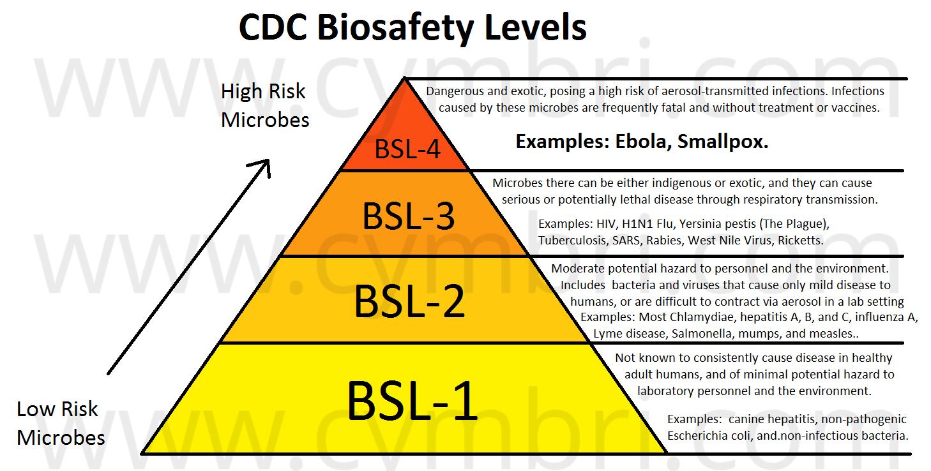

Slide 13
BSL - 1
Suitable for work involving well-characterized agents not known to consistently cause disease in immunocompetent adult humans
Present minimal potential hazard to laboratory personnel and the environment
Not necessarily separated from the general traffic patterns in the building
Work is typically conducted on open bench tops using standard microbiological practices
Special containment equipment or facility design is not required, but may be used as determined by appropriate risk assessment
Laboratory personnel must have specific training in the procedures conducted in the laboratory and must be supervised by a scientist with training in microbiology or a related science
cdc.gov/biosafety

Slide 14
General Safety Guidelines
Tie back long hair.
Do not wear open-toed shoes (sandals or flip-flops).
Do not eat, drink, apply cosmetics, or use personal electronic devices in the work area.
Keep lab benches and tables clear of everything except lab materials, notebooks, and “necessary” implements. Open storage of supplies, personal items, and nonessential equipment increases the amount of surface area susceptible to contamination in the event of a spill. These items should be placed in closed storage whenever possible.
Handle materials and equipment with care, and never use chemicals and dyes without proper supervision.
Wear lab goggles at all times.
Know the location of and how to use eyewash and fire safety equipment.
Never pipette by mouth. All liquids should be transferred using a pipette bulb or pipetting device.

Slide 15
Gel Electrophoresis Safety Guidelines
Each laboratory should contain a sink for hand-washing.
Wash hands before and at the conclusion of the lab. To wash hands properly, do the following:
  Wet hands with clean, running water and apply soap.
  Rub hands together to make a lather and scrub them well; be sure to scrub the backs of the hands, between the fingers, and under nails.
  Continue rubbing hands together for at least 20 seconds.
  Rinse hands well under running water.
  Dry hands using a clean towel, or air-dry them.
If the power is on, do not touch the buffer or electrophoresis equipment, as you may receive an electrical shock.

Slide 16
Gel Electrophoresis Safety Guidelines Cont.
Never leave the electrophoresis power unit on without supervision. There is a risk of fire if the buffer leaks out or if the buffer should evaporate completely during electrophoresis.
Never leave stir plates, hot plates, or heat blocks on without supervision.
Be sure that students are familiar with the operating instructions and safety precautions before they use any centrifuge.
Use caution with hot liquids and glassware. Wear heatproof gloves to move hot glassware and metals.
Follow specific safety and disposal guidelines for the stain you are using. The current recommendation is to use GelGreen™ and SyberSafe™ for DNA staining.
Check all SDSs for all chemicals and reagents in the lab before preparing and running the lab.
Never look at an unshielded UV light source. Wear a full-face UV shield and cover all exposed skin if your UV light source is unshielded.

Slide 17
Microorganism Safety Guidelines
    Treat all microorganisms as if they were pathogenic.
    Wear disposable gloves when handling bacteria in the transformation lab (Laboratory 5/5A/5B).
    When handling microfuge tubes, pipette tips, cell spreaders, and Petri plates, avoid spills and any unnecessary contact. Inform the teacher if a spill occurs.
    Wash hands with a disinfectant soap before and after working with microorganisms. Non-disinfectant soap will remove surface bacteria and can be used if disinfectant soap is not available. Gloves may be worn as extra protection.

Slide 18
Microorganism Safety Guidelines:
Dealing with laboratory Waste
      Place all equipment that comes into contact with bacteria in a well- labeled biohazard bag.
      Do not put liquid waste in the biohazard bag. Pour liquid waste into a specially designated container.
      Return the biohazard bag with the kit to be autoclaved and reused.
      Sterilize the liquid waste by adding 10% bleach solution and then pouring it down the drain.

Slide 19
Microorganism Safety Guidelines:
Cleaning UP
      Clean up spills immediately, using caution. Soak the spill with a 10% bleach solution and cover with paper towels. After allowing the spill to soak in the bleach for two minutes, carefully clean up and place the materials in the biohazard bag. Wash the area again with disinfectant.
      Use a 10% bleach solution to disinfect all benches and work areas before and after working with microorganisms.
      If there are glass fragments, use a specially designated brush and dustpan to sweep them up. Place the fragments in a 10% bleach solution, then drain and dispose of them, according to local regulations.
      Wear chemical-resistant goggles and be cautious when handling the bleach solution.
      Know the location of the nearest eyewash station and sink.
NOTE: Do not let students handle the bleach solution.

Slide 20
LabXchange Resources
Lab Safety Introduction
1B https://www.labxchange.org/library/items/lb:LabXchange:0dd15771:video:1
Lab Safety
2B 1 https://www.labxchange.org/library/pathway/lx-pathway:689d0e65-d60d-4770-b161-bb2fd28274ba/items/lx-pb:689d0e65-d60d-4770-b161-bb2fd28274ba:video:f306828a
MSDS (Material Safety Data Sheets)
2B 2 https://www.labxchange.org/library/items/lb:LabXchange:bfc106de:video:1
Lab 2/2a Flow and Safety Considerations
2C 2 https://www.labxchange.org/library/pathway/lx-pathway:689d0e65-d60d-4770-b161-bb2fd28274ba/items/lx-pb:689d0e65-d60d-4770-b161-bb2fd28274ba:video:26284453
Lab 4A Flow and Safety Considerations
4C 1 https://www.labxchange.org/library/pathway/lx-pathway:f32b6bf9-dbf7-436c-8c95-217b2046454f/items/lx-pb:f32b6bf9-dbf7-436c-8c95-217b2046454f:video:3c9e7d80
Lab 5 Flow and Safety Considerations
https://youtu.be/5hy1B7EHlqw
Lab 6 Flow and Safety Considerations
5D 1 https://www.labxchange.org/library/items/lb:LabXchange:706cee1a:video:1

Slide 21
References
American Biological Safety Association
  https://my.absa.org/tiki-index.php
Center for Disease Control
  www.cdc.gov
Lab Manager
  www.labmanager.com
Occupational Safety & Health Association
  www.osha.gov

