Slide 1
SUMMER PDI 2024
ABE RI

Slide 2
https://youtu.be/bEY7dbVauv8

Slide 5
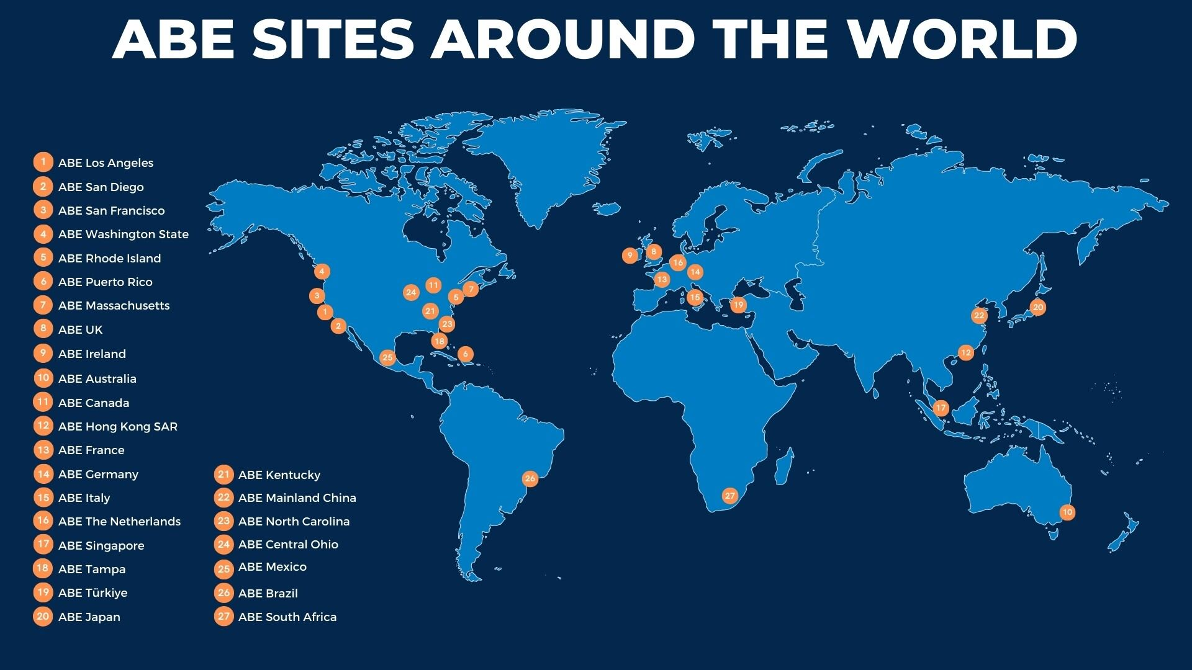
ABE WORLDWIDE

Slide 6
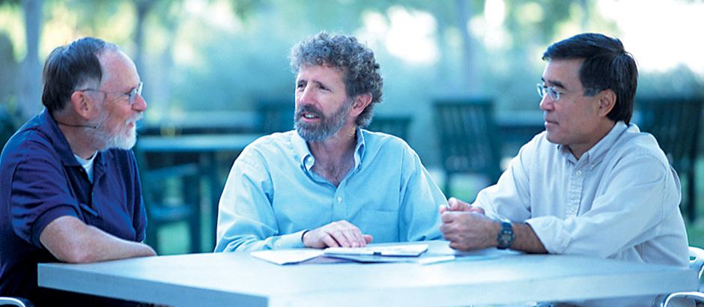
OUR HISTORY: THE PIONEERS OF THE AMGEN BIOTECH EXPERIENCE
1989 – Amgen scientists worked with a biology teacher in Thousand Oaks, California, Hugh Nelson, to learn the procedures Amgen uses to develop biologics and to fine-tune a series of labs for high school students
2000 - Pierce College Professor Marty Ikkanda rewrites the program to resemble college curriculum in collaboration with Rick Jacobsen, Bruce Wallace, and Bio-Rad
2003 - To honor one of the program’s founders who passed away, the program was named the Amgen-Bruce Wallace Biotechnology Lab Program
2004 - The Amgen-Bruce Wallace Biotechnology Lab Program, supported over the years by Amgen Inc., finds a home with the Amgen Foundation.
2013 - The program was renamed the Amgen Biotech Experience and joined forces with Education Development Center, Inc. as the global program office overseeing the program’s growth
The Amgen Biotech Experience was developed by high school teacher Hugh Nelson, Amgen scientist Bruce Wallace, and Professor Marty Ikkanda

Slide 7
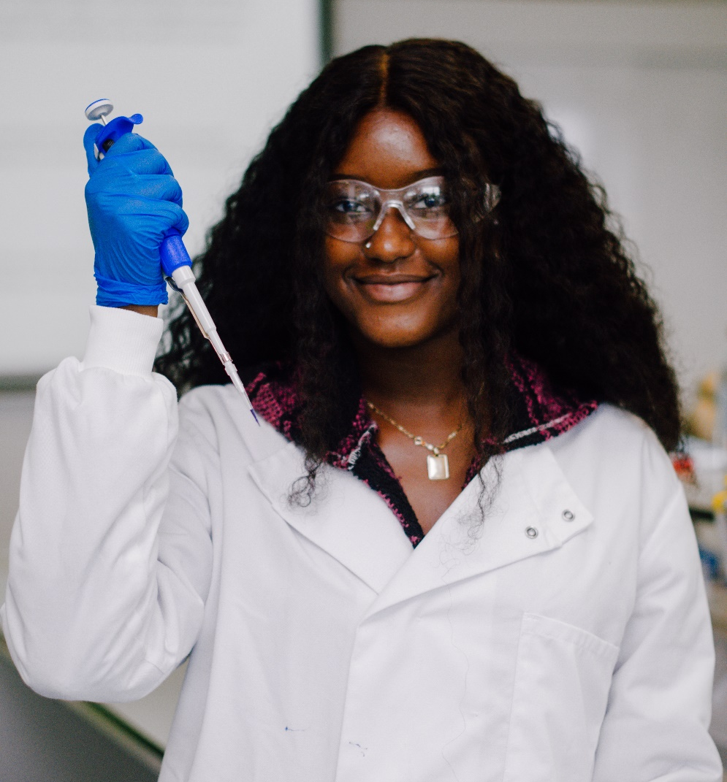
AMGEN BIOTECH EXPERIENCE (ABE)
ABE is an innovative science education program that introduces secondary school students to the excitement of scientific discovery. ABE provides teachers with the loan of research-grade equipment, supplies, curriculum, and professional development—all at no cost.
Available in Amgen communities in North America, Europe, and Asia Pacific.
More than 900,000 students to date; anticipate 1,000,000 students by the end of 2023 because of the Amgen Foundation’s more than $42 million commitment to the program.
PD opportunities, such as the ABE Master Teacher Fellowship Program, where fellows explore a topic of personal interest in the biosciences and develop corresponding classroom resources and will become advisors contributing to the development and depth of the ABE program.
ABE Web-based Investigations: ABE’s eLearning resources are designed to allow students to explore biotechnology content online in a self-paced fashion. Learn more about the many different types of teaching and learning resources offered by ABE.
TODAY’S STUDENTS
TOMORROW’S INNOVATORS
I wouldn’t have known about this field,
how stimulating and enjoyable it is, without having sampled the life of a scientist through the labs used in the Amgen Biotech Experience.
~Former ABE Student
www.amgenbiotechexperience.com

Slide 8
GOALS OF THE ABE PROGRAM
The goals of ABE are that, through their participation in the program:
Teachers are prepared to:
engage students in science learning experiences that promote students’ knowledge of biotechnology and biology;
show students how the science they are learning has real-life applications; and provide students with information about careers related to pharmaceutical biotechnology

Slide 9
AND THE STUDENTS……
Students gain:
understanding of key biology concepts,
knowledge of real-world biotechnology applications,
awareness of biotechnology and biotech careers, and
interest in biotechnology and science.

Slide 10
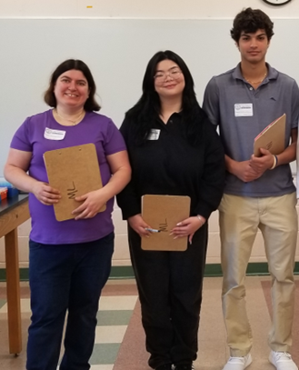
RI ABE SITE OFFICE
Doreen Osgood
Arielle Chaves
Kim Basa
Will Nebus

Slide 11
RI ABE: 2008 TO CURRENT
Schools involved
RI
CT
MA
25 total schools: 20 participated 2023-2024
63 total teachers (cumulative total since 2016
28 teachers participated in 2023-2024
~2000-2800 students/year

Slide 12
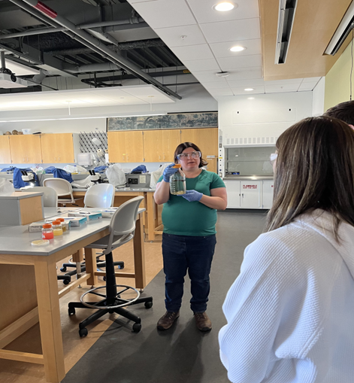
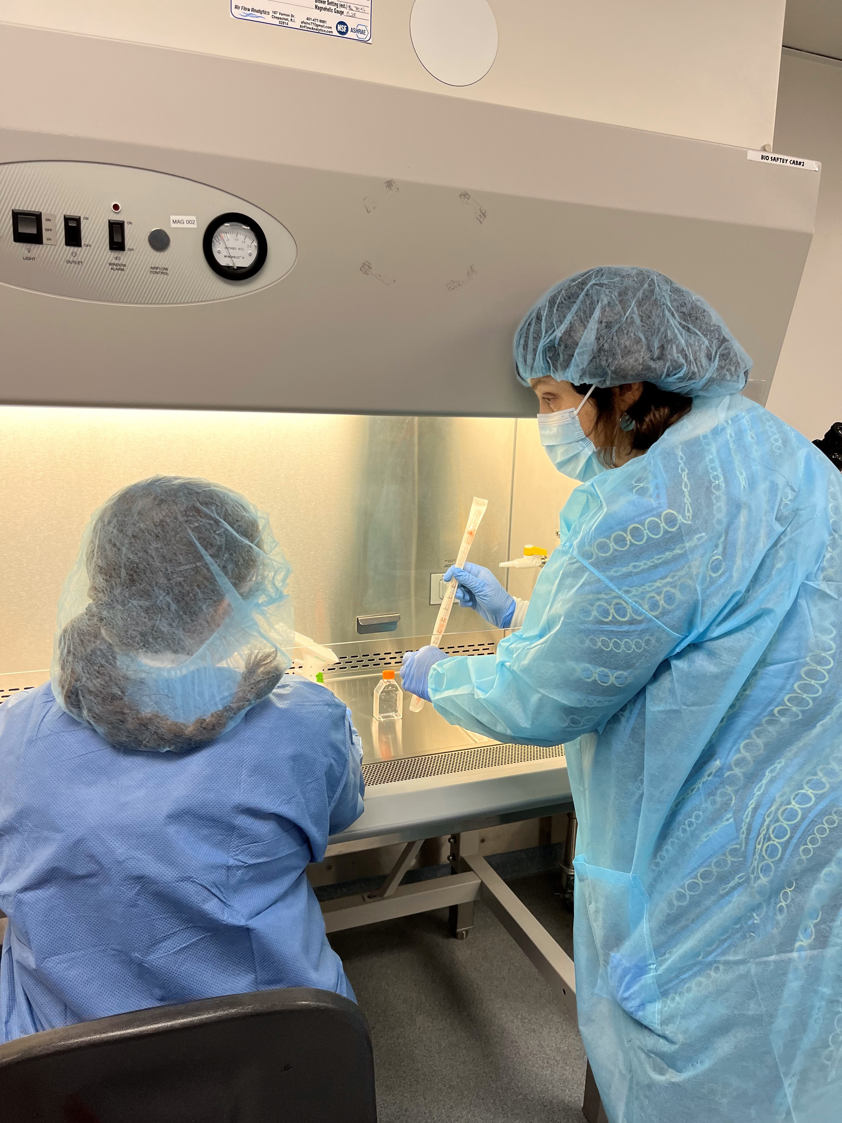
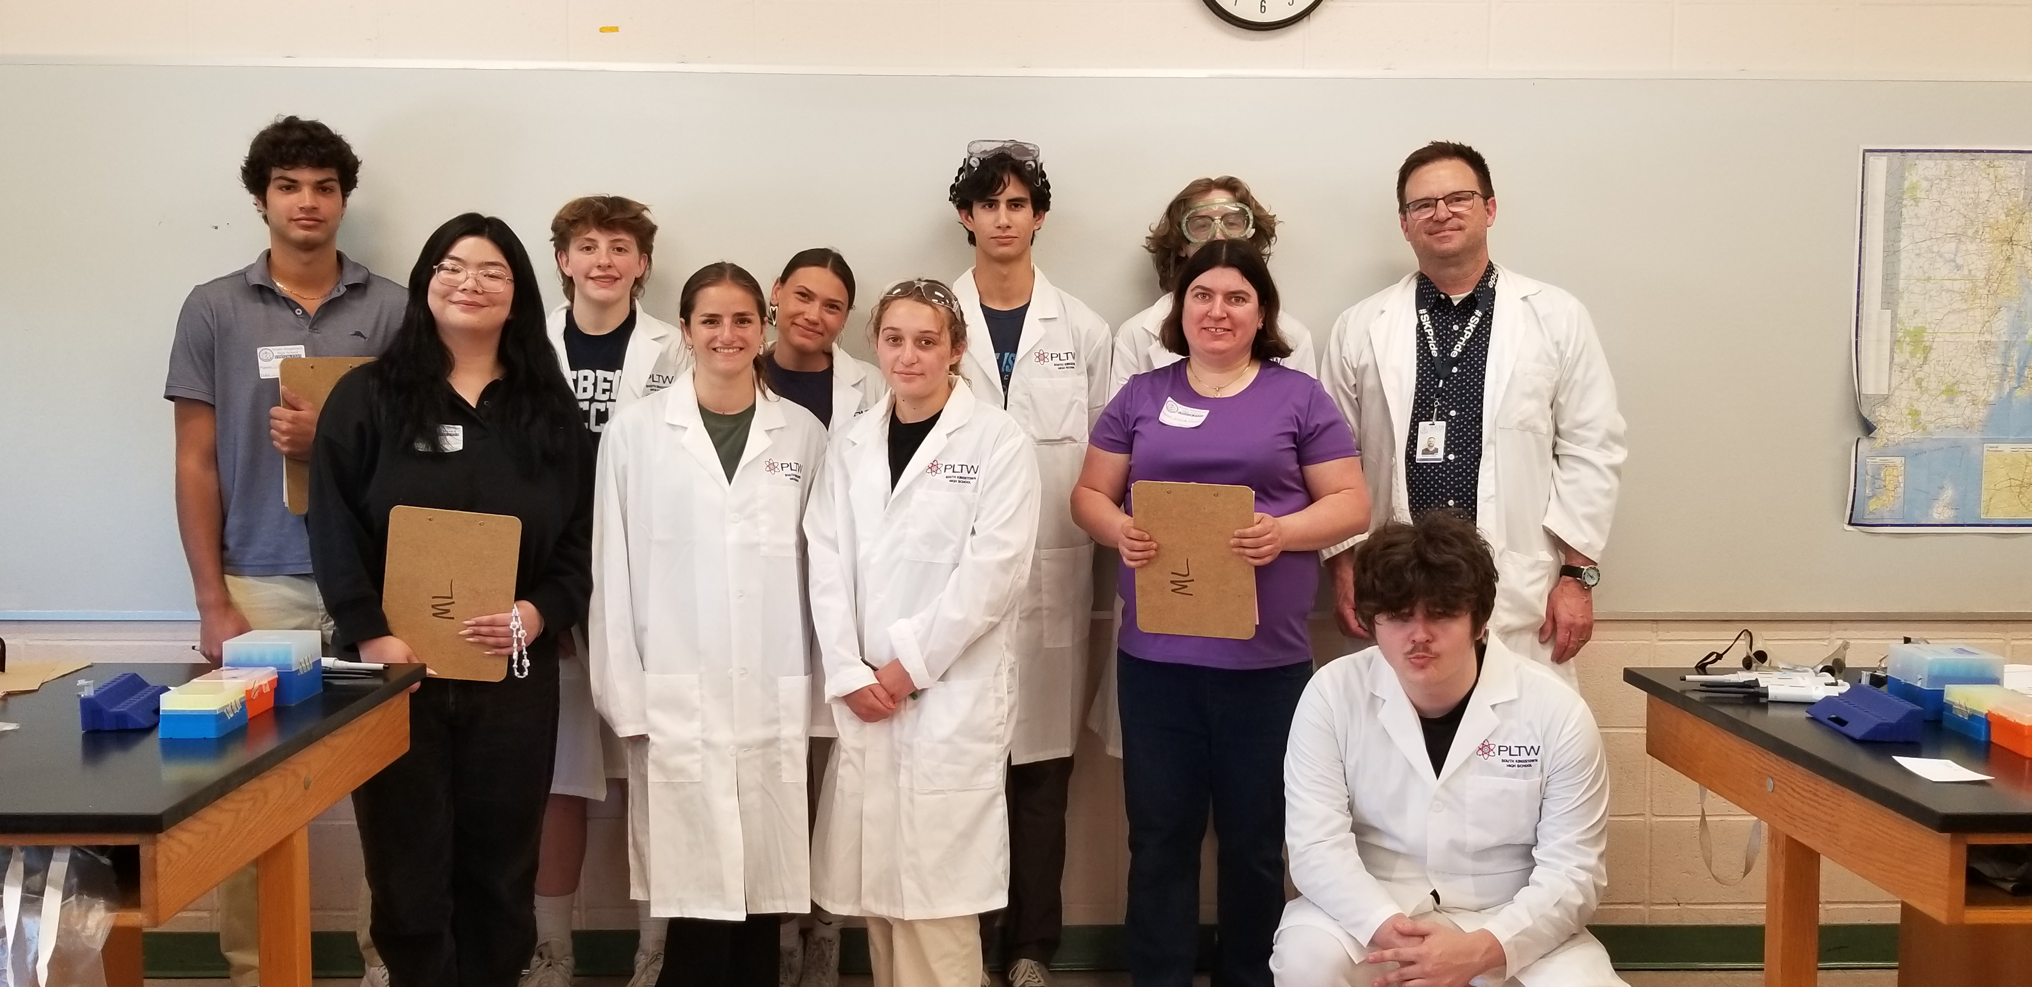
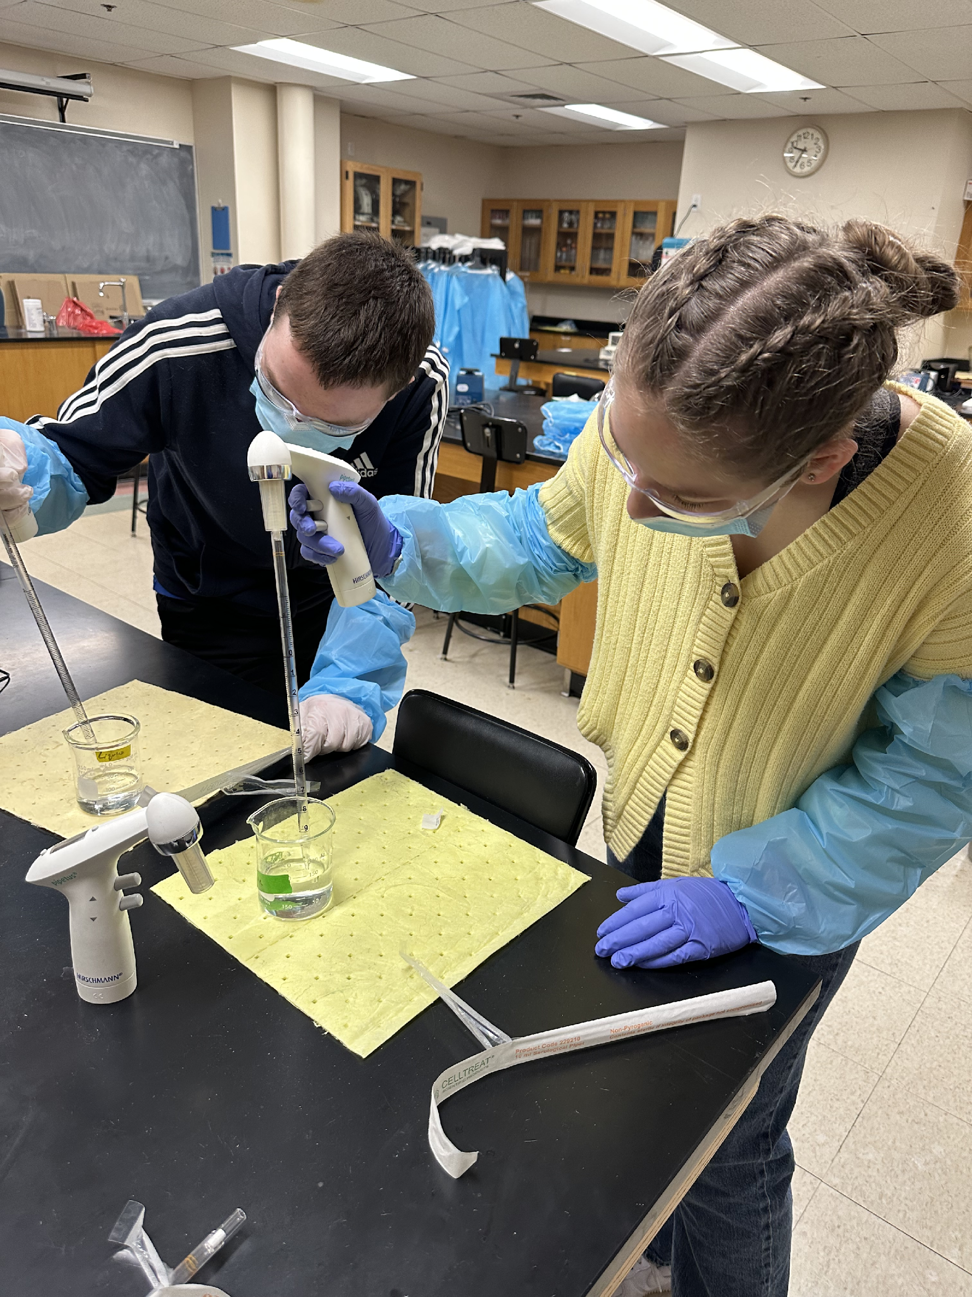
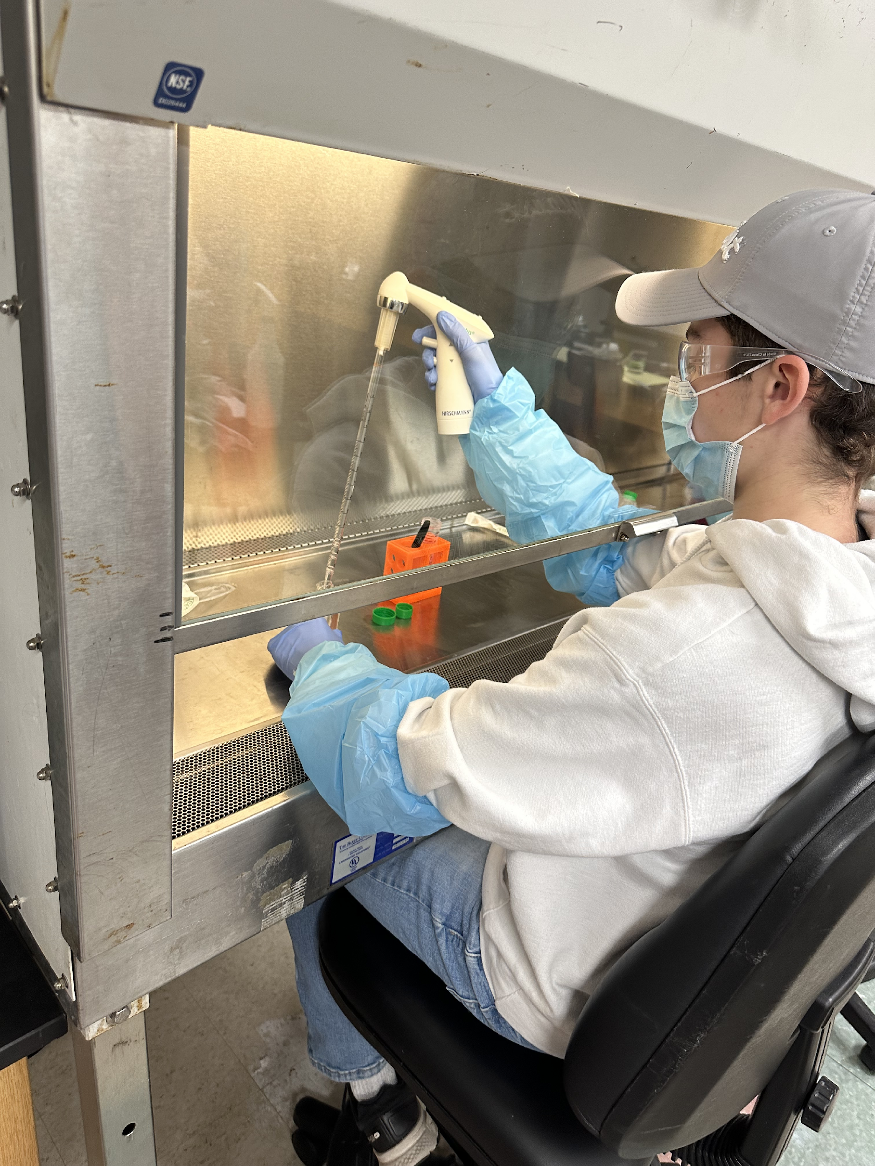
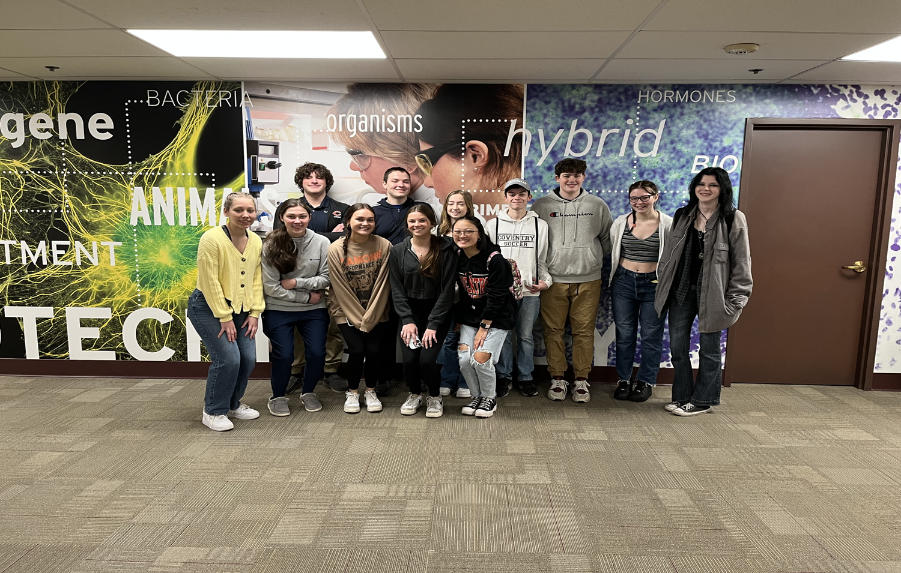
ABE RI OUTREACH
ABE RI coordinator and lead lab technician, Arielle Chaves, demonstrating bacterial growth to Coventry HS students, March 2024.
South Kingstown High school NOCTI students( 2024) with teacher Mike Lobdell (right back) and URI biotech program undergraduate lab assistants Will Nebus (left back) and Kim Basa ( left front).
Dr. Doreen Osgood (URI Biotech faculty and ABE RI director) showing proper use of ascetic technique
Julie Pankowicz’s Coventry High School class 2023.
Automatic pipette
skills
Aseptic transfer of cell culture reagents

Slide 13
ABE LAB MANUAL

Slide 14
LAB MANUAL ( ABRIDGED) 2019
New curriculum:
Modular approach – can use entire book or just individual chapters
ABE lab sequence:
Complete genetic engineering sequence
3.5 weeks
Abridged genetic engineering sequence –
3 weeks
Focus on Bacteria sequence –
2 weeks
Introduction to biotechnology
About 6 days

Slide 15
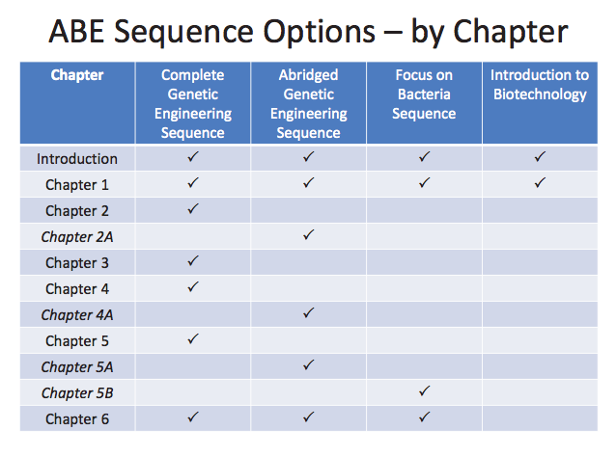

Slide 16
TEACHER MANUAL
Teacher manual is meant to SUPPORT the students
Does not have lab procedures restated
Appendix:
Lab 1.3 – optional
Clone that gene
DNA ladder diagram
Bacterial growth predictions

Slide 17
LAB MANUAL - OV
Curriculum overview
Connections to academic standards
NGSS ( Next Generation Science Standards)
Common Core Standards
21st Century Core Competencies
Assumption of prior knowledge & skills
Assessing student learning
Lab Safety
Materials and Prep

Slide 18
LAB MANUALS
Manuals
All sequences available online for print
Website; curriculum; teacher/student guides
Teacher guide password protected:
M3rlot!

Slide 19
ABE Teacher Guide
https://youtu.be/5j4Wt3rSA_Q

Slide 20
ABE Student Guide ( only available online)
https://youtu.be/e4I3ZDo9FnI

Slide 21
NOT JUST A LAB…..
Real world experience
Relatable to students
Introduces them to the notion that some diseases can be treated through gene cloning
What is Biotechnology
What is gene cloning?

Slide 22
WHAT IS BIOTECHNOLOGY?
Biotechnology = Biology + Technology
Employs use of living organisms in technology and medicine
Use of living systems and organisms to develop or make useful products, or "any technological application that uses biological systems, living organisms or derivatives thereof, to make or modify products or processes for specific use"
Fourteen month-old genetically engineered (“biotech”) salmon (left) and standard salmon (right).

Slide 23
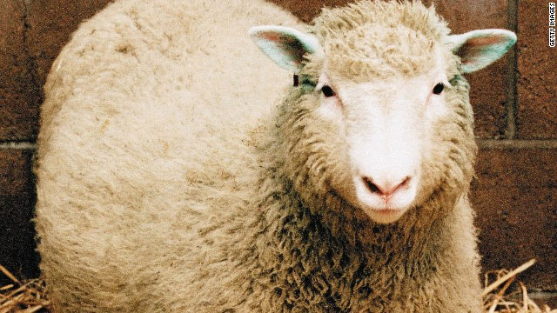
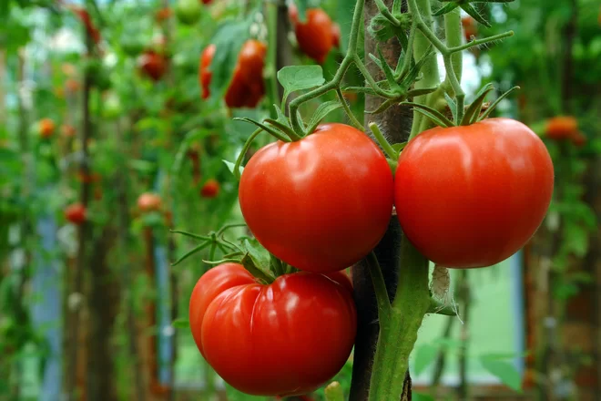
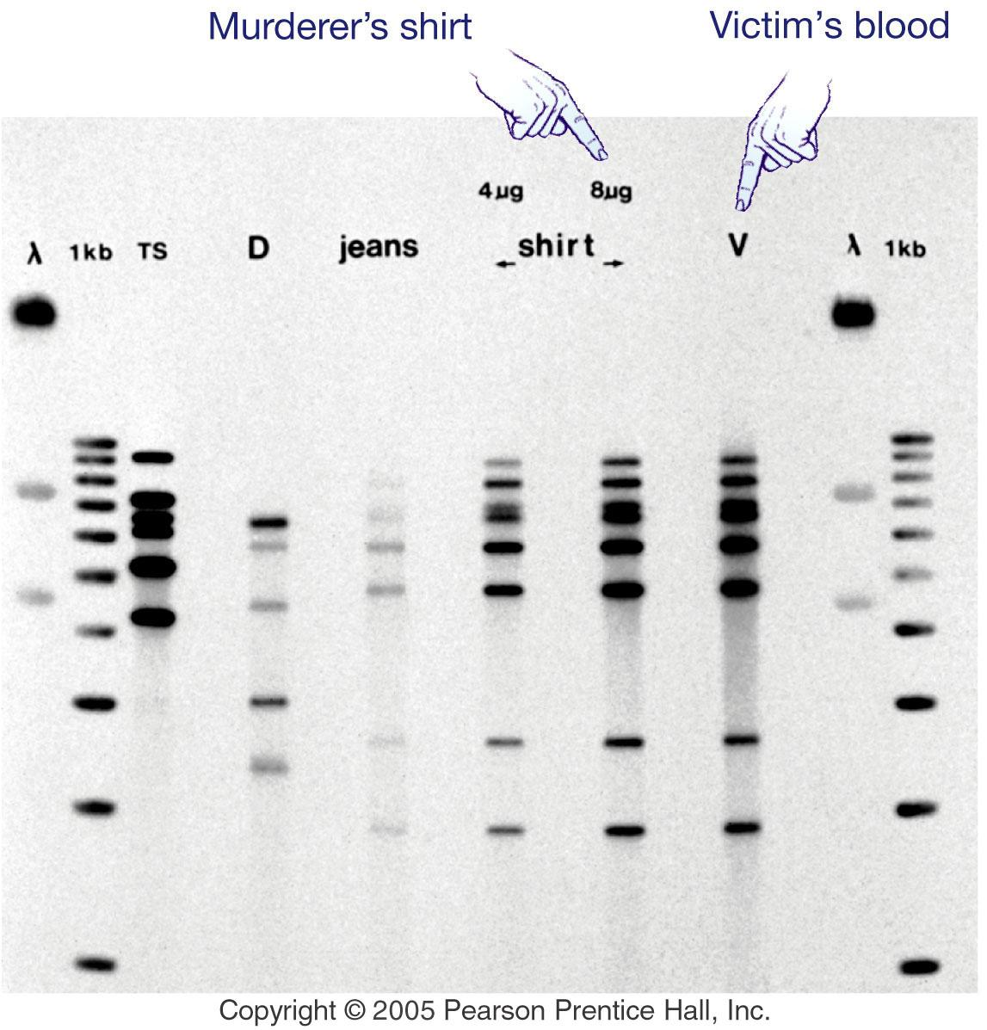
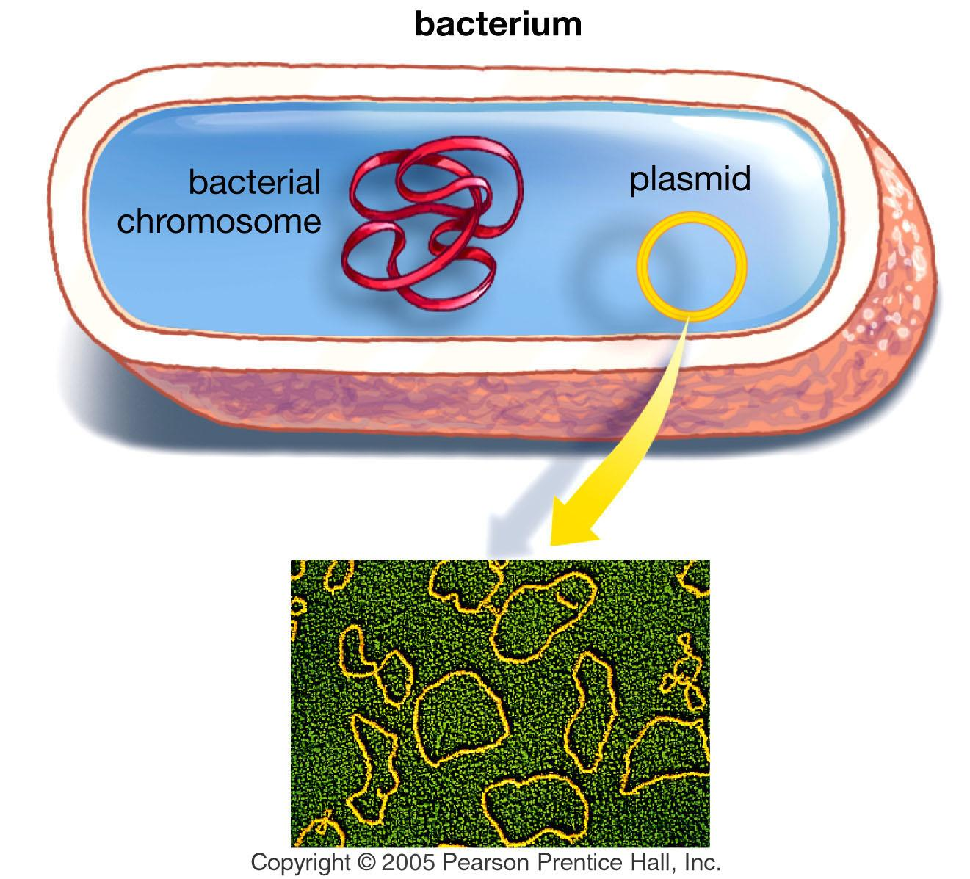
Biotechnology
CONSIDER: What do you already know about cloning?
Processes used to create copies of DNA fragments (molecular cloning), cells (cell cloning), or organisms.
Genetically modified foods
Animal cloning: Dolly
Flavr Savr tomato.
Gene cloning for pharmaceutical production
Inserts the human gene that encodes the protein into bacteria
Bacteria now make the protein!
The promise and perhaps perils of embryonic stem cells
DNA fingerprinting

Slide 24
WHAT IS GENETIC ENGINEERING?
Genetic engineering allows scientists to insert human DNA into other organisms
these genetically modified organisms make human proteins that the DNA encodes for
Recombinant DNA
The proteins can be used to treat a wide variety of diseases and help millions of people
Examples?!?!
The sequence of labs in the Amgen Biotech Experience mimics the research and development process used for the recombinant products that are currently available to treat a wide range of diseases

Slide 25
Biotechnology
COVID VACCINE DEVELOPMENT
Notes:
Synthetic RNA vaccines are the fastest to develop. A fully synthetic gene is cloned in a plasmid vector, which is then used as template for the in vitro synthesis of the RNA vaccine
In the case of viral vectors, the synthetic gene coding for the spike protein is inserted into one of many viruses that usually have been engineered so that they cannot replicate in the human host. The virus is then grown in culture and used to deliver the synthetic gene during vaccination.
Protein based vaccines” the synthetic gene coding for the spike protein, prefusion stabilized or also receptor binding domain only, is used to engineer mammalian cells, baculovirus, or plant cells to produce the recombinant protein that then is purified, combined with adjuvants, and used as vaccine.

Slide 26
THE STORY….
Nearly 1 in 4 teens between 12 and 19 is prediabetic
Glucose in blood becomes high
Why are we seeing more cases?
Many complications and adverse health problems
Jennifer’s story……

Slide 27
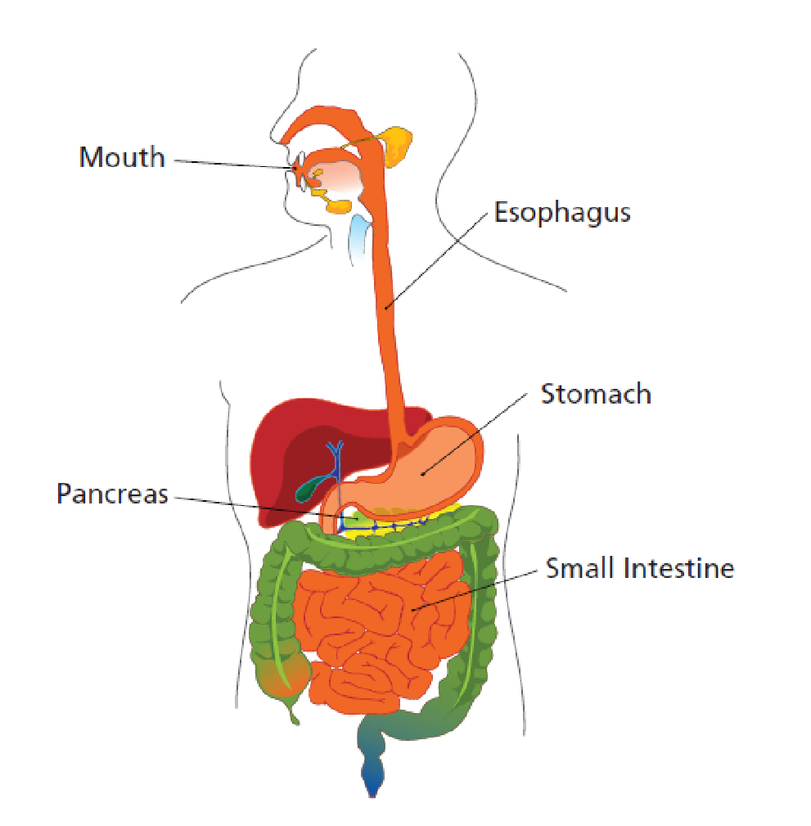
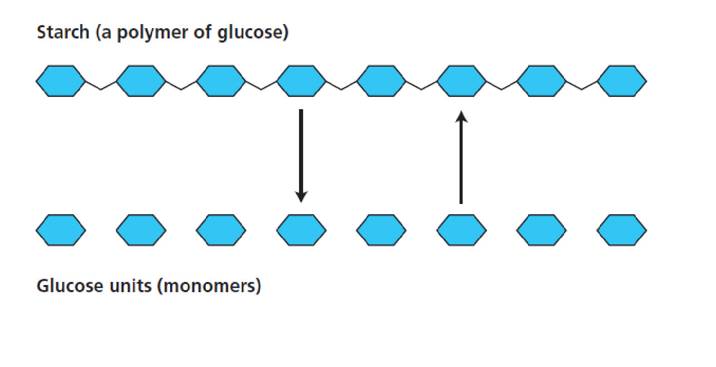
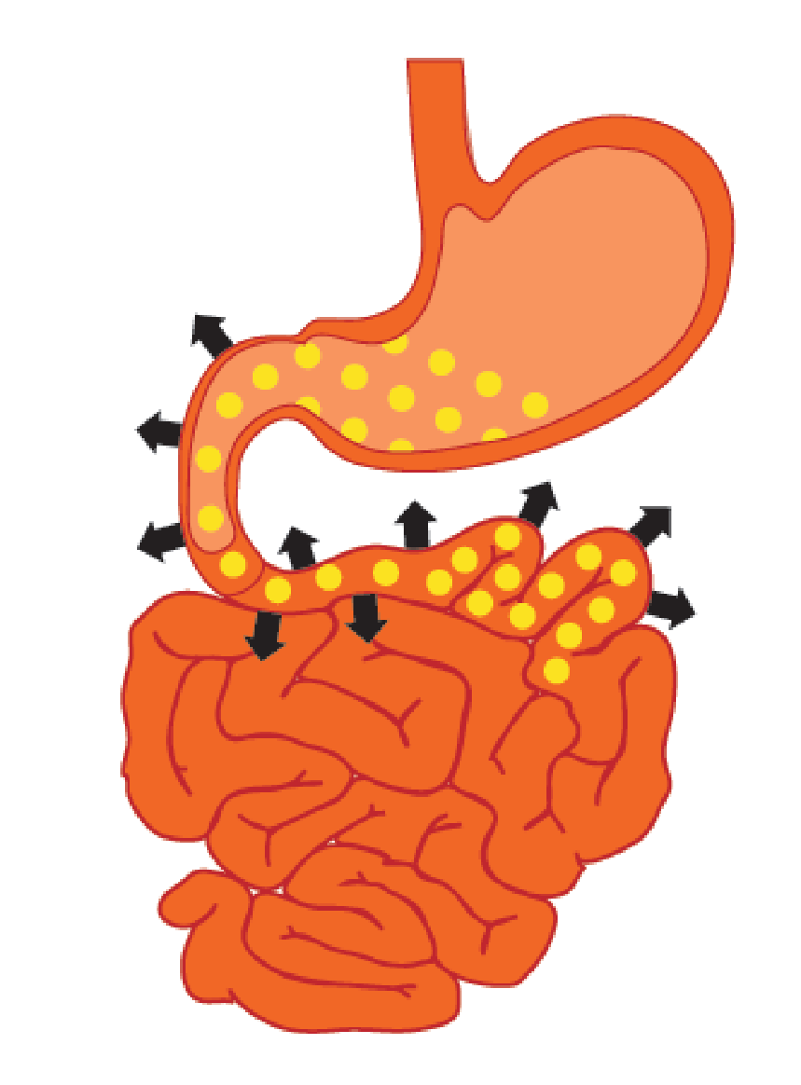
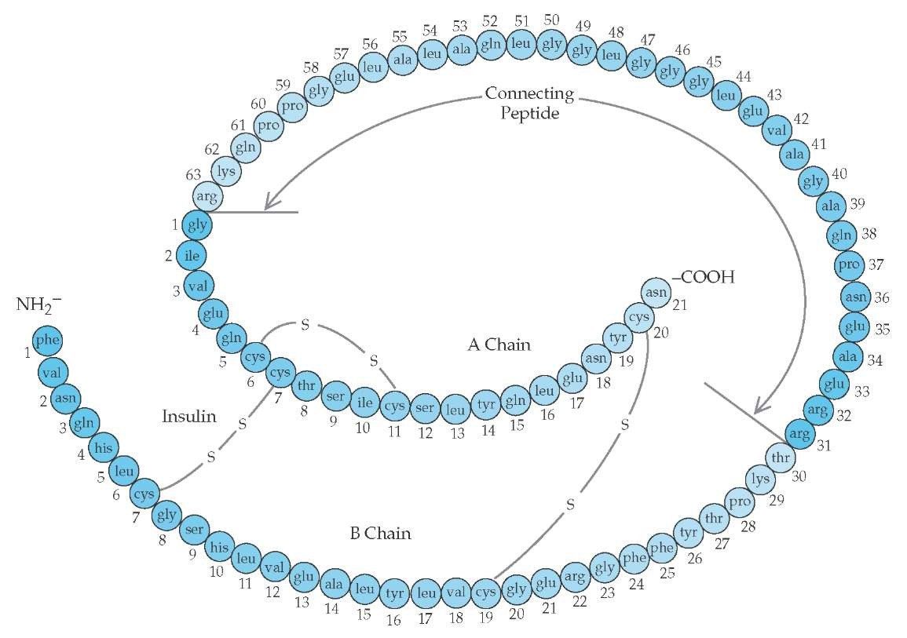
NORMAL PHYSIOLOGY
Eat starch
Broken down into glucose
Glucose is absorbed in blood
Carried to the cells in the body via circulatory system
Stimulates the pancreas to secrete insulin hormone
Metabolizes glucose for useable energy

Slide 28
NORMAL PHYSIOLOGY
Glucose must enter the cell to be useful
Cellular respiration = ATP production
Must pass through the cell membrane
Insulin binds to a receptor on the target cell and allows glucose to enter
Happens via a glucose channel
Without insulin, glucose cannot penetrate the cell membrane!!!!!

Slide 29
DIABETES
Inability of glucose to enter the cell
Blood glucose levels go high
Type 1
Body’s inability to make sufficient insulin
Can regulate
Type 2
Body’s inability to effectively use the insulin that it does produce
Cellular resistance = no binding
Blood sugar rises
Beta cells produce more insulin
Beta cells exhaust themselves and insulin levels then drop

Slide 30
WHAT HAPPENS?
Treatment for diabetes:
Type I – individuals can regulate by monitoring their sugar levels by monitoring blood and injecting insulin as needed
Type II - can sometimes regulate through diet and exercise
There is no cure for diabetes… yet

Slide 31
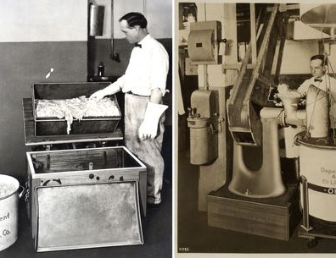
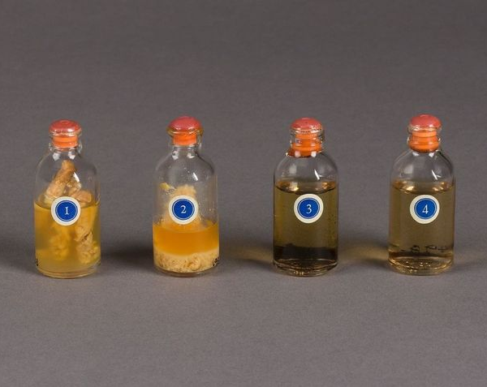
HISTORY OF INSULIN USE
Non-synthetic
Extract insulin from pig and cow pancreas
More than two tons of pig parts were needed to extract just eight ounces of purified insulin
Synthetic
Rise of diabetes
Now genetically engineered and manufactured by BACTERIA!!!
1982 – first commercially successful product made by recombinant DNA technology

Slide 32
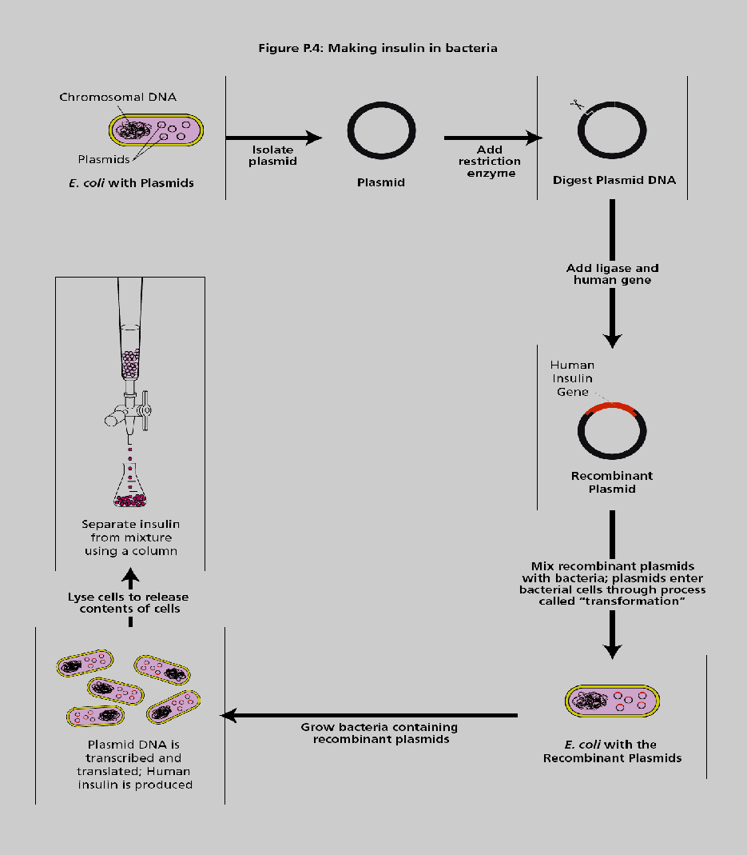

Slide 33
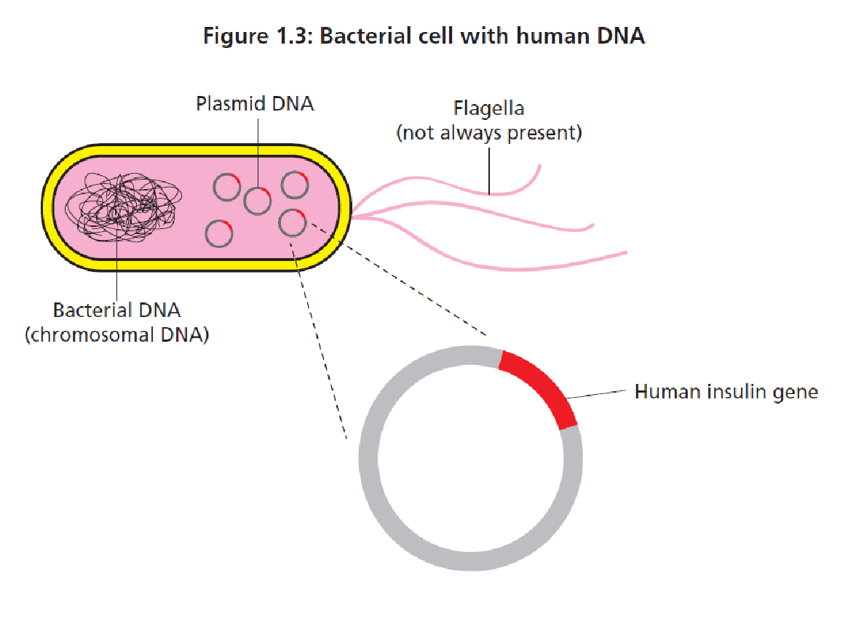
WHAT ARE THE STUDENTS DOING?
Problem:
How can we mass-produce a useful protein?
Solution:
Take the gene for the protein from the organism that makes it and put it into something that will make large quantities of that protein.

Slide 34
HOW DO THEY DO IT?
Procedure:
Find the gene that makes the protein
Cut the gene out
Put the gene into a carrier
Use the carrier to insert the gene into bacteria
Turn on the gene so the bacteria makes the protein

Slide 35
HOW DO THEY DO IT?
E.coli with a human gene
Making new proteins in bacteria
The challenge:
Transform bacteria to produce a red fluorescent protein
chimera of prokaryotic and eukaryotic genetic elements
Prokaryotic elements:
Plasmid
Eukaryotic elements:
rfp gene from sea anemone (encodes mFP)
Transform E. coli
Purify protein using chromatography column
The BIG idea?
DNA PROTEIN TRAIT

Slide 36
PROCEDURES INVOLVED
Red Fluorescent Protein
Restriction Digest (cut the rfp gene out)
Ligation (put the rfp gene into a plasmid) Lab Exchange Only
Confirmation
Transformation (put the plasmid with rfp into a bacteria)
Culture the bacteria, isolate and purify the protein

