Slide 1
Intro to LabXchange for ABE

Slide 2


What is LabXchange?
LabXchange is a global science classroom open to every curious mind.
Created at Harvard University with support from the Amgen Foundation, this powerful digital tool makes high-quality science education accessible and gives learners and educators, everywhere, the courage to chart a meaningful path in science—for FREE!

Slide 3




How LabXchange Can Help!
20,000+ Science Resources Content from over 150 credible collaborators.
Simulations & Interactives Learners can experiment risk free and experience real science.
Personal Dashboard
Find, organize and share your favorite content.
Customization & Creation Tools Customize and create content to personalize learning for students.

Slide 4
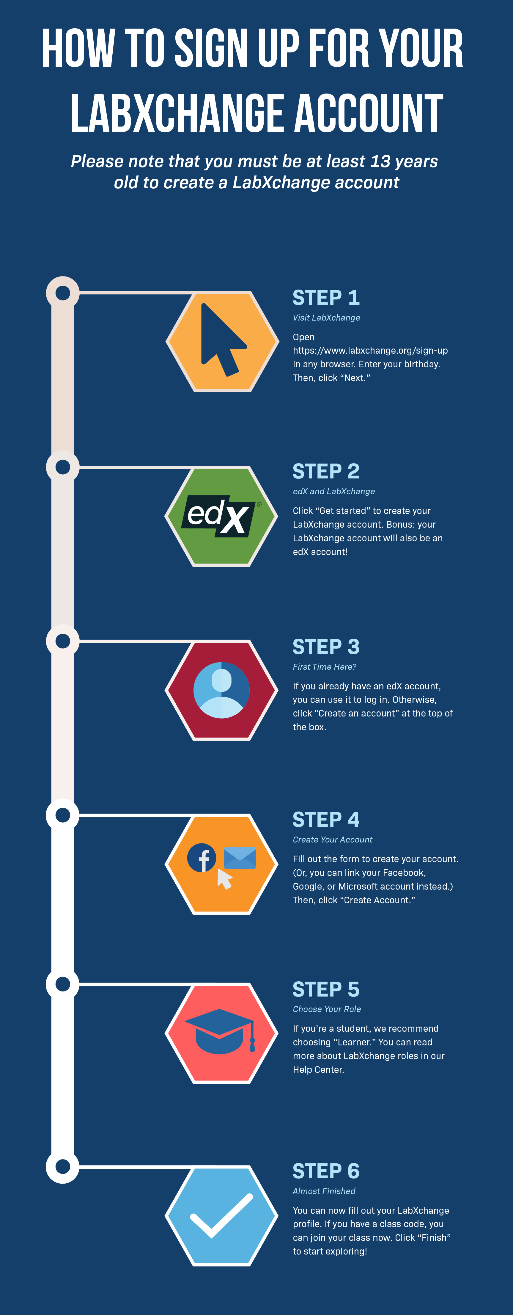

Slide 5
Creating a LabXchange Account
https://www.labxchange.org/library/pathway/lx-pathway:0c014f7f-089c-4f50-b304-48a4b6a39469/items/lx-pb:0c014f7f-089c-4f50-b304-48a4b6a39469:lx_image:998e8696

Slide 6
Creating an ABE Profile
The video shows ABE teachers how to:
add ABE to their LabXchange profiles,
search for other ABE members on the platform.
https://www.labxchange.org/library/pathway/lx-pathway:0c014f7f-089c-4f50-b304-48a4b6a39469/items/lx-pb:0c014f7f-089c-4f50-b304-48a4b6a39469:video:901a90f5

Slide 7

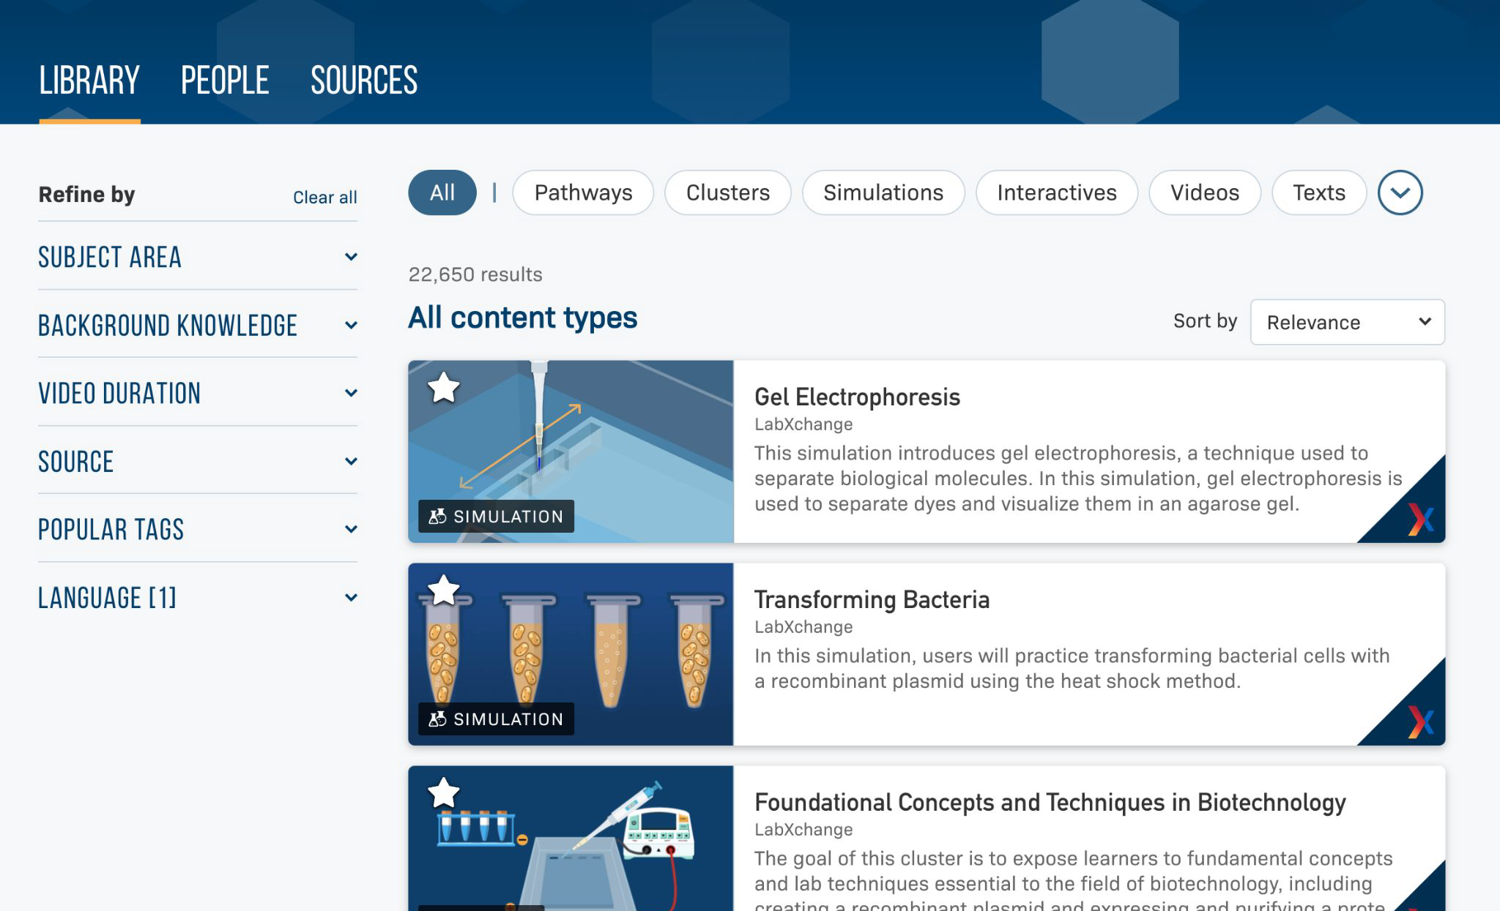

Our Library
20,000+ High Quality Science Resources Content from over 150 credible collaborators.

Slide 8
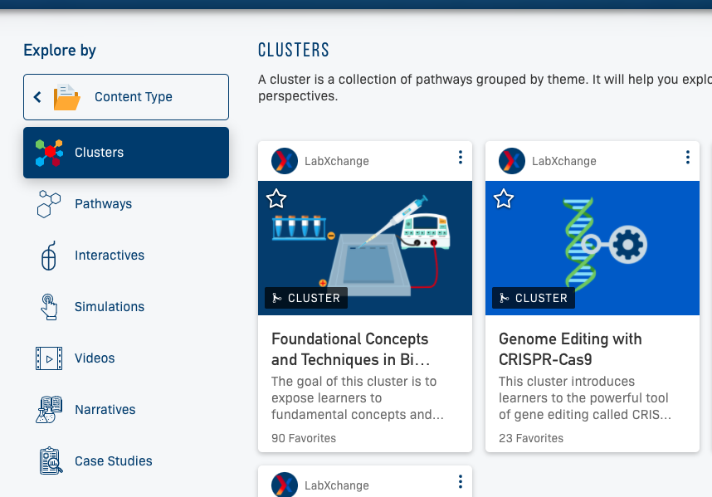
Resource types
LXC Content:
Library
Pathways
Clusters
Notes:
Resources are arranged in different ways:

Slide 9
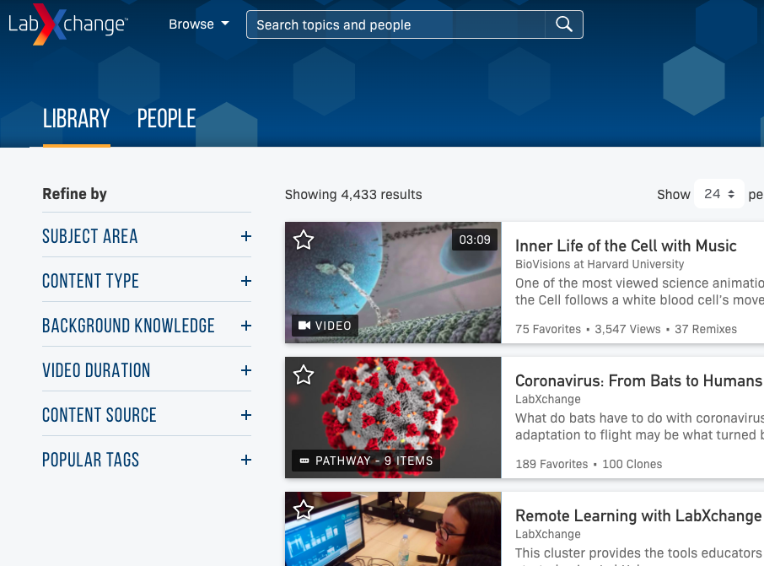
content
All pieces of LXC content are stored in the library
Use “favorites” function to keep track
Notes:
Video clips, readings, interactives, simulations, images, etc
Use “favorites” function to keep track of ones you like.
No account/sign in necessary to access the library content

Slide 10
Using the LabXchange Library
The video demonstrates to ABE teachers how to use the LabXchange library. It shows them how to:
search through available resources
filter them by type, language, subject area, and more
https://www.labxchange.org/library/items/lb:LabXchange:62ff5161:video:1

Slide 11
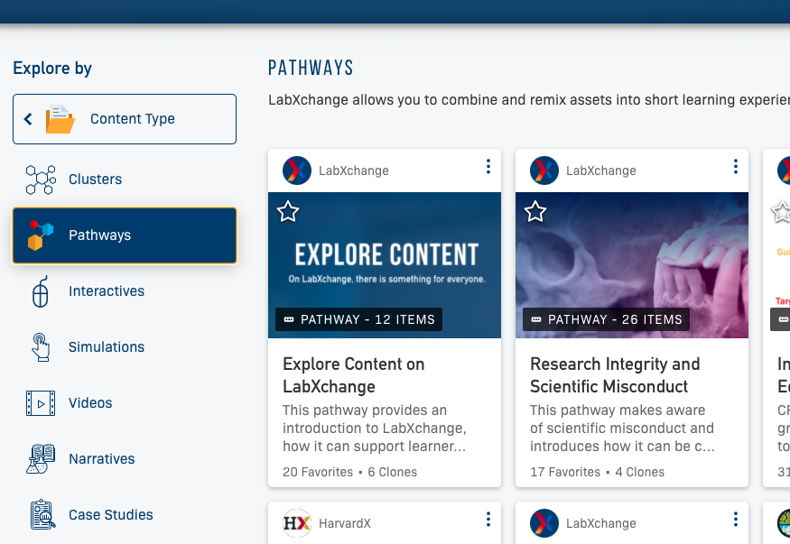
pathways
Pathways can be found in the library and under the “explore” function.

Slide 12
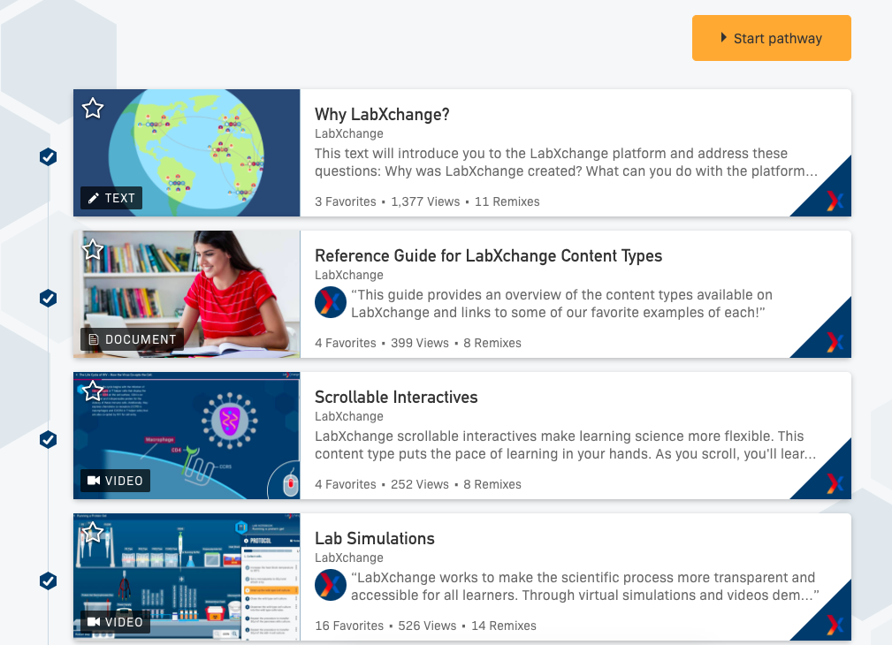
pathways
Pathways are content pieces grouped sequentially about a particular topic.
Notes:
You can use preexisting pathways as is, clone and modify them, or make your own.

Slide 13
clusters
Clusters are groups of pathways by topic (also in library or explore)

Slide 14

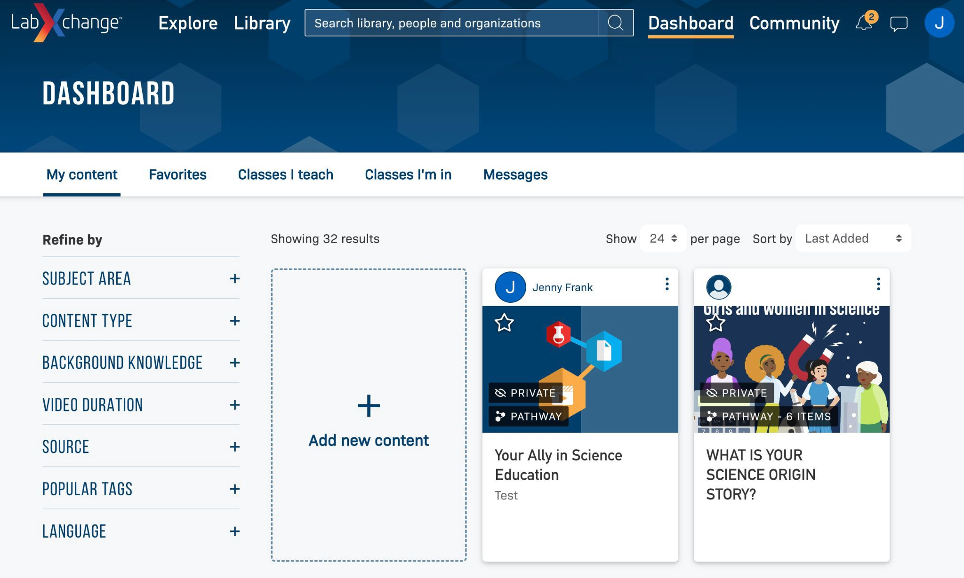

Your Personal Dashboard
Personal Dashboard Find, organize and share your favorite content.

Slide 15
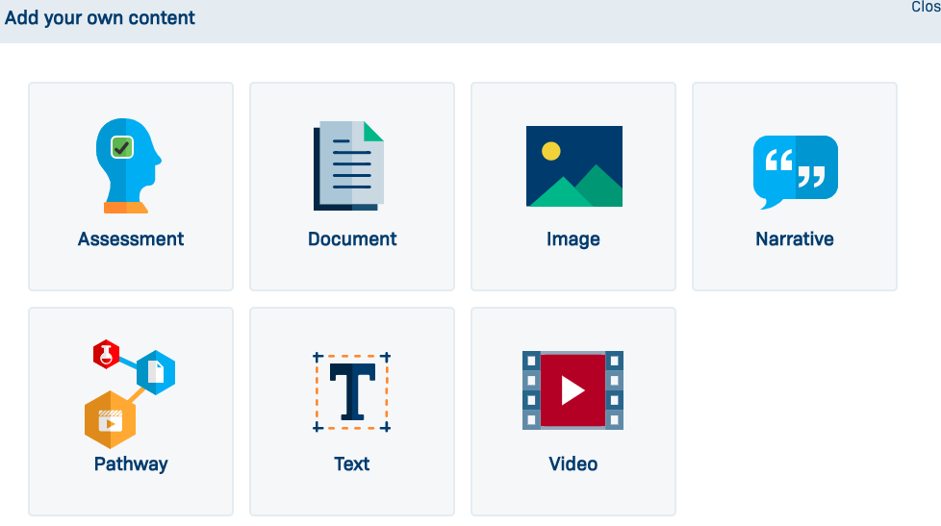
Create/add your own content
From the Educator Dashboard

Slide 16
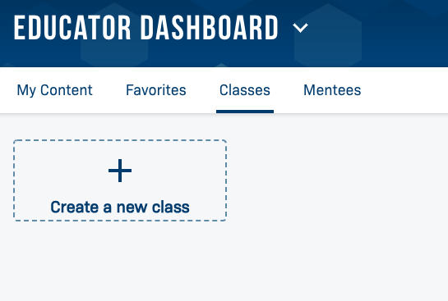
Classes
Also from the Educator Dashboard, click the “Classes” tab
Notes:
sequence of pathways and/or lessons that would be covered in a class; allows you to track learners’ progress, add assessments, etc.

Slide 17
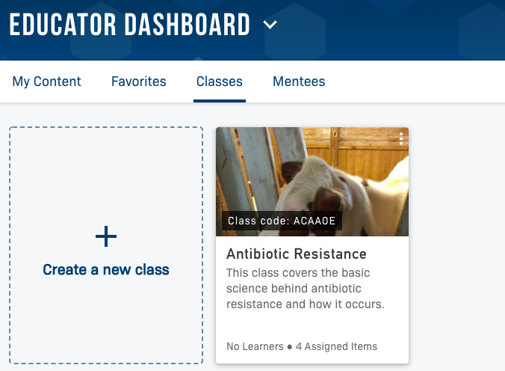
Creating a class
Create Class
Add Content
Students Register (class code)
Monitor Progress
Discussion Boards

Slide 18
Creating a Class on LabXchange
how ABE teachers can create a LabXchange class for their students.
https://www.labxchange.org/library/items/lb:LabXchange:f6bdc5f0:video:1

Slide 19
ABE Related Content on LabXchange
Cluster: Foundational Concepts and Techniques in Biotechnology
Notes:
Go to the cluster, Foundational Concepts and Techniques in Biotechnology, then click “Tours”

Slide 20
Creating and Adding Content to LabXchange
creating and adding content to LabXchange. It also shows teachers how to create the various types of assets as well as how to "clone" a pathway and adapt it for their learners’ needs.
https://www.labxchange.org/library/items/lb:LabXchange:840b4ec9:video:1
The ABE-focused cluster (named Foundational Concepts and Techniques in Biotechnology) contains some of the most valuable resources, since it allows for the greatest ease in browsing carefully curated assets and pathways.
https://www.labxchange.org/library/items/lb:LabXchange:ede83a61:video:1

Slide 21
ABE LANDING PAGE/

Slide 22
LabXchange Assets for Foundations of Biotech Labs

Slide 23
Colony PCR
https://www.labxchange.org/library/pathway/lx-pathway:9d767909-26ba-4430-9f60-3830284bc31f

