Slide 1
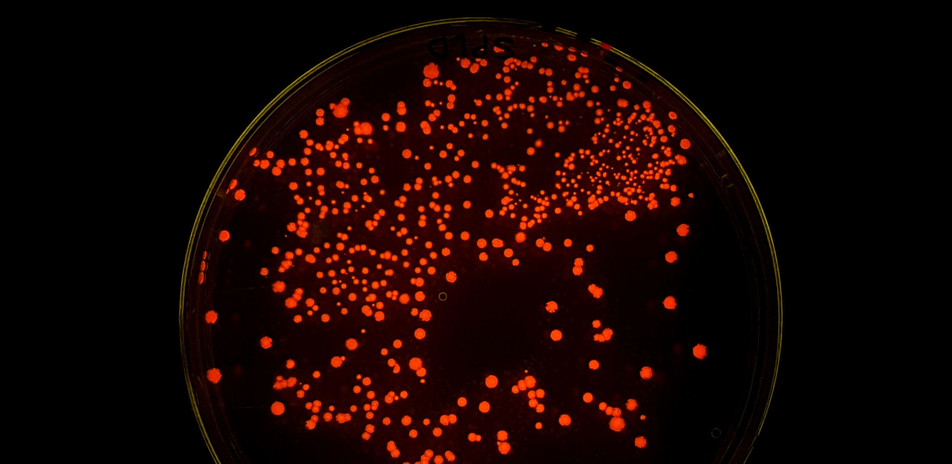
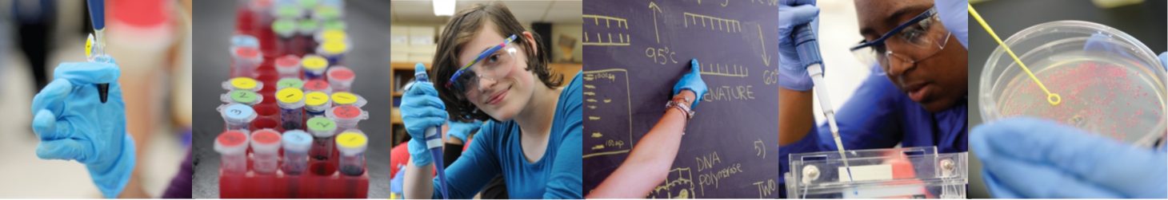

Amgen Biotech Experience
Community of Practice Network Meeting
December 2025

Slide 2
1. Biotech in the news
2. Exploring Precision Medicine
3. UK site news

Slide 3
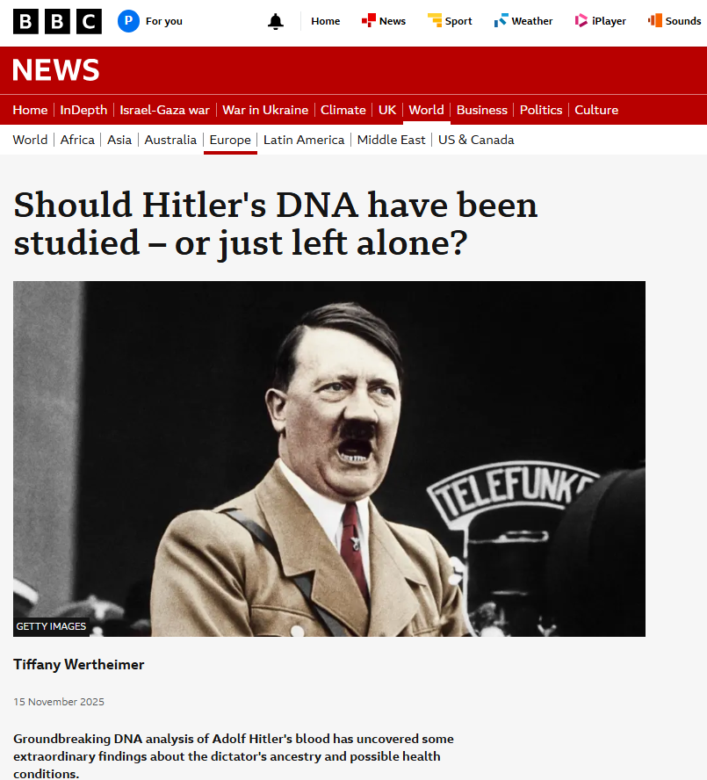
Biotech in the News
15th November
https://www.bbc.co.uk/news/articles/c5ylw4pz83do
Blood-stained swatch of fabric from Hitler’s sofa in his underground bunker
Analysed by a team of scientists led by Prof. Turi King
Results have appeared in media ahead of publication in peer reviewed journal and were reported in the C4 documentary “Hitler’s DNA: blueprint of a dictator

Slide 4
IMPORTANT TO NOTE:
There is no such thing as a ‘dictator gene’
DNA analysis results are not a diagnosis / indication of predisposition
Ethical questions – should the analysis have been done at all? Who say’s ‘Yes’ on Hitler’s behalf? Who reads beyond the headlines?

Slide 5
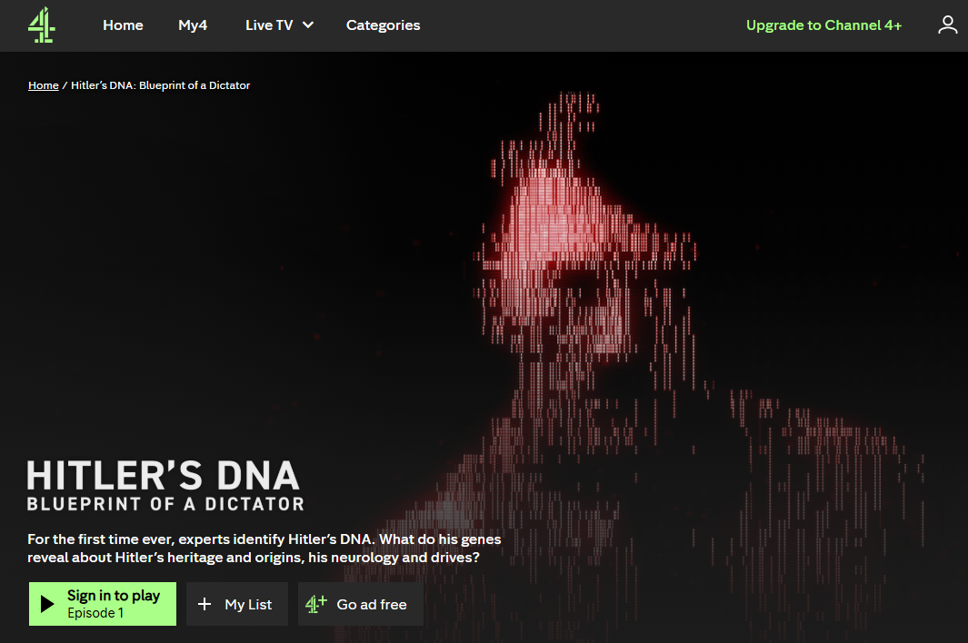
Biotech in the News
Hitler did not have Jewish ancestry (a rumour since 1920’s)
He did have Kallman Syndrome - genetic disorder - which can affect puberty and the development of sexual organs
The results showed ‘very high polygenic scores’ for a predisposition to autism, schizophrenia and bipolar disorder
"Just because you have something encoded in your DNA, doesn't mean you'll express it.“
Dr Sundhya Raman
"Going from biology to behaviour is a big jump.”
Prof Simon Baron-Cohen, director of the Autism Research Centre at Cambridge University
https://www.channel4.com/programmes/hitlers-dna-blueprint-of-a-dictator

Slide 6
Exploring Precision Medicine

Slide 7
OVERVIEW
The Exploring Precision Medicine module explores practically the connections between genes and traits. Students learn how slight genetic differences can impact how well a patient responds to certain medications and explore how future physicians may use DNA sequencing to inform clinical decision-making.
7 Chapters of Activities
Full sequence: 15 days / 3 weeks of activity based a class meeting daily for ~50 mins
Lab Only sequence: ~5 days
Series of webinars on YT, released monthly, issued by the PO,
https://tinyurl.com/ABE-EPM

Slide 8
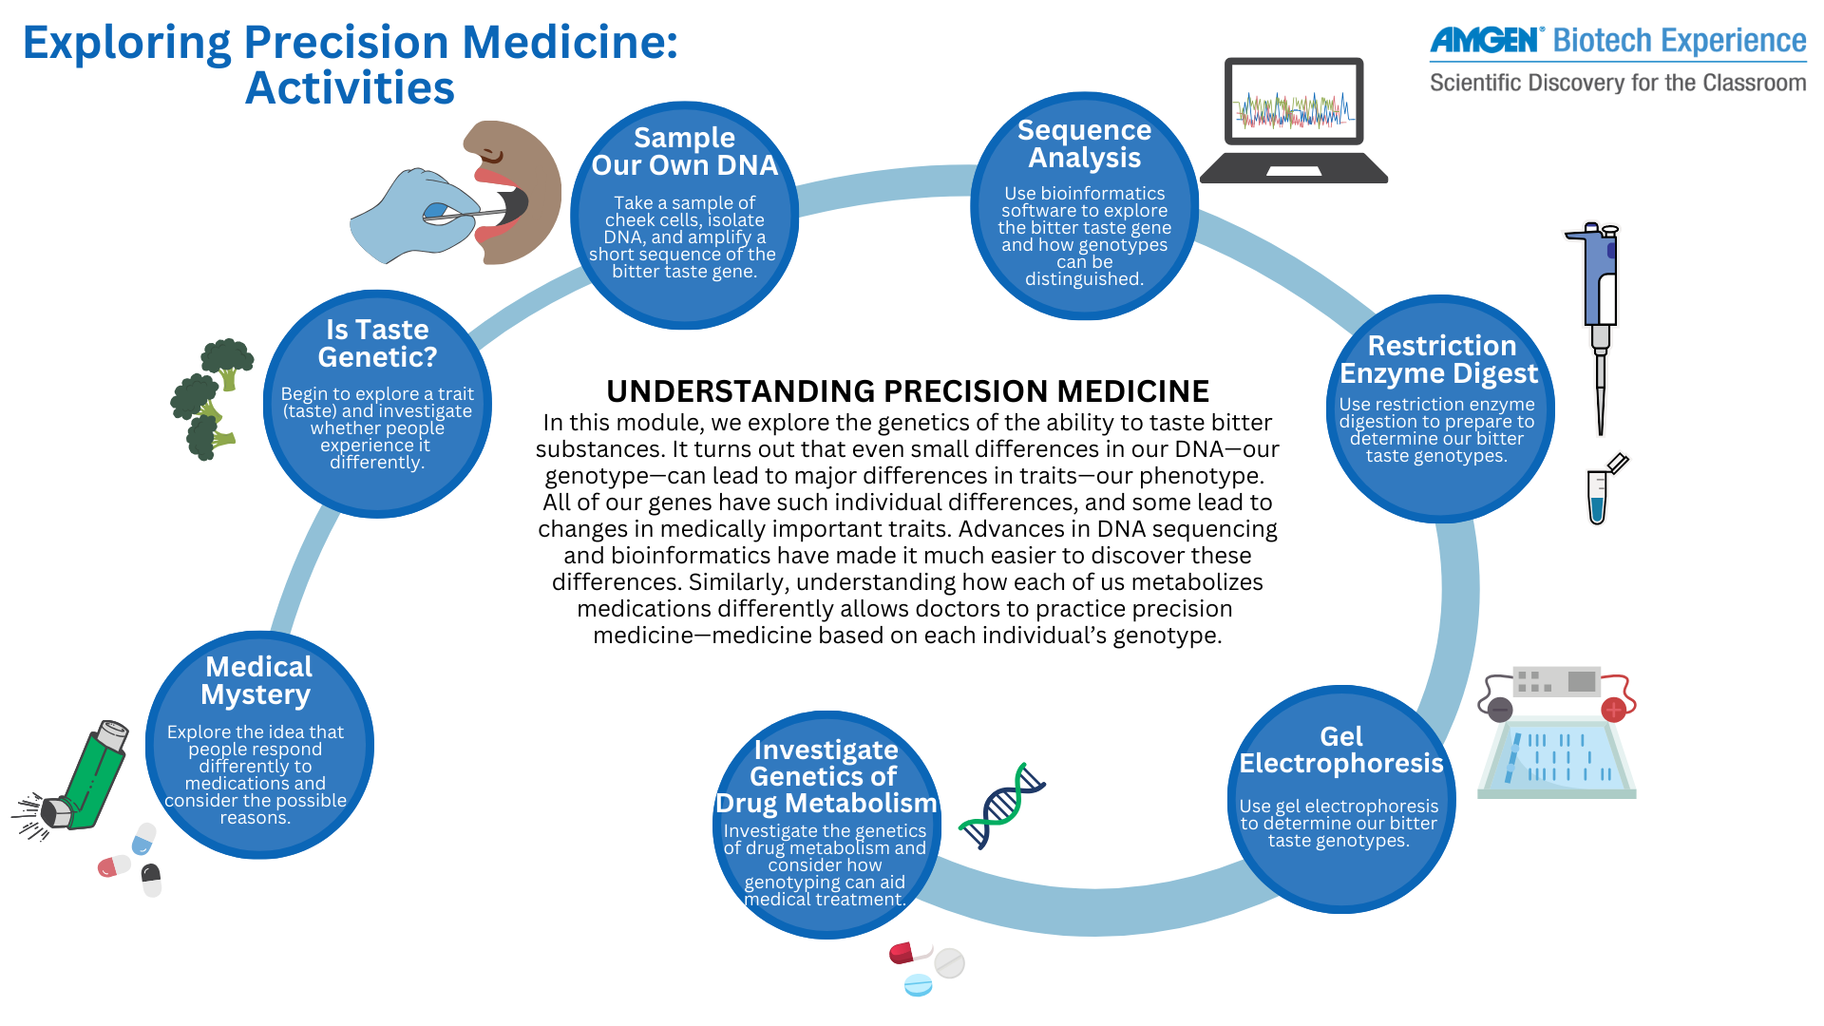

Slide 9
Exploring Precision Medicine
“WET” labs
PTC Testing
Cheek Cell DNA extraction
PCR
Restriction Digest
Gel Electrophoresis
“DRY” labs
Bioethics
Analysis of published data
DNA Alignment
Food ‘Tasting’
• Engage: An opportunity to capture students’ interest, assess their prior knowledge, and frame the
central concept of the lesson
• Explore: The hands-on portion of the lesson, consisting of lab work, reading articles, screening
videos, use of analytic software, etc.
• Explain: Interactive discussion to help students connect their prior knowledge to new
understandings they have gained through exploration
• Elaborate: An opportunity for students to extend their knowledge to new situations, for example, by
researching a concept online
• Evaluate: Formal assessment of student learning

Slide 10
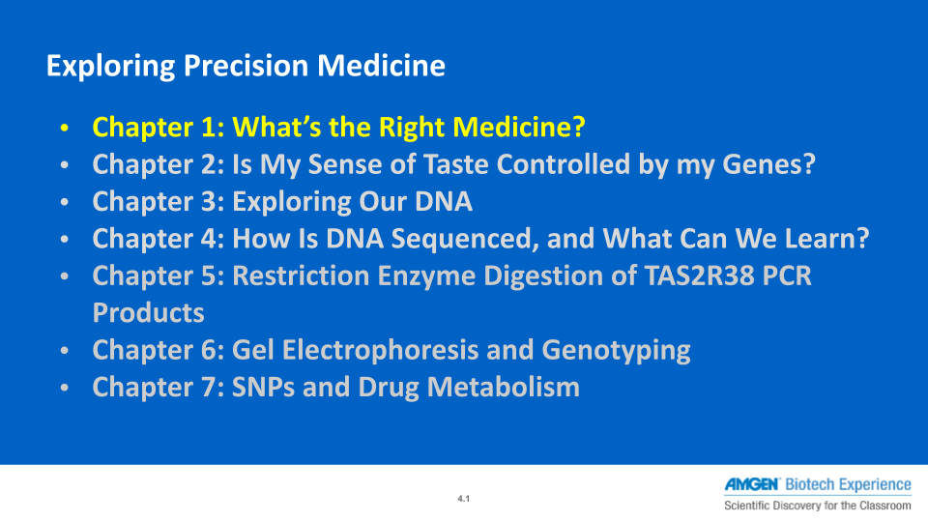

Slide 11
Site news ….
Master Teacher Fellows
Teacher Conference - FREE
Kit bookings and feedback

Slide 12
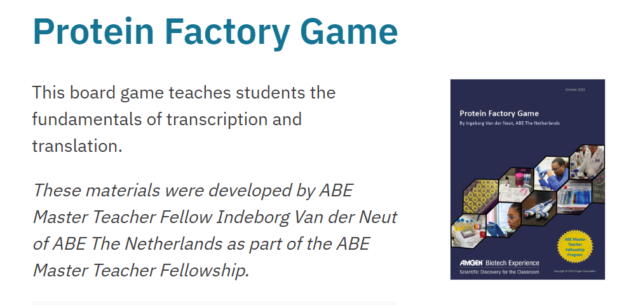
Master Teacher Fellows: teacher developed materials
Congratulations to
Alison Ackroyd – Mid Kent College
Patricia Hess – St. Georges Sch, Harpenden
Sam Ward – Thomas Alleyne, Stevenage
https://www.amgenbiotechexperience.com/curriculum-resources/teacher-developed-materials

Slide 13

FREE Teacher Conference:
18th March 2026
WT Sanger Institute …
Cutting Edge Science
Sharing Sessions
Networking
Site visit
CAMBRIDGE
Bookings will open this side of Christmas with a closing date of 23rd February. Early expression of interest can be sent to stem@herts.ac.uk and we will contact you when the form goes live!

Slide 14
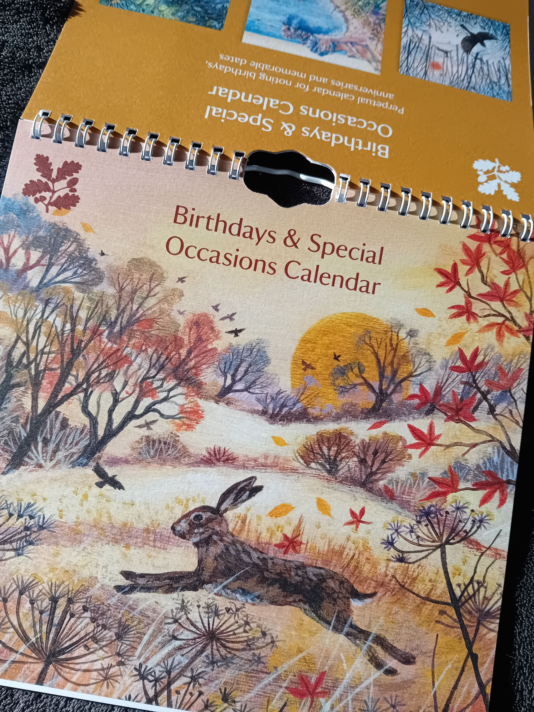
Kit Bookings
Email your hub lead ASAP if you haven’t yet booked a loan slot for 2026
Wait to hear back from them & don’t assume booking successful
Contact them closer to the time of the booking to confirm specific arrangements – car parking / time of pick-up, numbers of students taking part in the labs

Slide 15
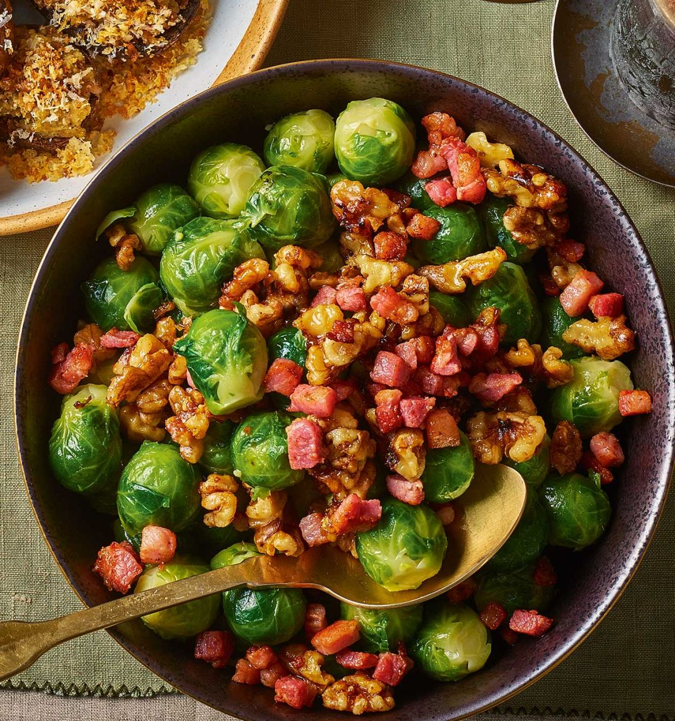
TAS2R38 & the Festive Season
FOOD | VERY BITTER (1) | SOMEWHAT BITTER (2) | NOT AT ALL BITTER (3) | salty, sweet, sour, bitter, or umami (savoury )?

Slide 16

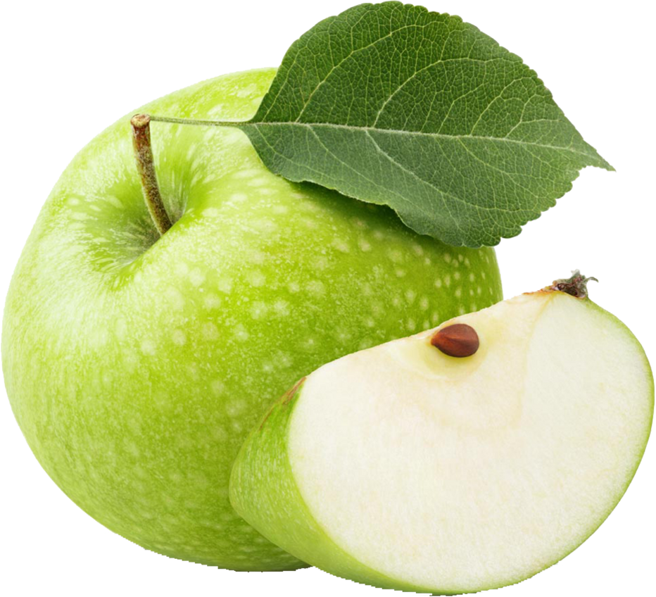
My bitterness ratings
For each food, rate its bitterness on a scale of 1 (very bitter) to 3 (not bitter)
Apples

Slide 17
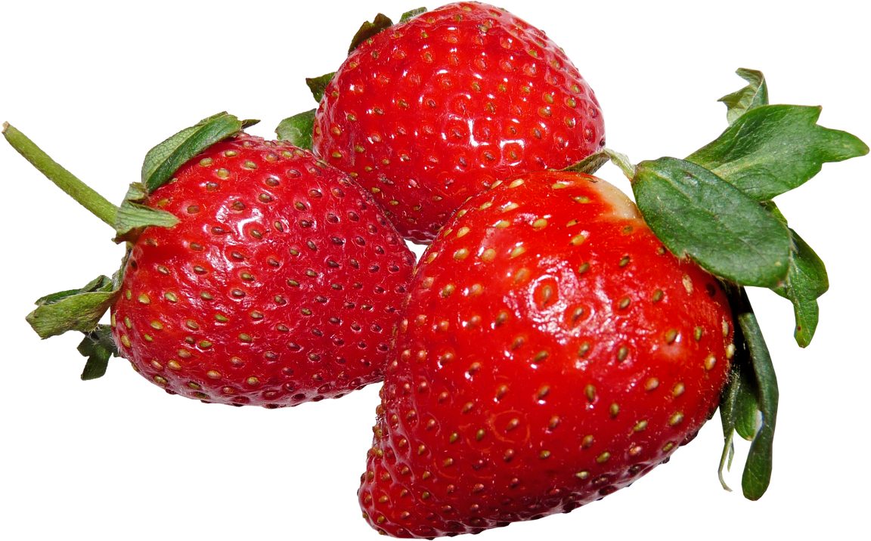
My bitterness ratings, continued
Strawberries

Slide 18
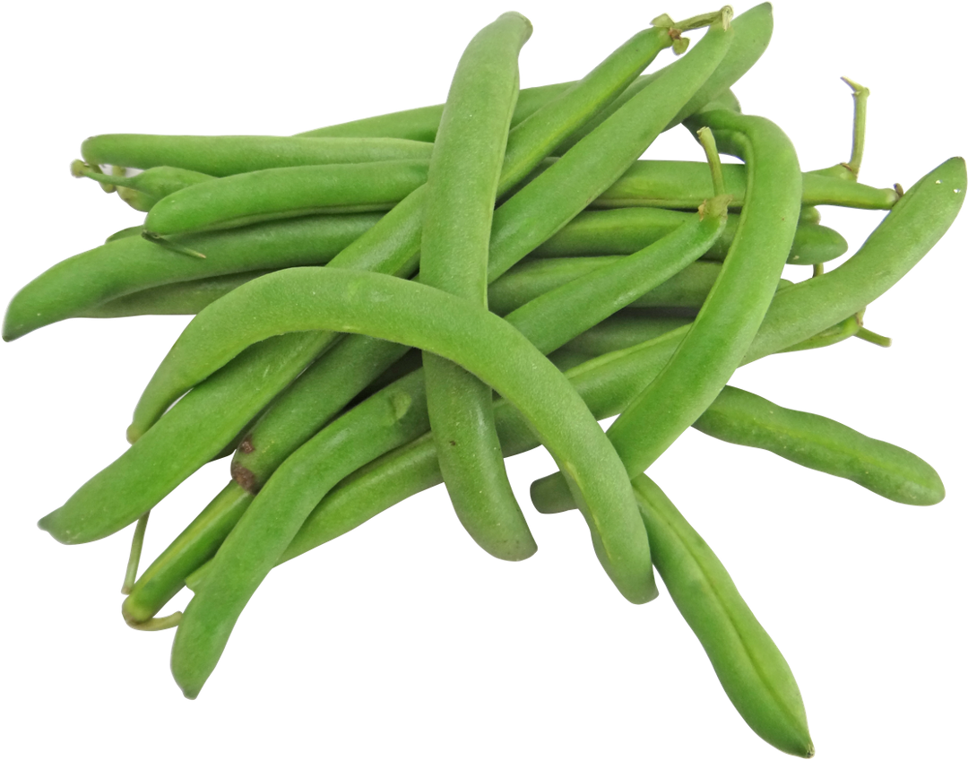
My bitterness ratings, continued
Beans

Slide 19
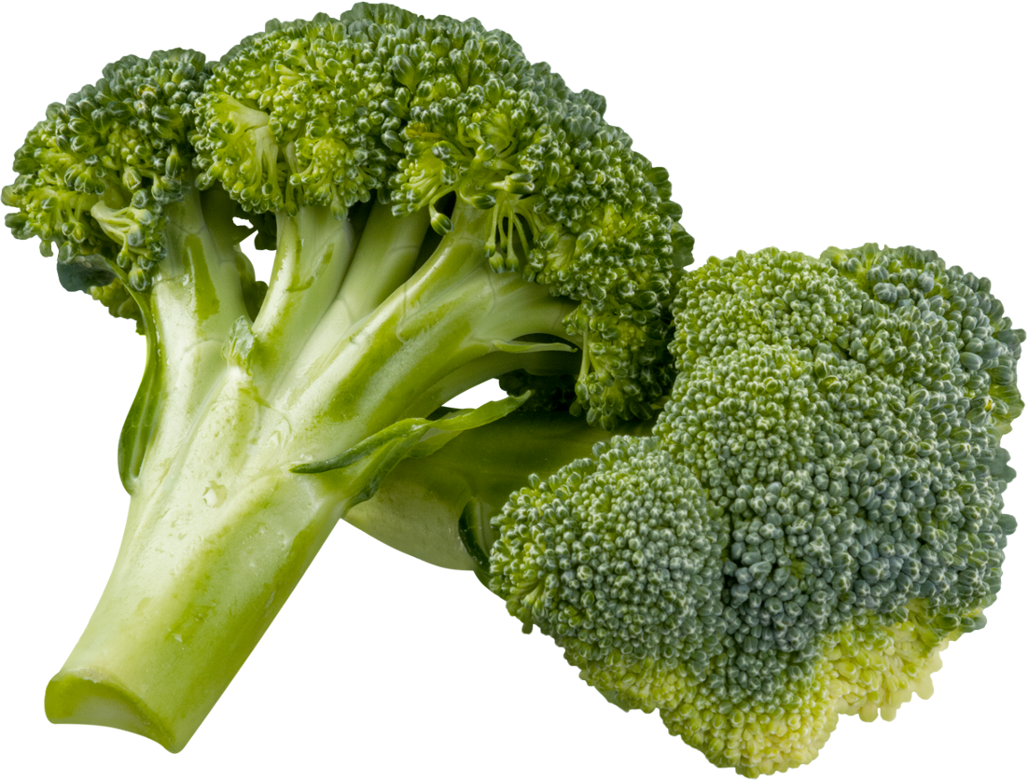
My bitterness ratings, continued
Broccoli

Slide 20
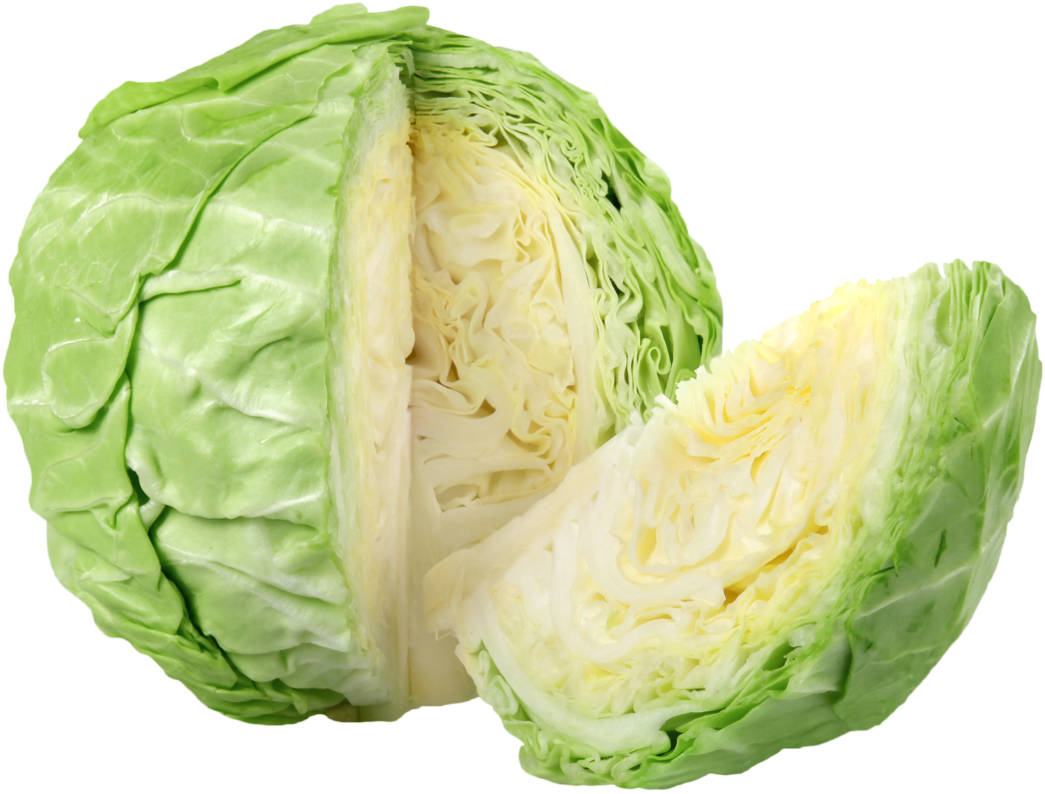
My bitterness ratings, continued
Cabbage

Slide 21
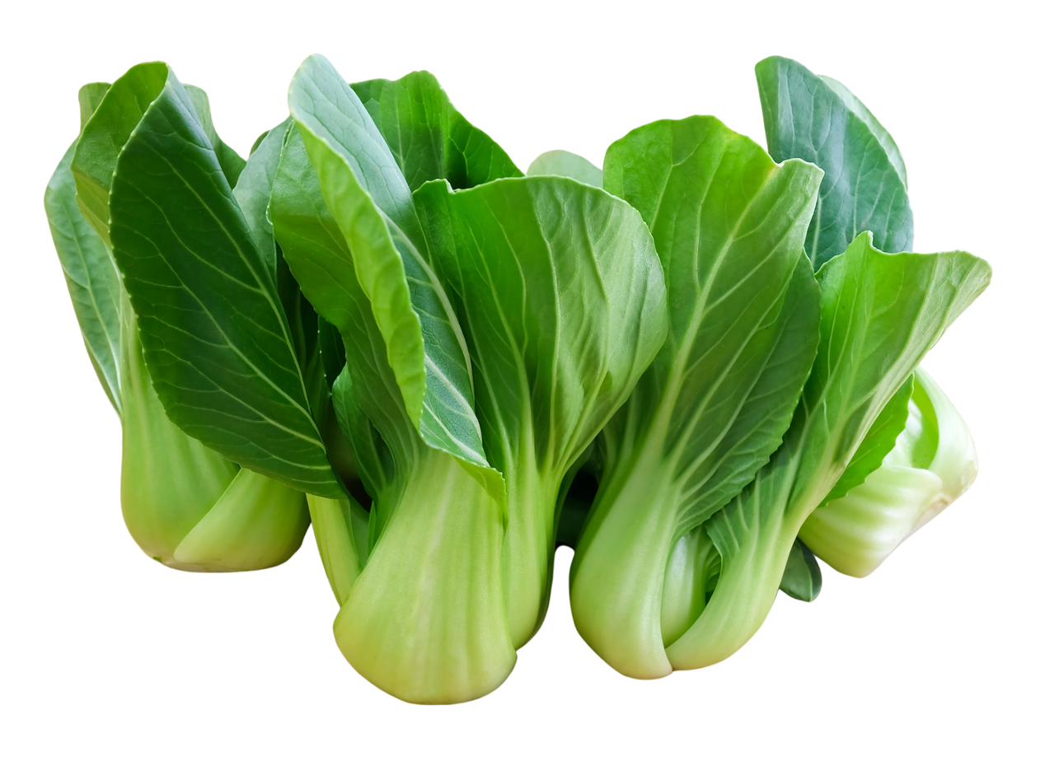
My bitterness ratings, continued
Bok Choi/Pak Choi

Slide 22
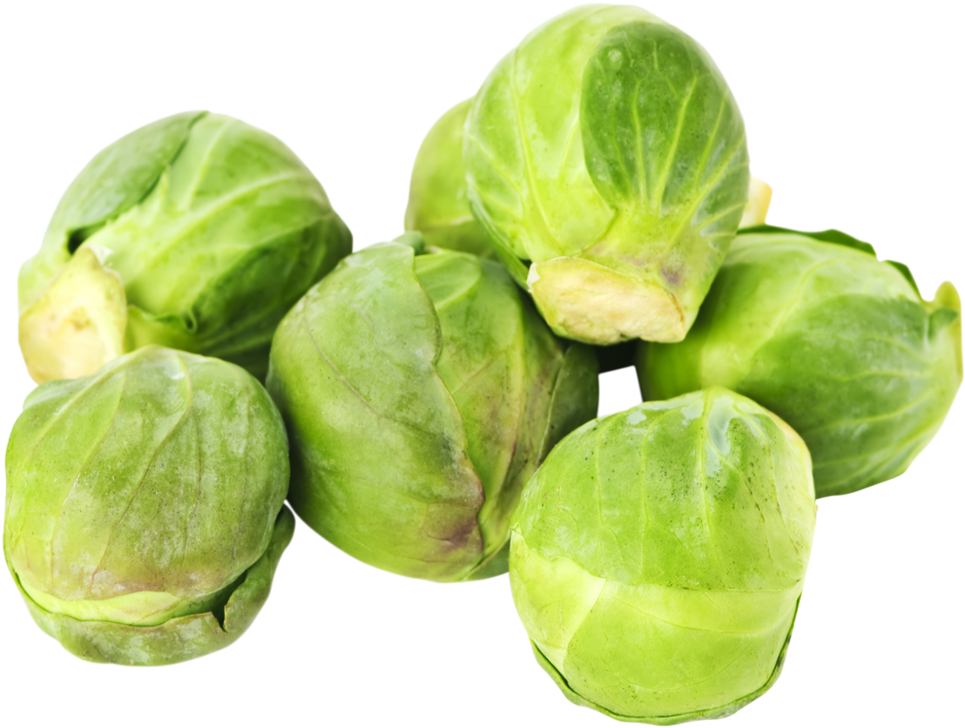
My bitterness ratings, continued
Brussels Sprouts

Slide 23
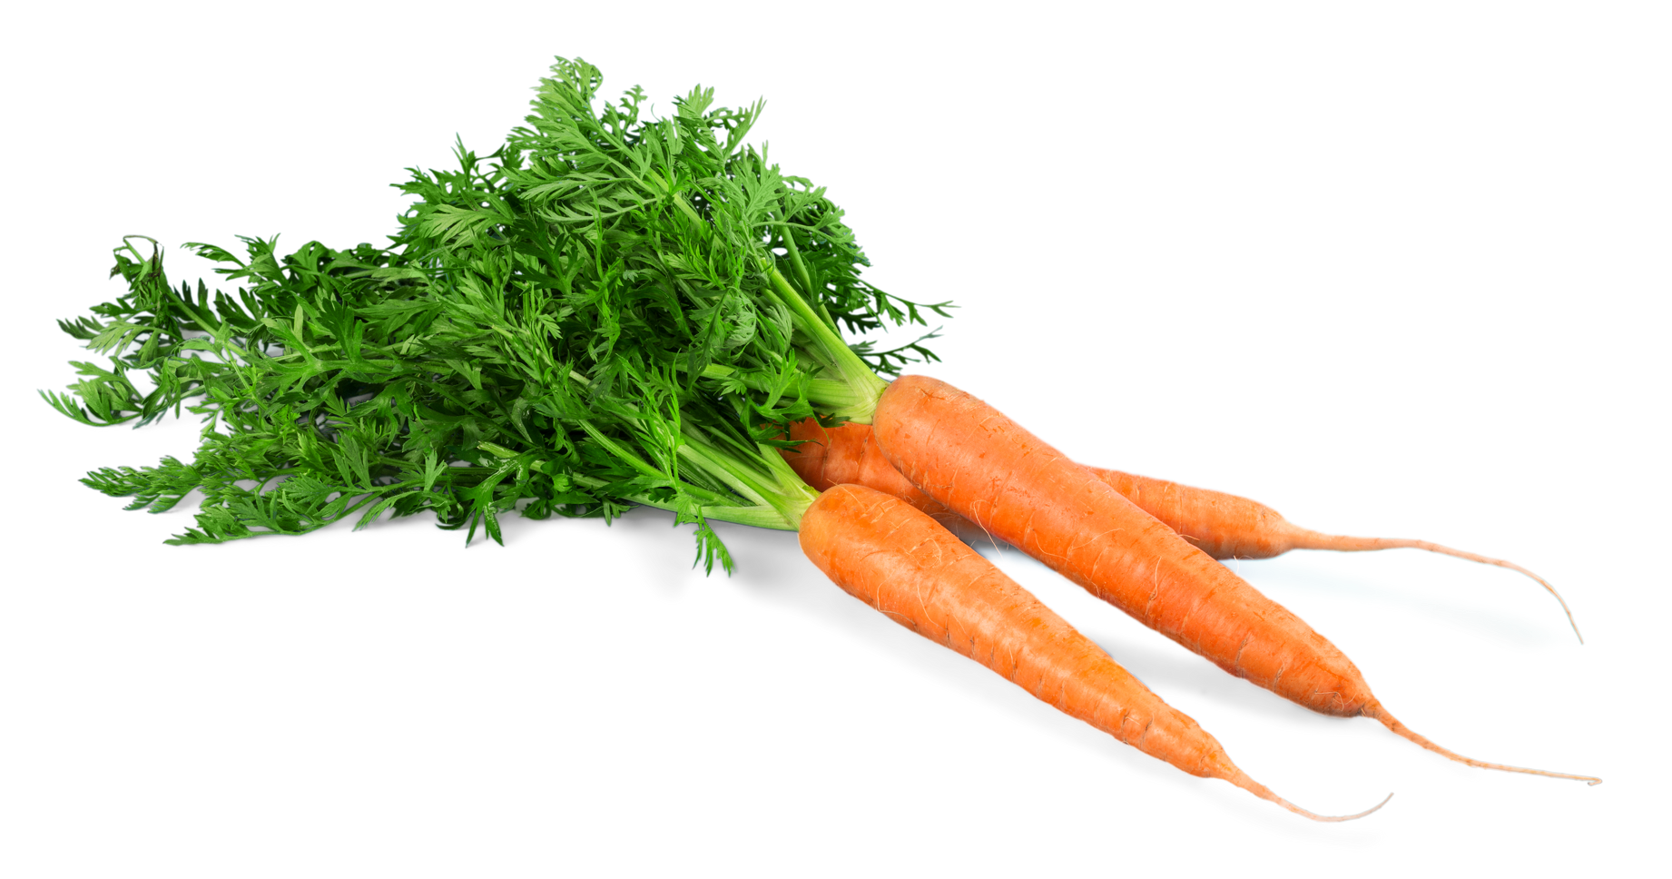
My bitterness ratings, continued
Carrots

Slide 24
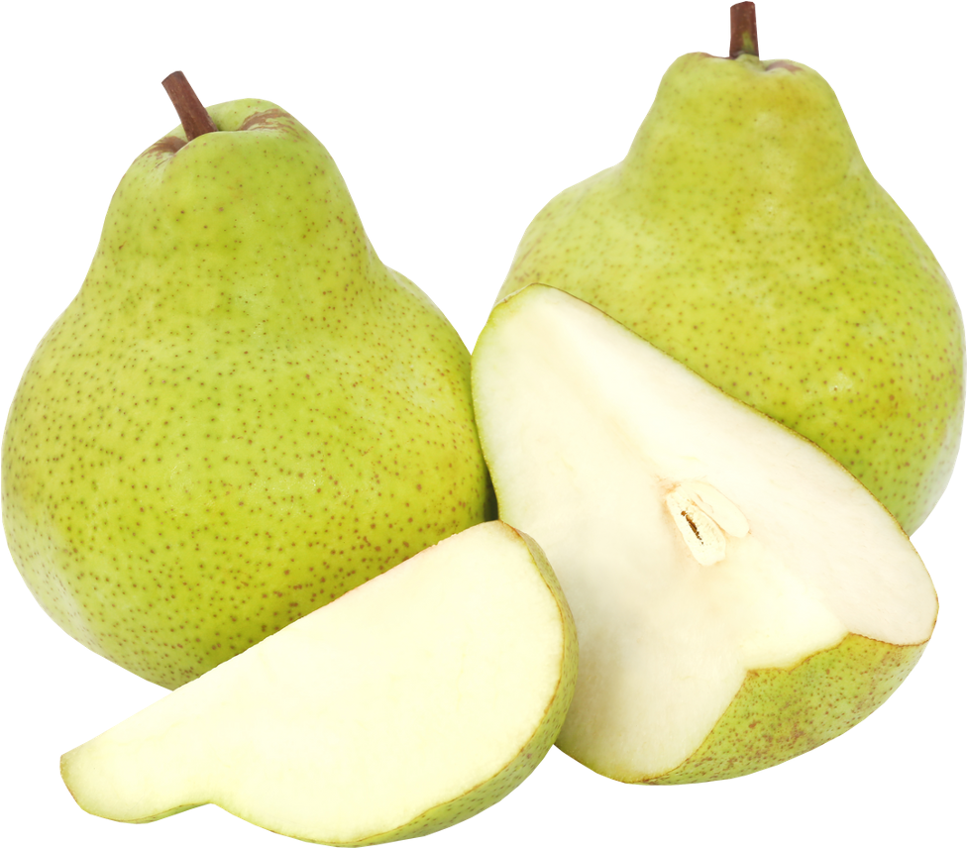
My bitterness ratings, continued
Pears

Slide 25
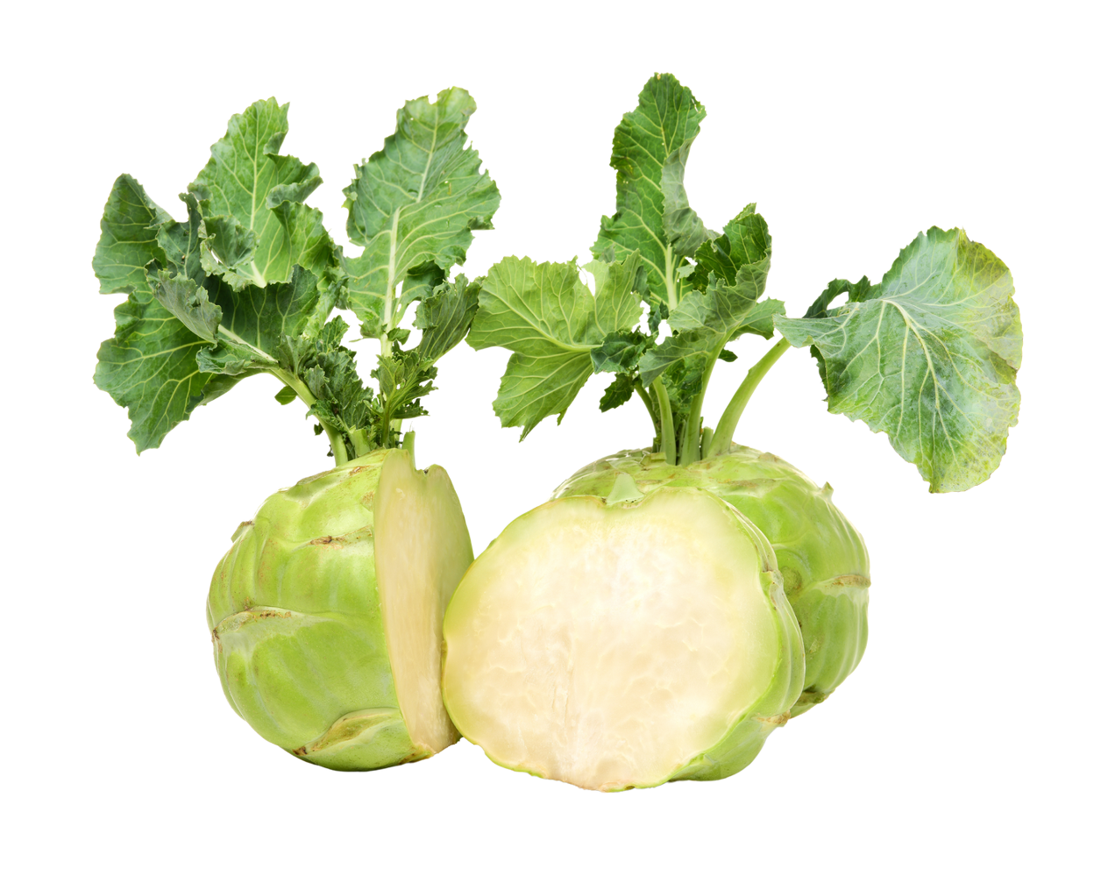
My bitterness ratings, continued
Kohlrabi

Slide 26
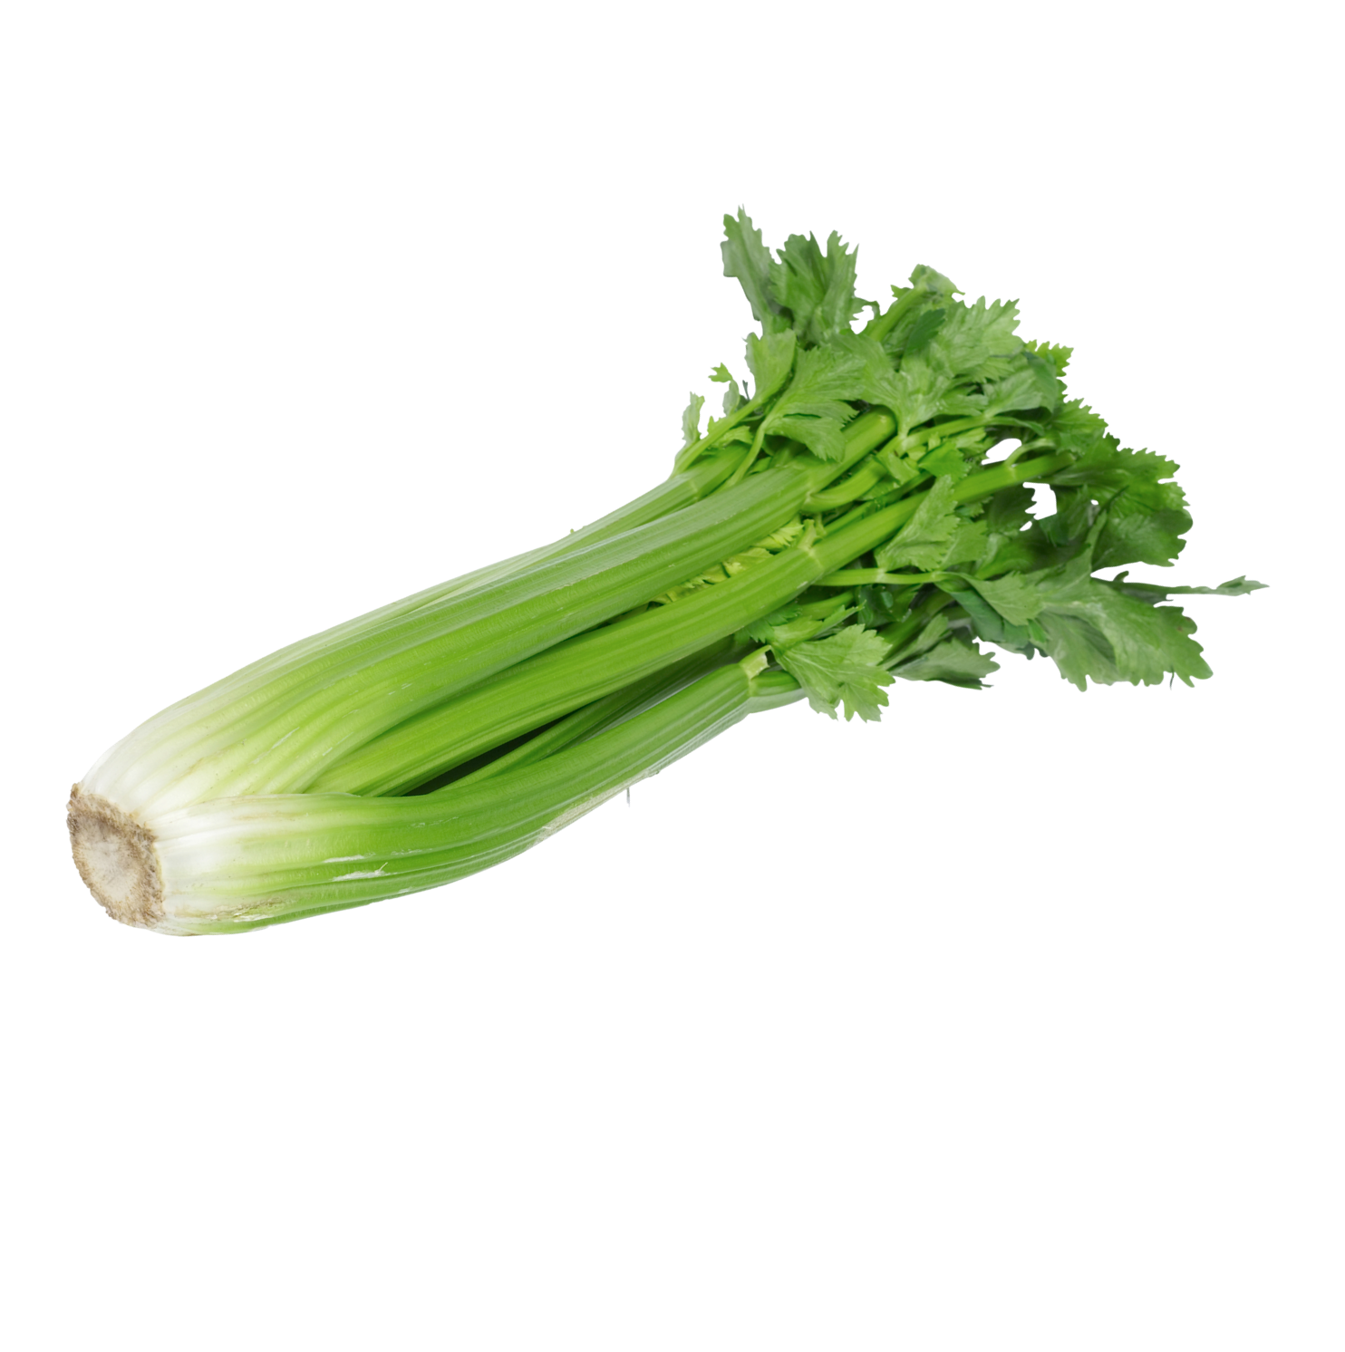
My bitterness ratings, continued
Celery

Slide 27
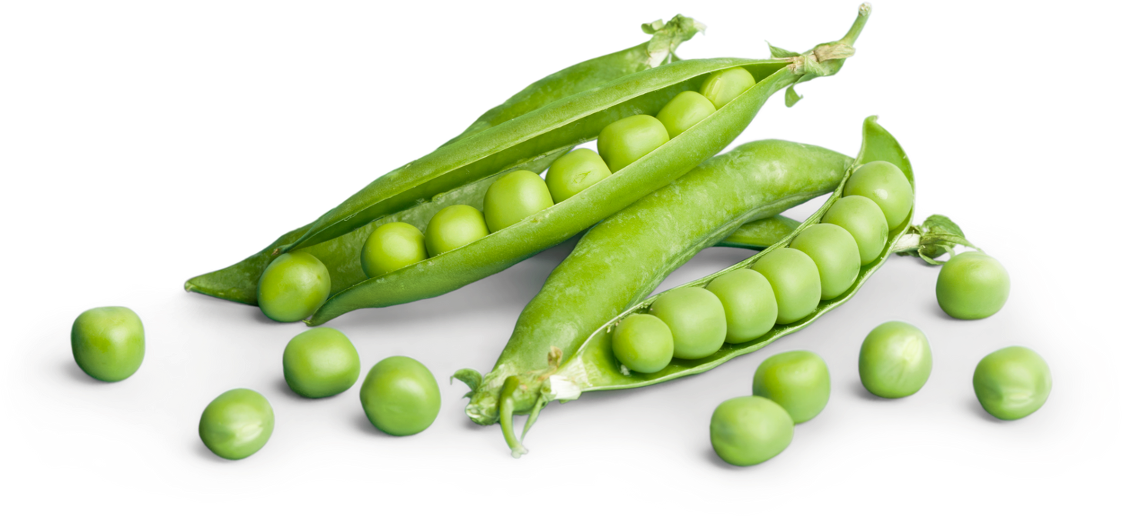
My bitterness ratings, continued
Peas

Slide 28
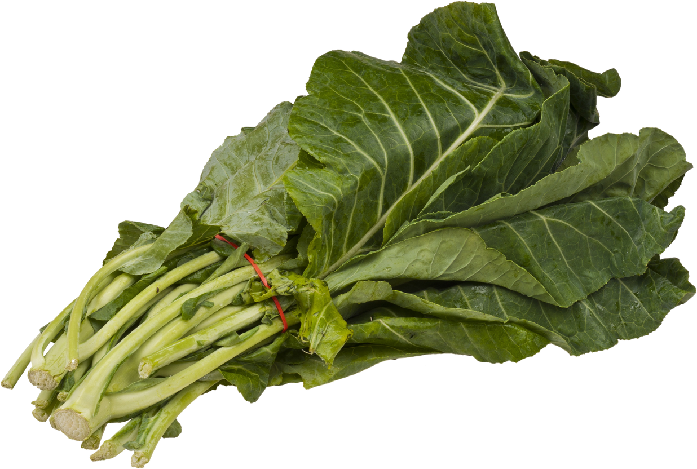
My bitterness ratings, continued
Collards

Slide 29
TAS2R38 & the Festive Season
Do you notice any groups within your data?
Which vegetables did you give the same ‘bitter rating’ ?
Did you realise that Sprouts, Collards, Cabbage, Kholrabi, Pak Choi and Broccoli are all members of the Brassicaceae
Containing the bitter-tasting compounds GLUCOSINOLATES
Known to have tremendous health benefits

Slide 30
MERRY CHRISTMAS !!!

