Slide 1
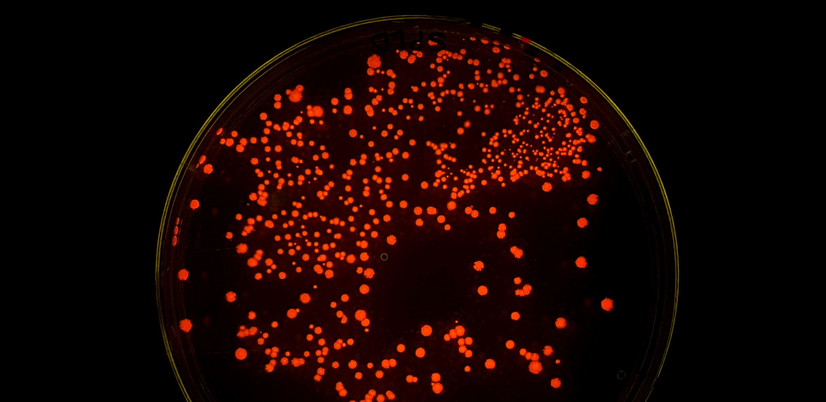
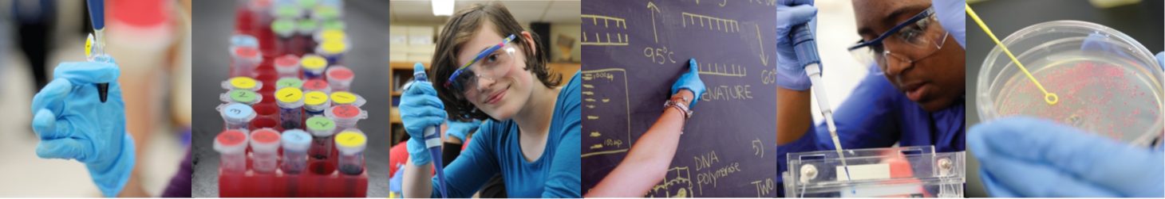

Amgen Biotech Experience
Community of Practice Network Meeting
20th November 2024

Slide 2
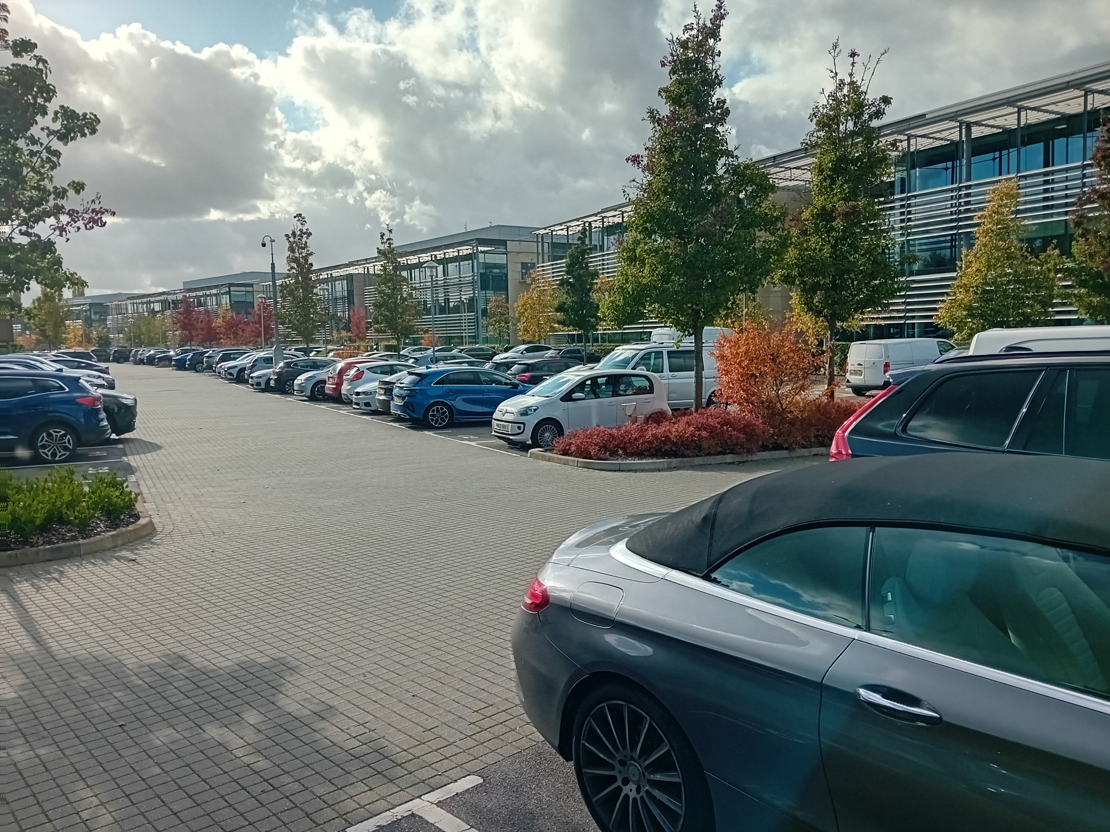
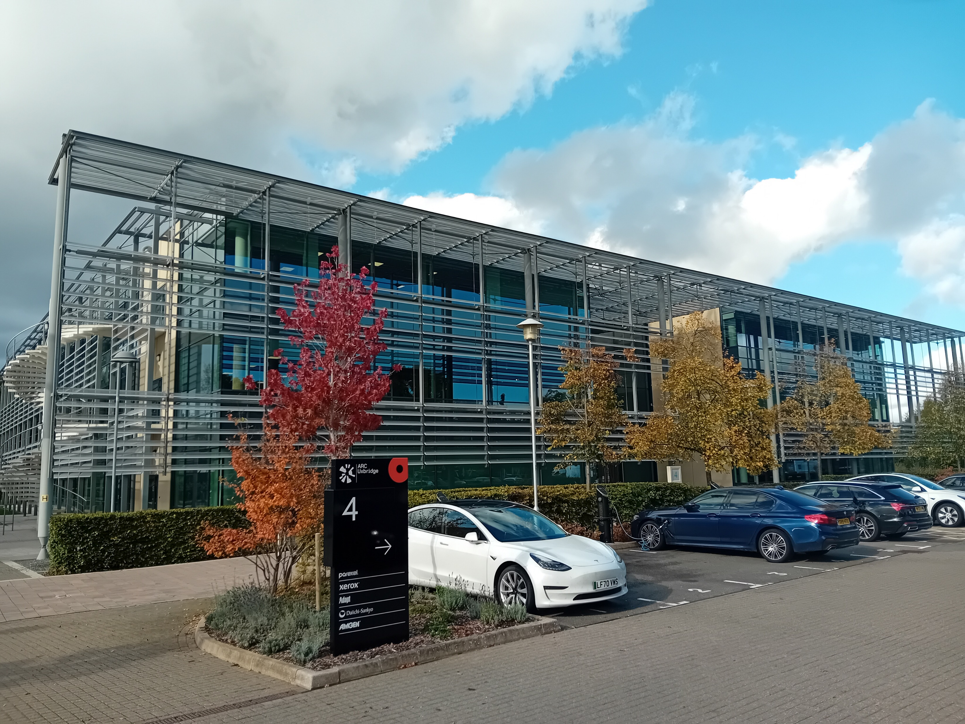
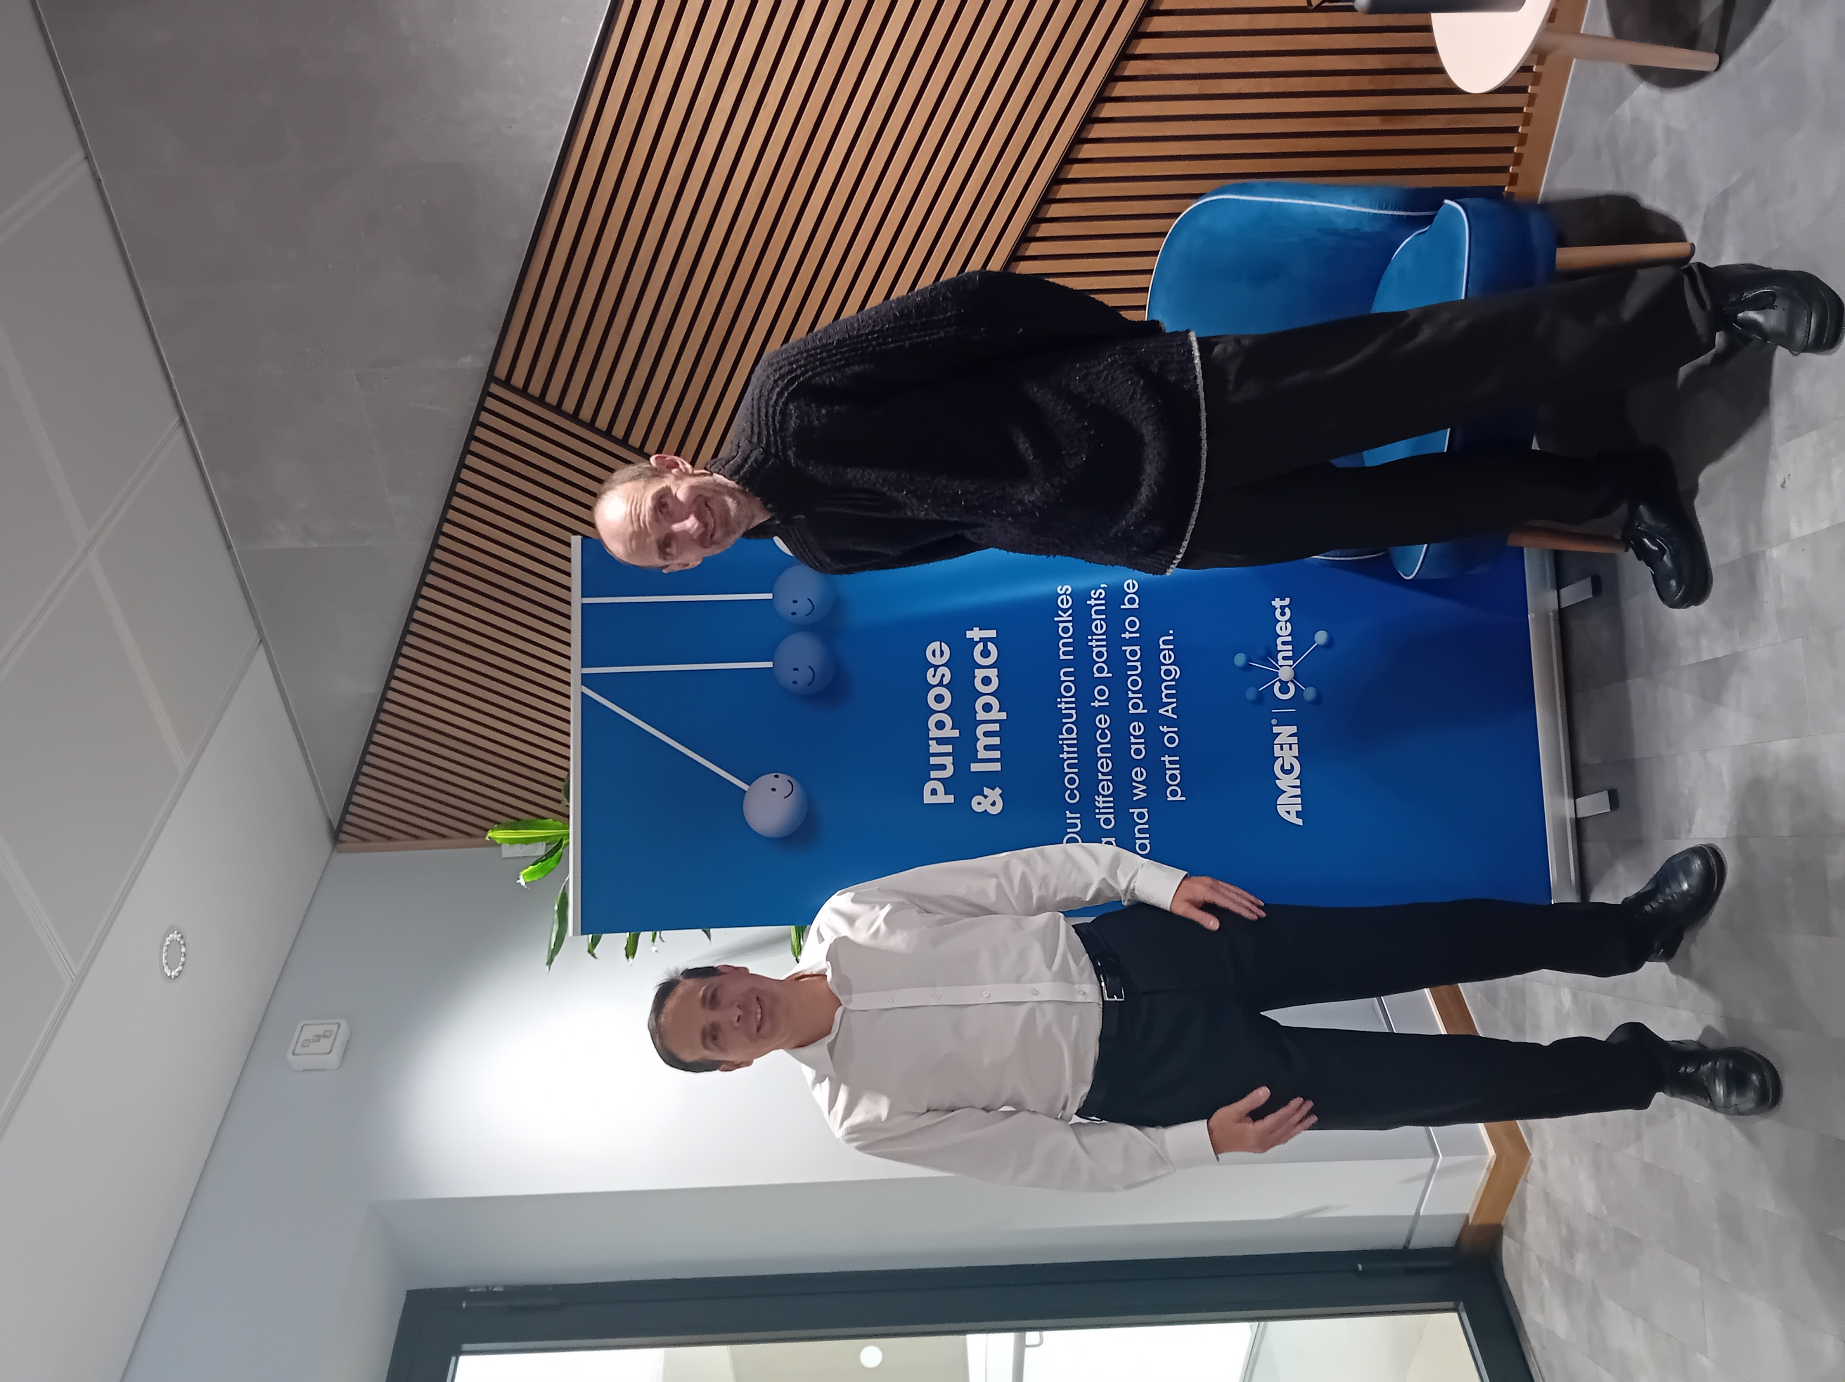
News: Visit to Amgen in Uxbridge for “Mission Week”
Amgen Biotech Experience
Community of Practice Network Meeting

Slide 3
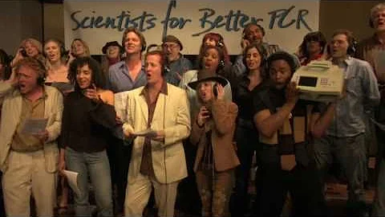
The Main Event: Polymerase Chain Reaction

Slide 4
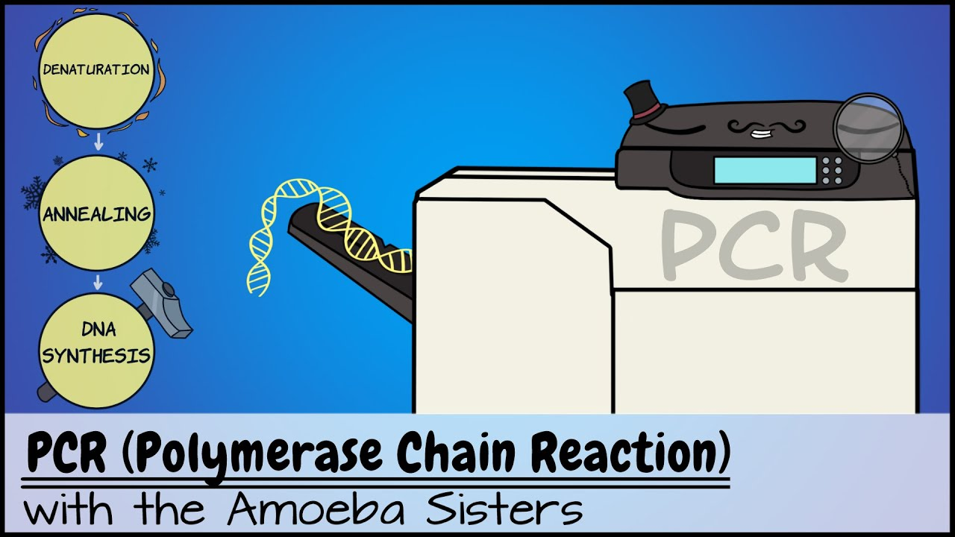
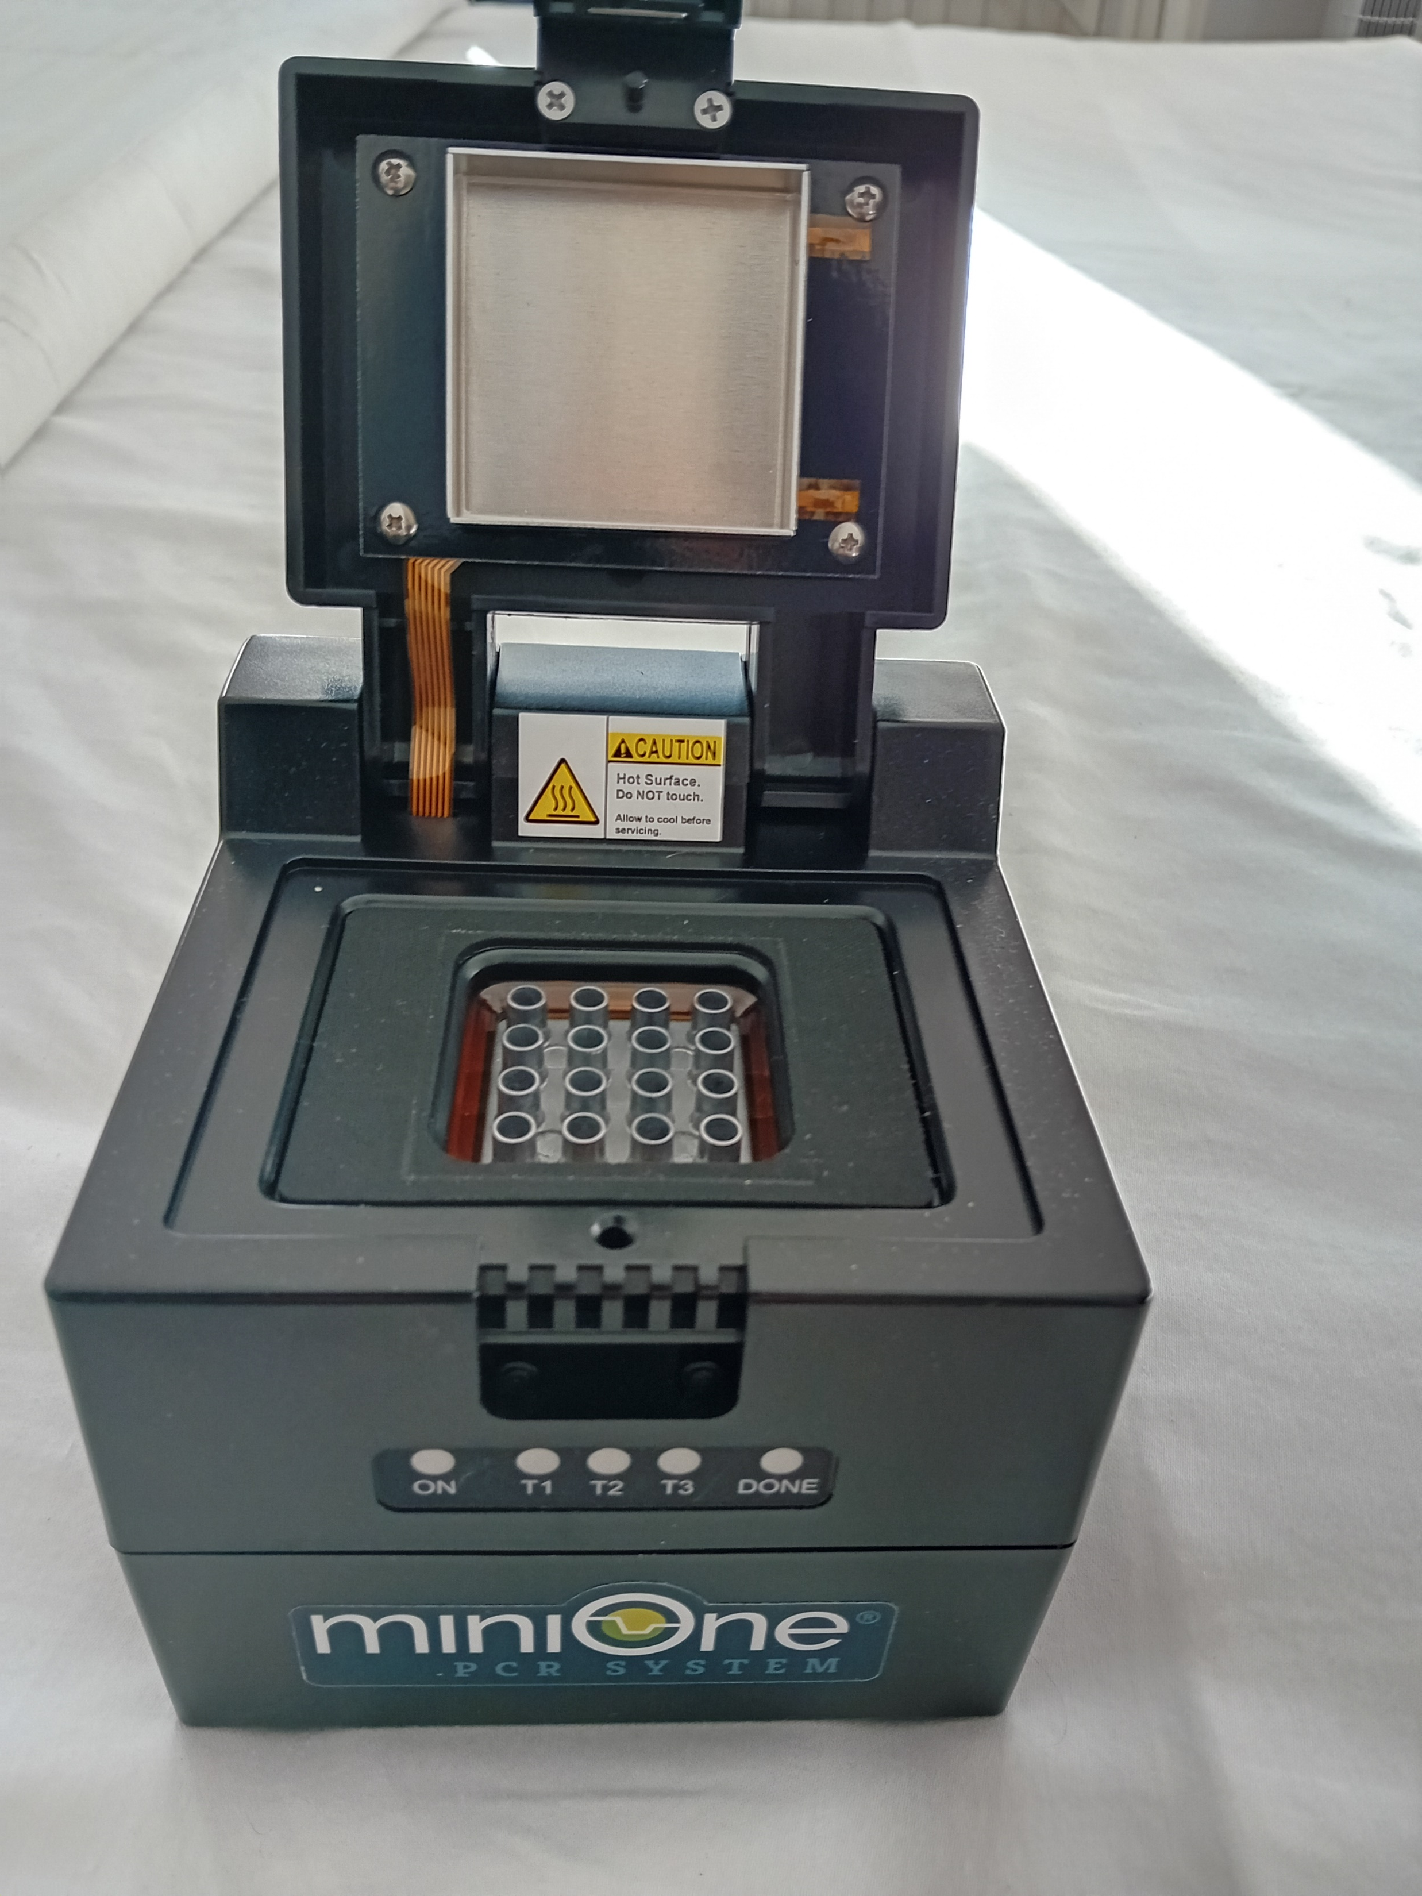
Amgen Biotech Experience
Community of Practice Network Meeting
Limited to 16 samples, but …

Slide 5
“Combining MiniOne with PCR”
Amgen Biotech Experience
Community of Practice Network Meeting
There are many opportunities in the ABE process to use PCR
Lab 4 (A plasmid + Ligation mixture)
Lab 4a (R-plasmid + Negative control)
Lab 7 (Red Colony + White Colony) & “teacher controls” - 3
Lab 7a (Red Colony only) & “teacher controls” - 2

Slide 6

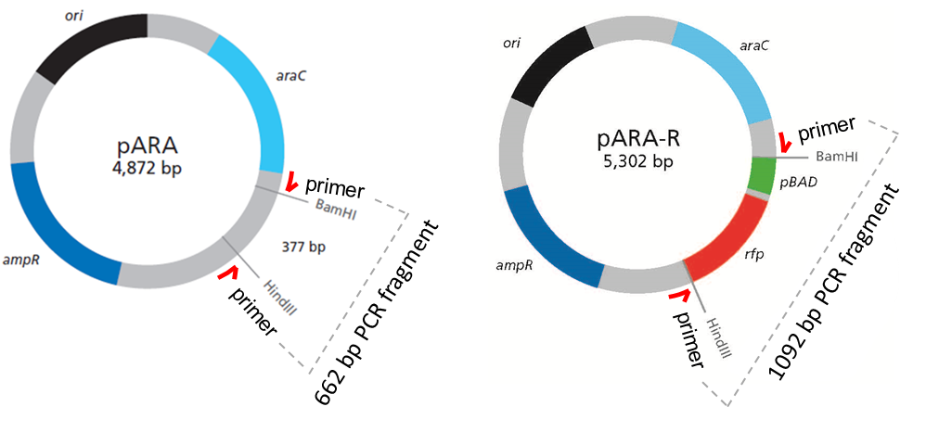
Template DNA
Notes:
So if we are trying to PCR the ‘rfp’ gene where might we find it and what templates can we screen?
The R-plasmid would make a good start
R is based on A, and actually the primers anneal to the plasmid backbone common to both plasmids – so you can expect products from both that will give a size difference

Slide 7
Template DNA
Notes:
So if we are trying to PCR the ‘rfp’ gene where might we find it and what templates can we screen?
The R-plasmid would make a good start
R is based on A, and actually the primers anneal to the plasmid backbone common to both plasmids – so you can expect products from both that will give a size difference

Slide 8
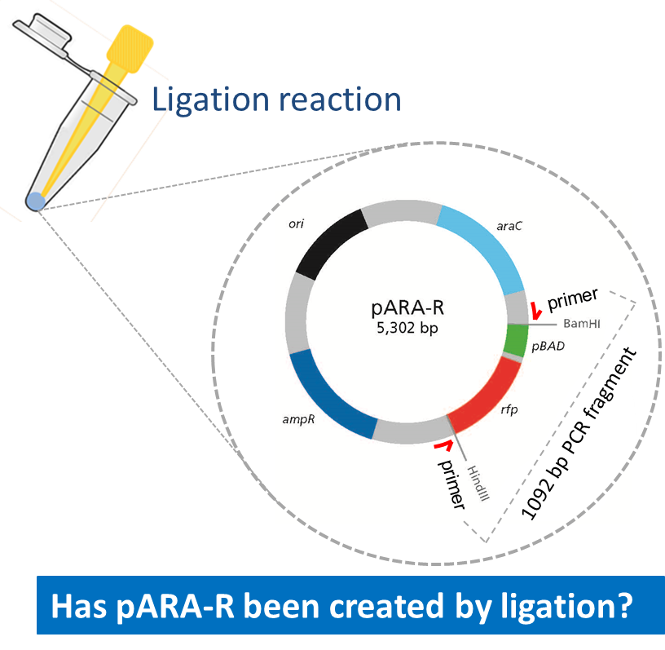
Template DNA
Notes:
Is rfp detectable in the ligation reaction?
Using the PCR after ligation, then running the products on an agarose gel, allows students to identify whether the ligation reaction has successfully created pARA-R, because if pARA-R is in the DNA used as template for the PCR, then a 1092 bp fragment will result.
This is the basis of LAB 4

Slide 9
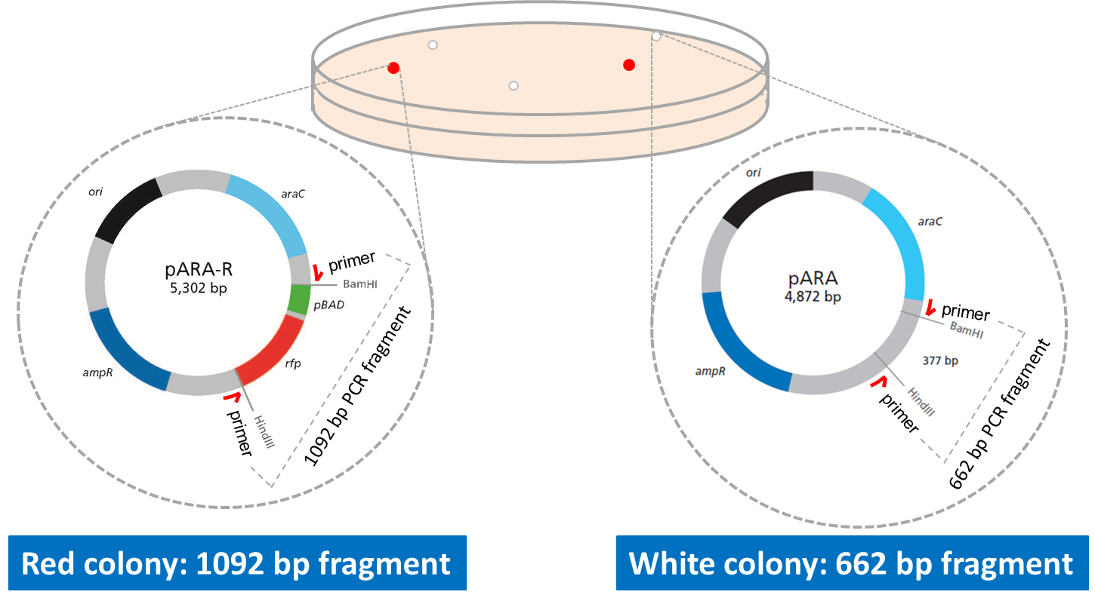
Template DNA
Notes:
Using the PCR after transformation, then running the products on an agarose gel, is even more exciting for me, because it allows correlation between phenotype and genotype.
Red colonies should produce a 1092 bp band visible after colony PCR by agarose gel electrophoresis.
White colonies should produce a 662 bp band visible after colony PCR by agarose gel electrophoresis (because white colonies contain A plasmid and not R).
This is the basis of LAB 7
Hopefully this will spur students to consider and understand the central dogma of molecular biology (DNA > RNA > protein), a concept that continues to be hard for students to grasp according to education literature and personal experience!
In training we will give you the chance to screen ALL the TEMPLATES, but in the classroom you may choose to just look at Lab 4 or Lab 7 (including some controls every time – are your reagents clean (ie. not contaminated with R-plasmid - =water/negative control); positive control – pure R-plasmid)

Slide 10
“Making the most of 16 slots”
Amgen Biotech Experience
Community of Practice Network Meeting
LAB | Description | No. samples | No. pairs of students | Total Number of tubes
Lab 4 | A + LIG | 2 | 8 pairs | 16 tubes
Lab 4a | R + neg | 2 | 8 pairs | 16 tubes
Labs 4 + 4a | A, R, neg | (2+1) | 7 pairs | 15 tubes
Lab 7 * | Red, White + TC | (2+3) | 6 pairs | 15 tubes
Lab 7a * | Red + TC | (1+2) | 14 pairs | 16 tubes
“party time *” | A, LIG, R, rc, wc, (neg) | 5 | 15 students | 16 tubes
* - need to have followed Lab 6/6a – bacterial transformation – before doing these PCR reactions

Slide 11
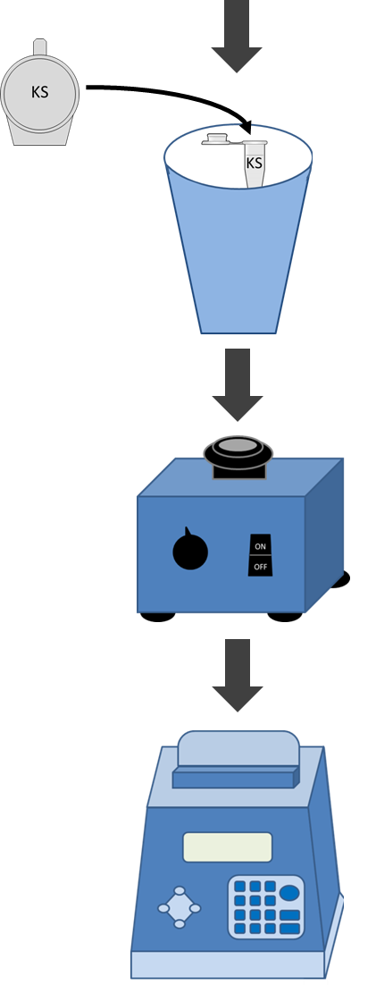
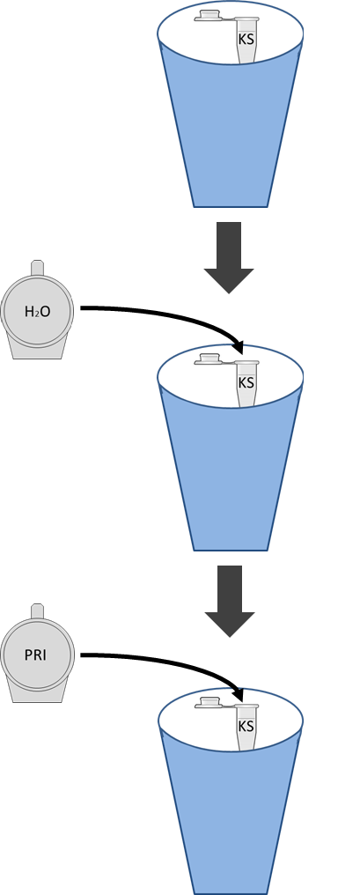
PCR Set-Up
1. Using small PCR tubes, find one labelled PRI
PRI
DNA
4. Add template DNA
2. Add water
H2O
5. Mix with tip
3. Add MM
6. Run thermal cycler
MM
Notes:
Step 2: setting up the PCR
Master mix contains buffer, magnesium chloride, nucleosides and DNA polymerase. Keep on ice to preserve maximum enzyme activity of DNA polymerase.
Remember:
Use fresh tips for each new component you add
Keep on ice
Label tubes on the side – with personal identifier - as labels on top rub off easily in thermal cycler
PCR machine will take about 2 hours to run.

Slide 12
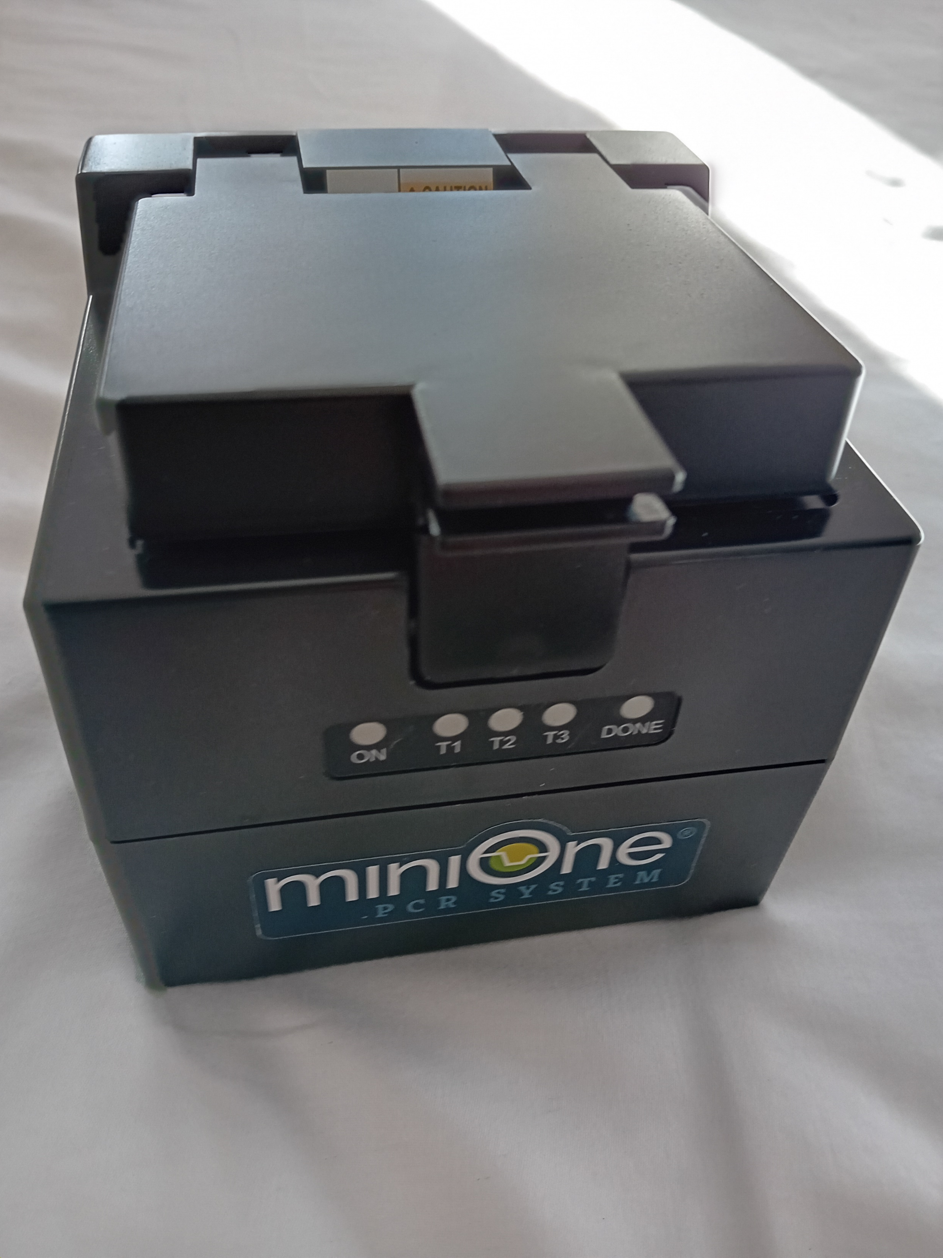

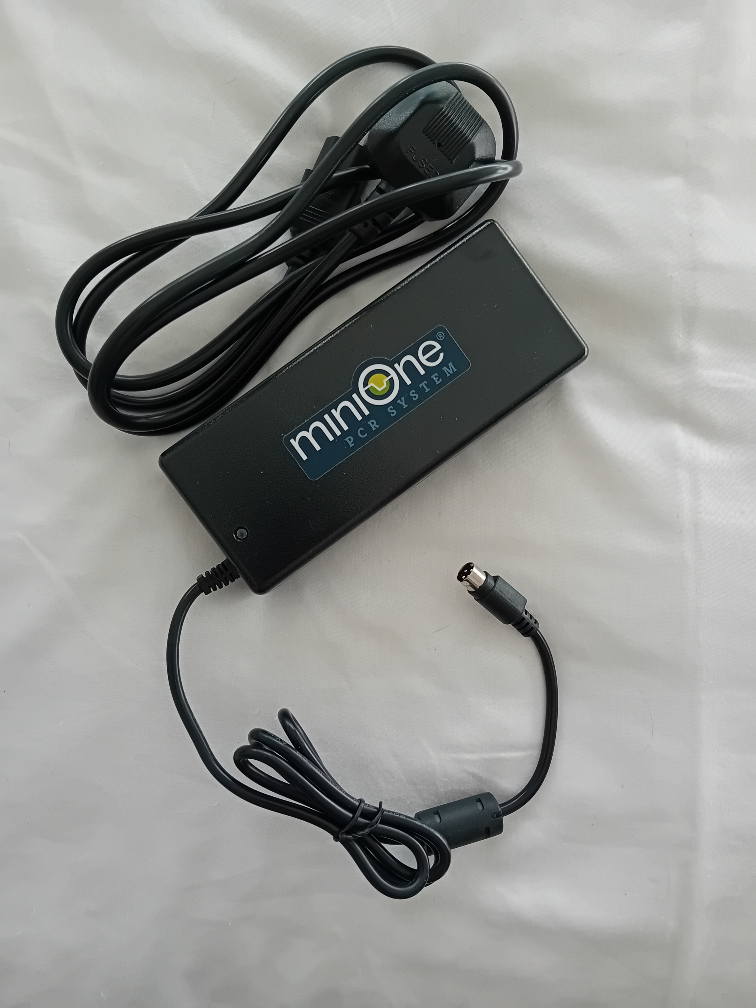
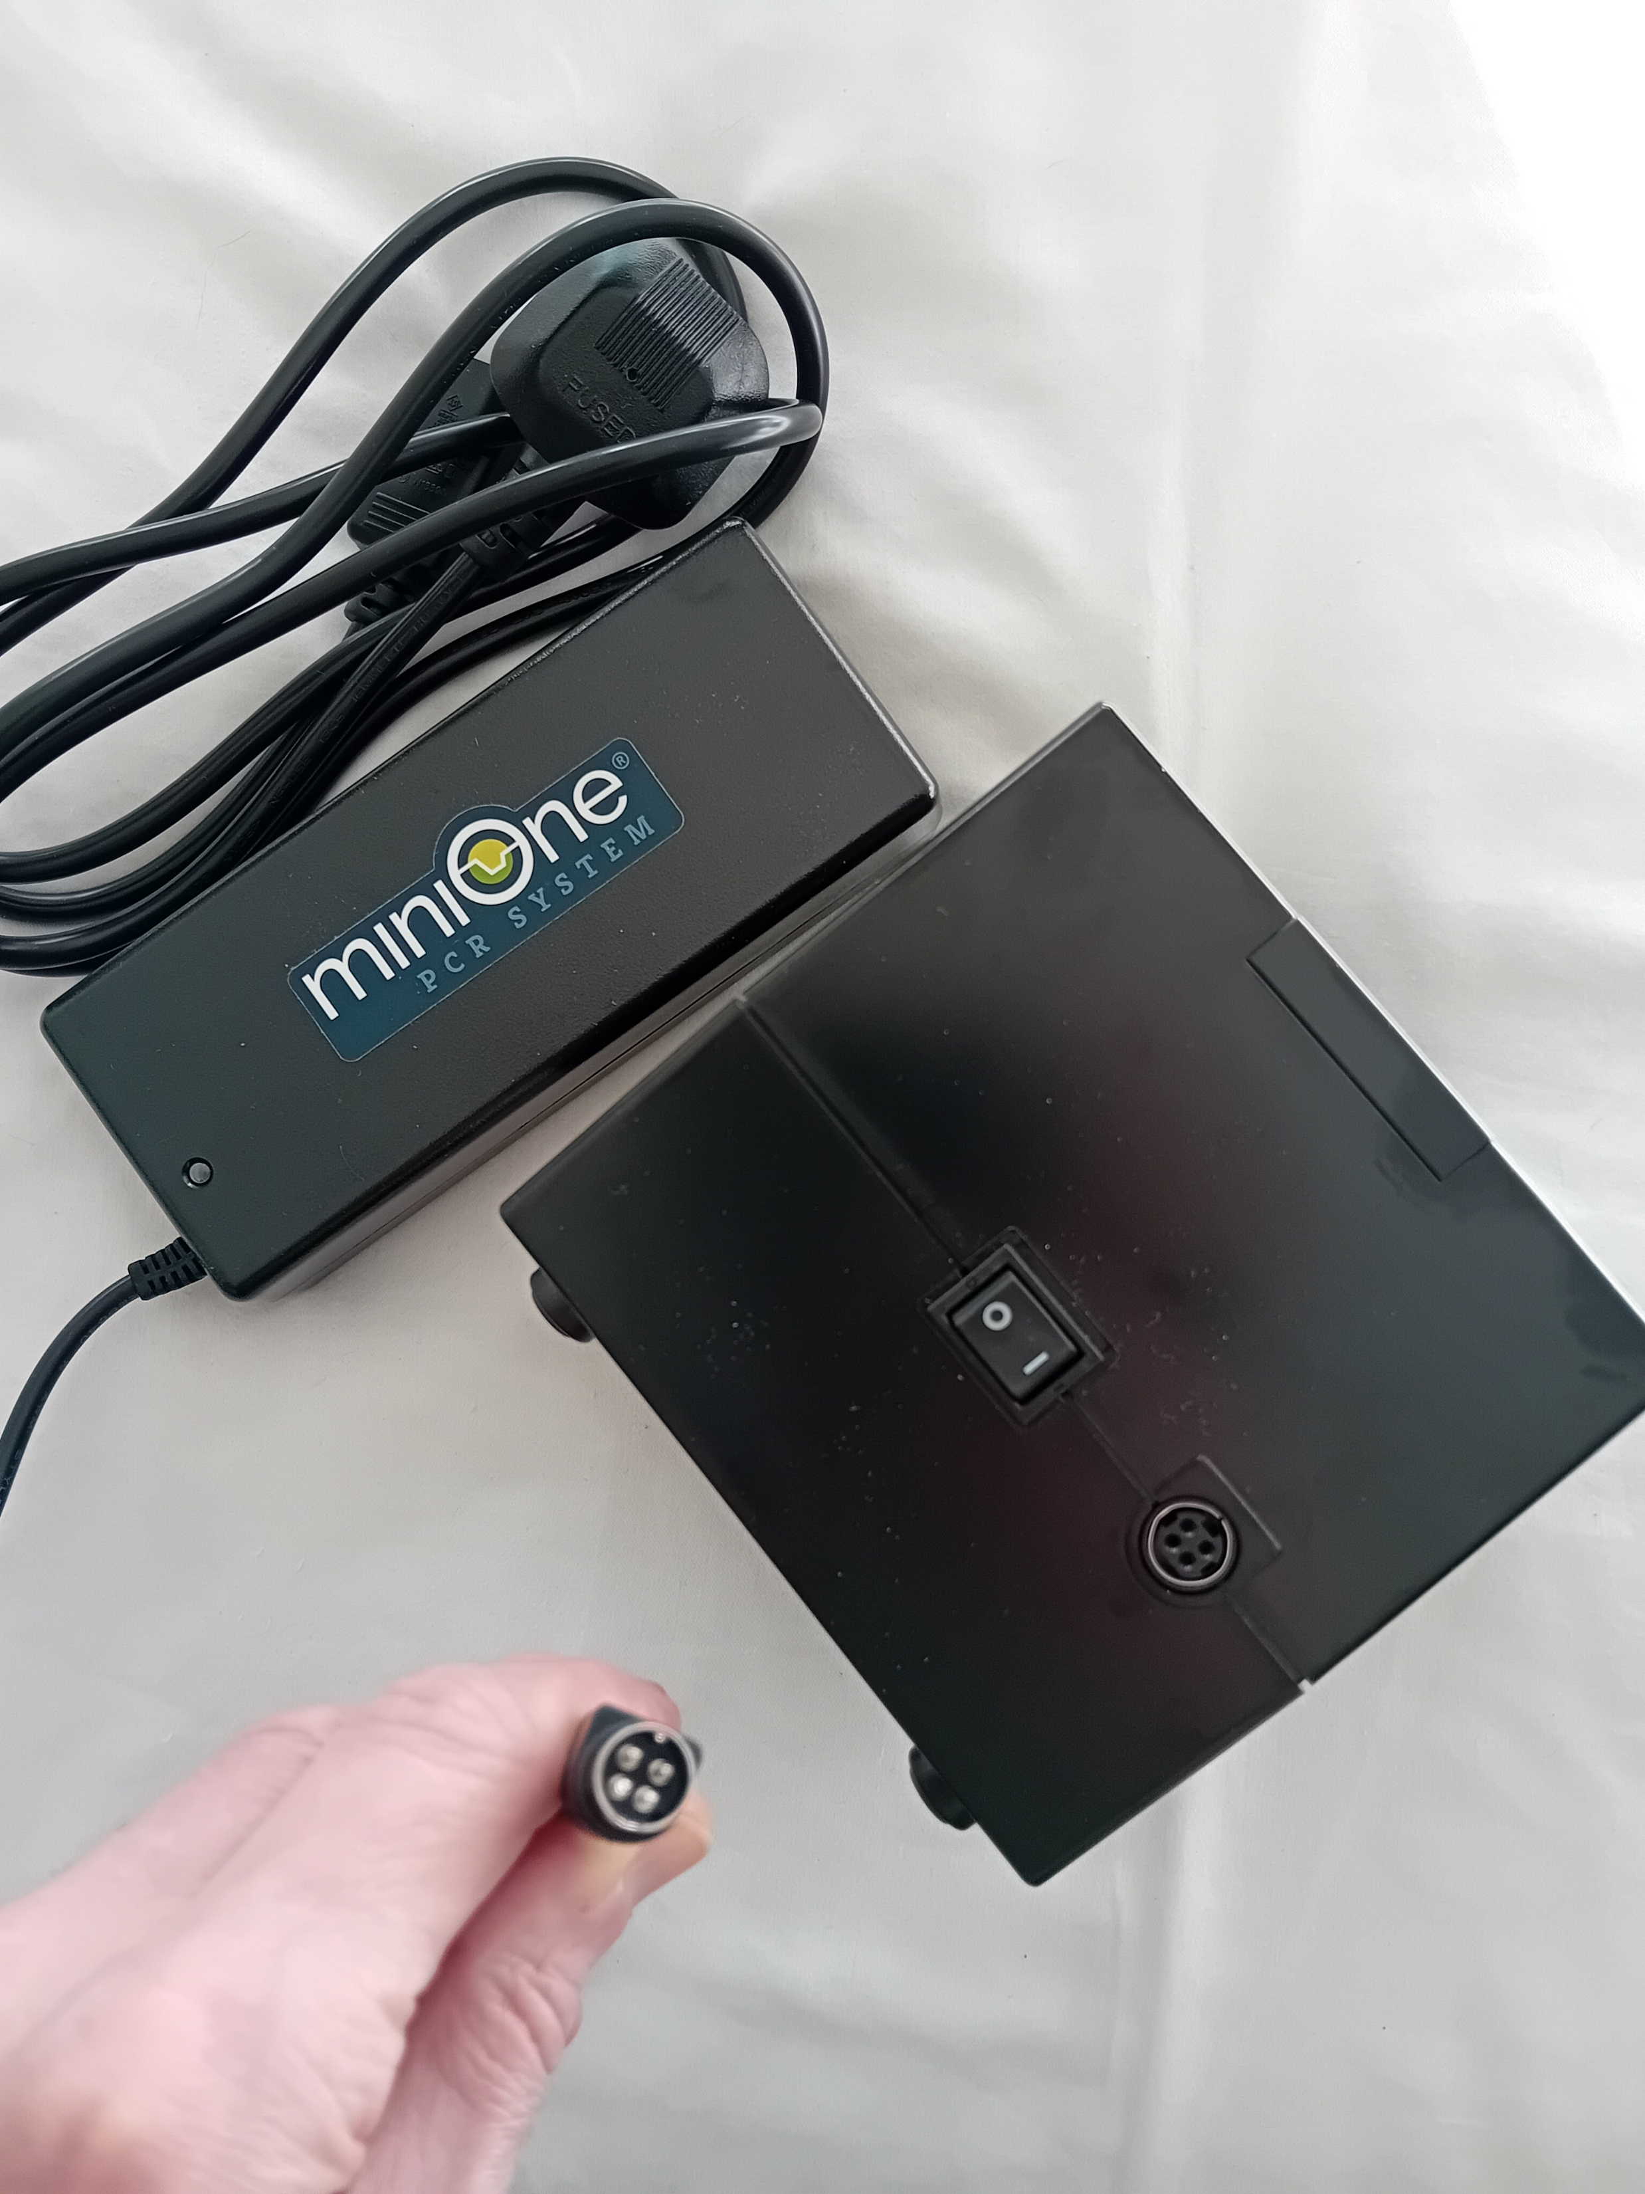
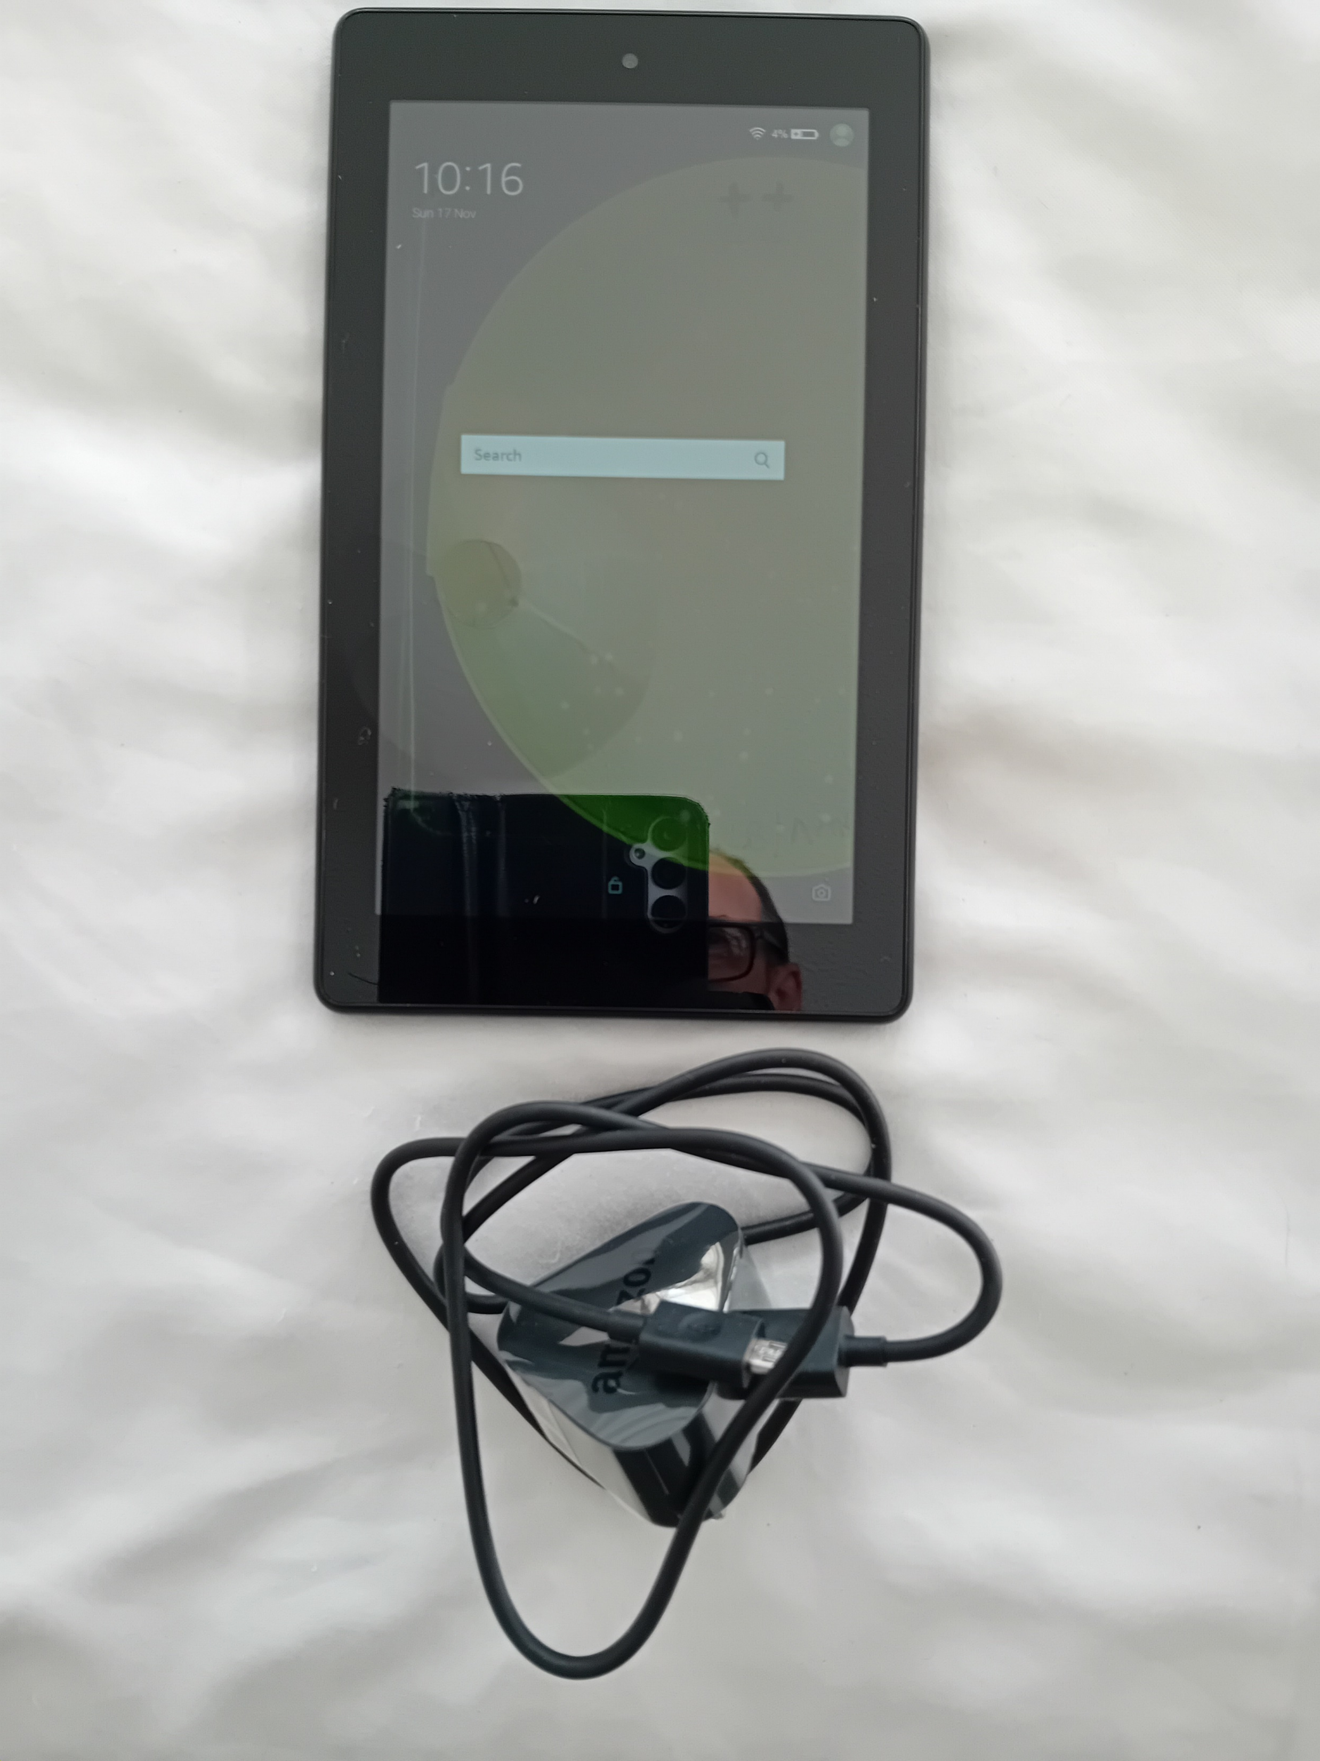
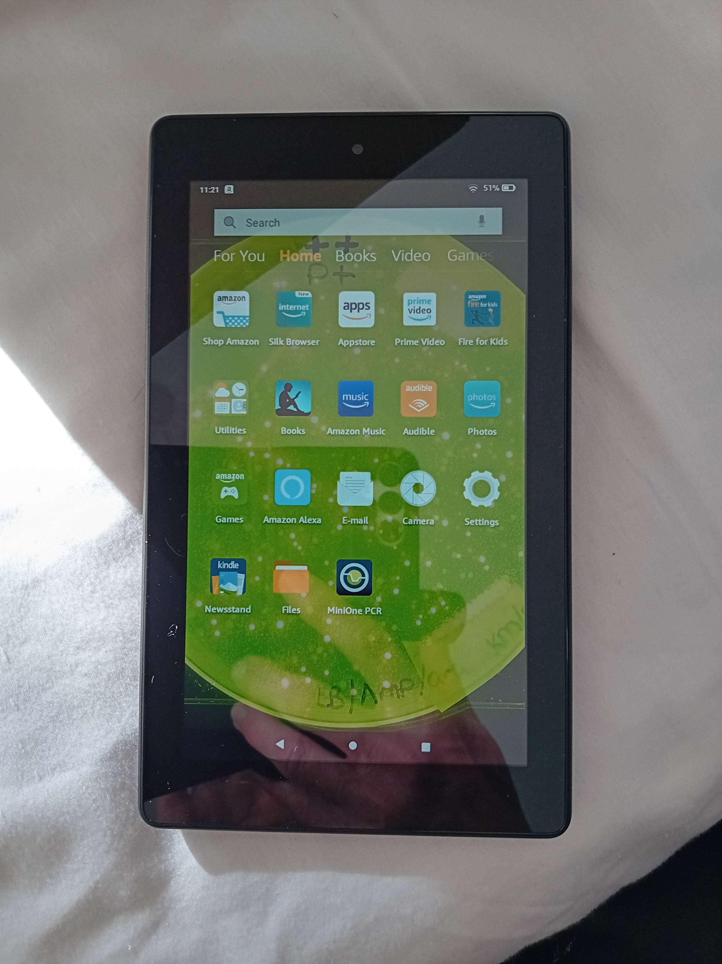
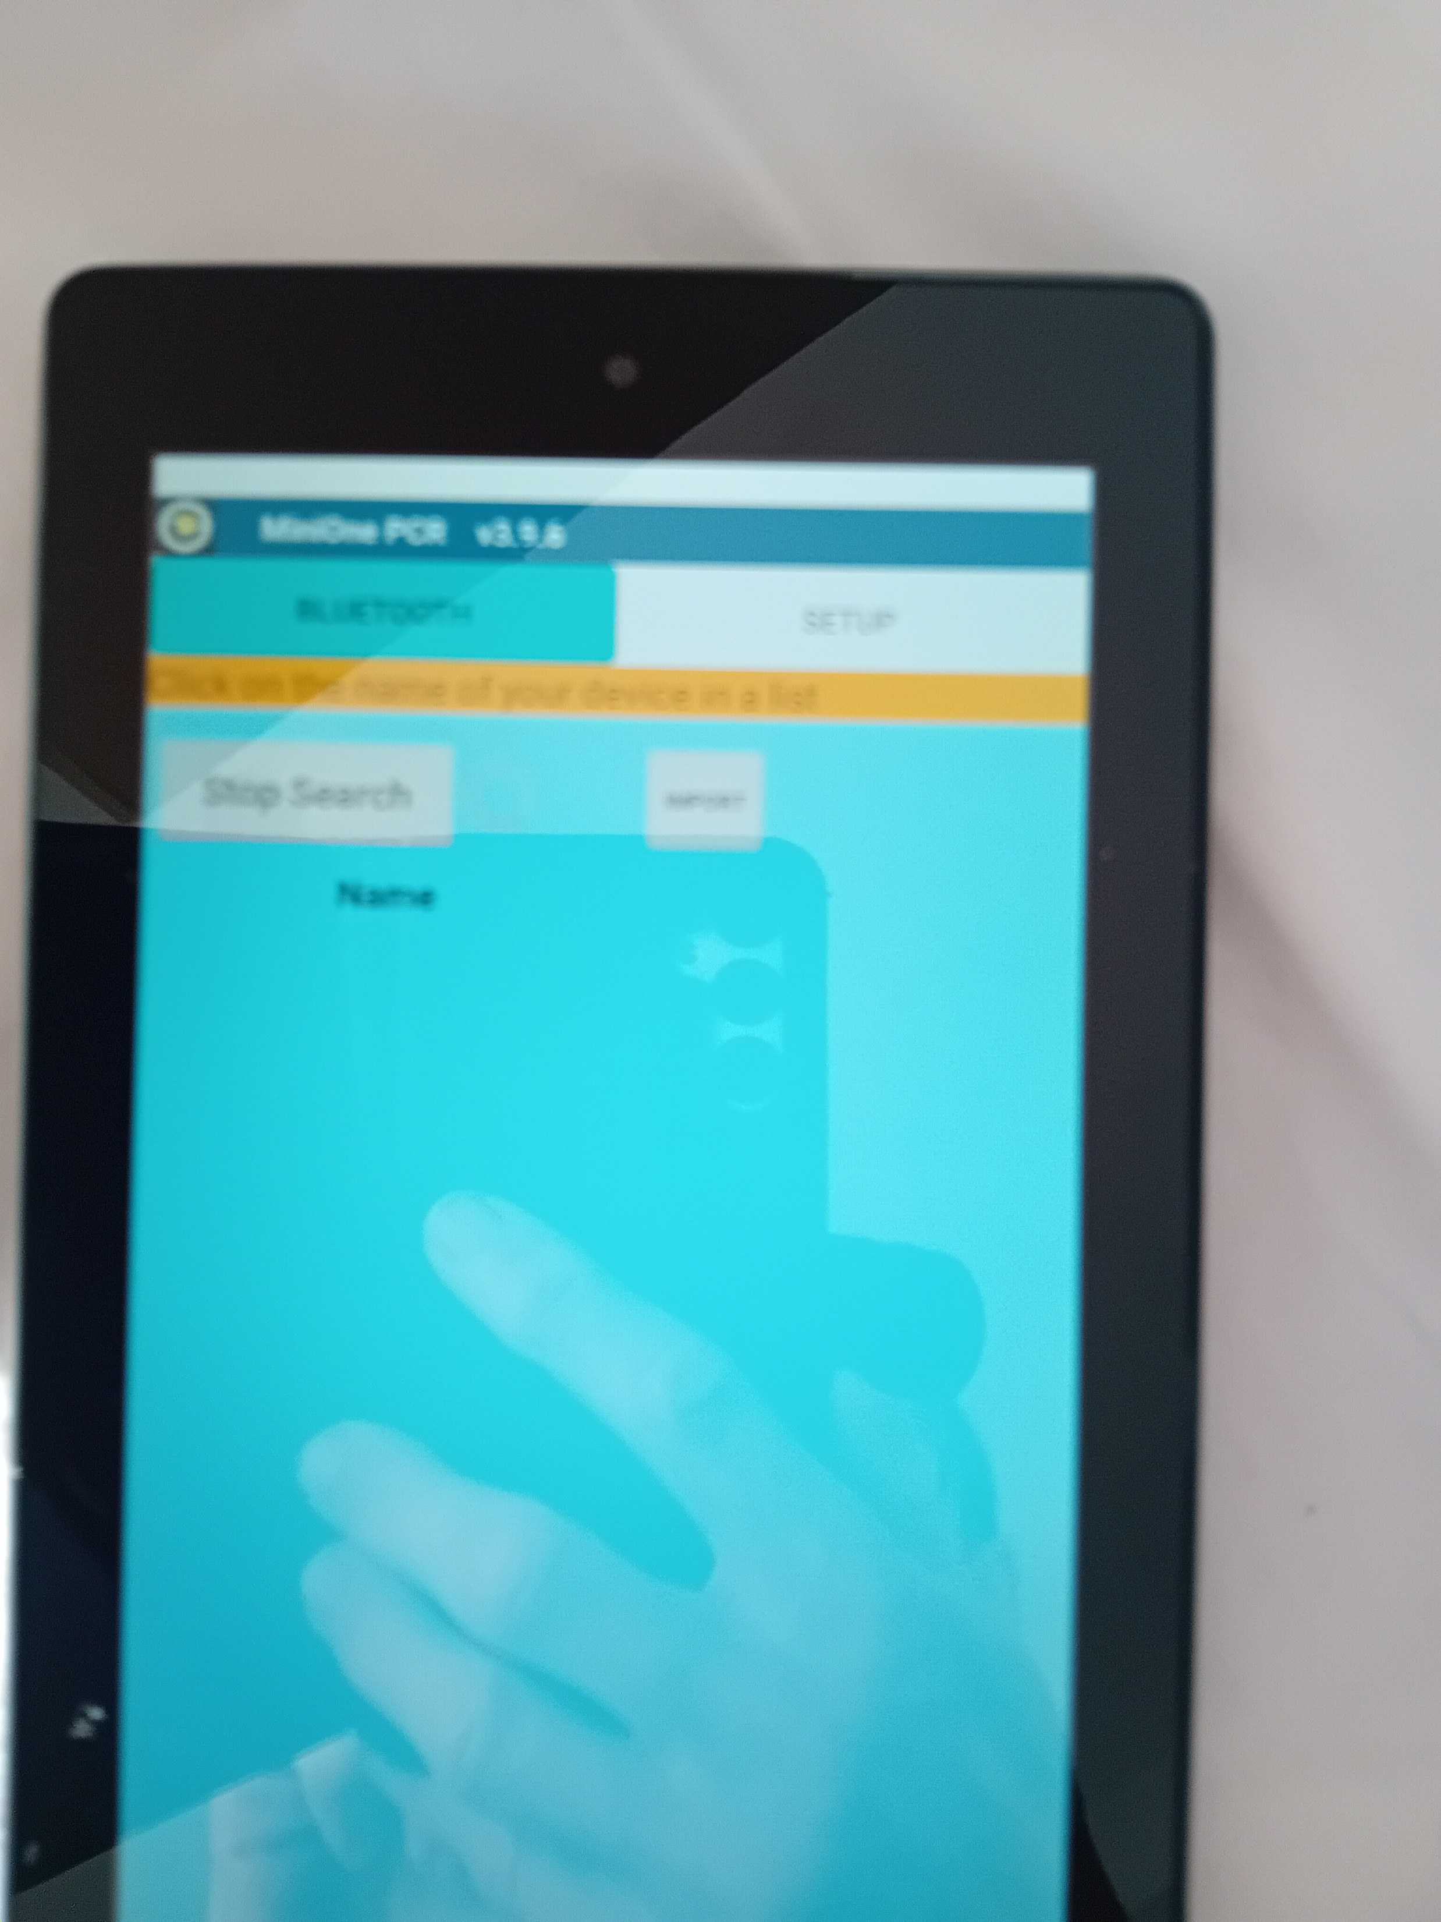
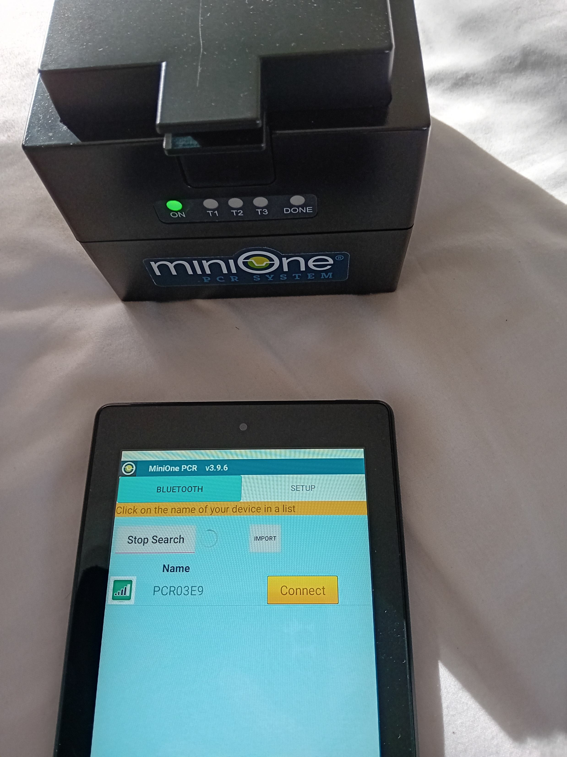
Amgen Biotech Experience
Community of Practice Network Meeting

Slide 13
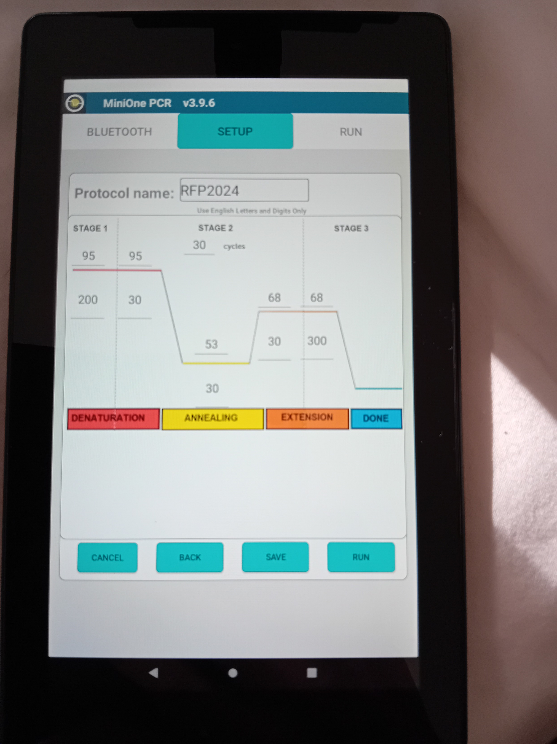
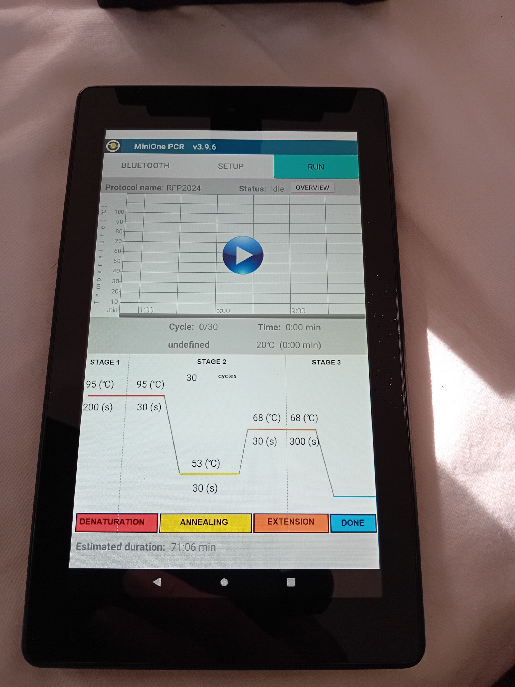
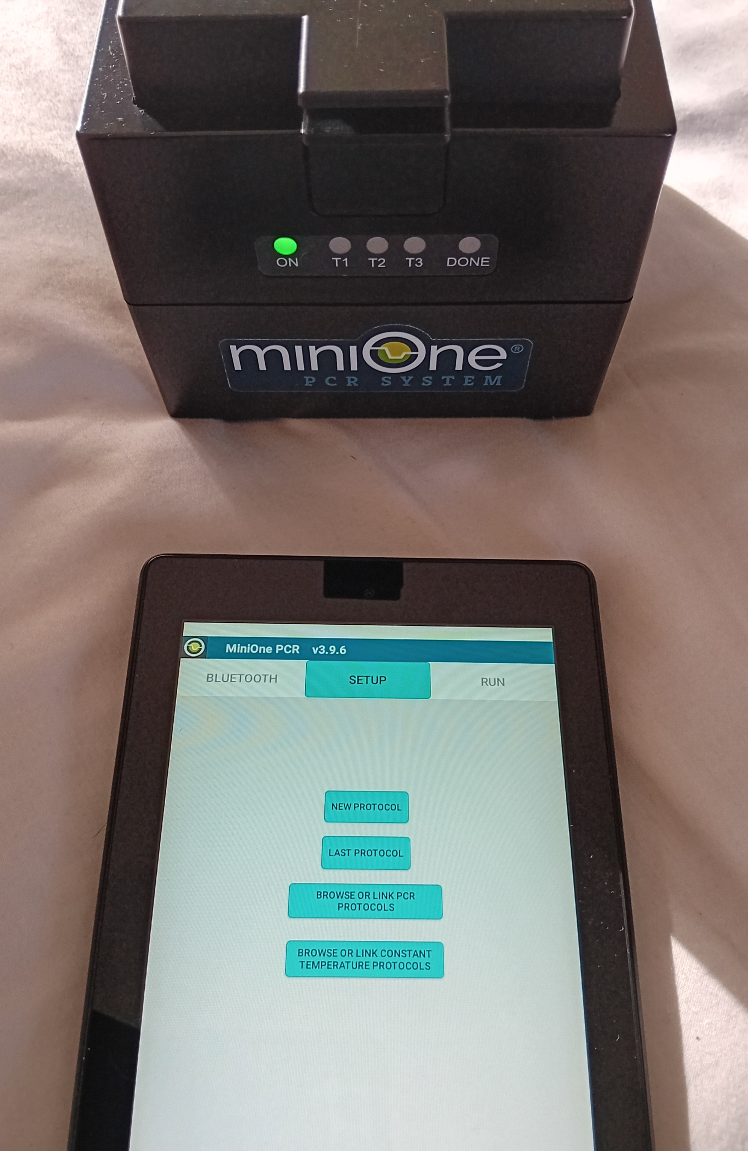
Amgen Biotech Experience
Community of Practice Network Meeting

Slide 14
71 minutes later ….
Amgen Biotech Experience
Community of Practice Network Meeting

Slide 15
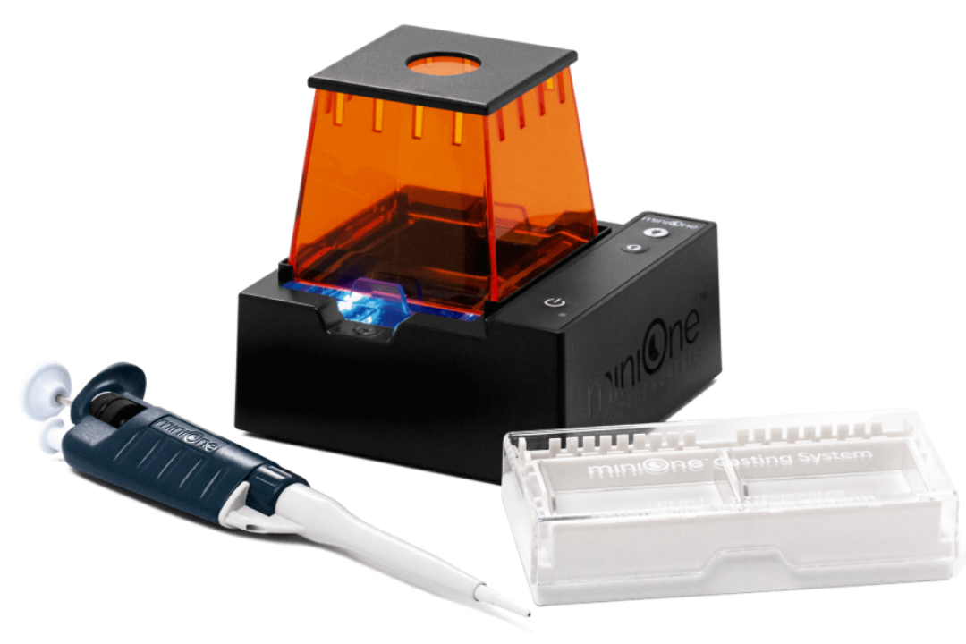
Electrophoresis time
Amgen Biotech Experience
Community of Practice Network Meeting
Comb limited to 6 or 9 slots, and you need a size marker on each gel

Slide 16
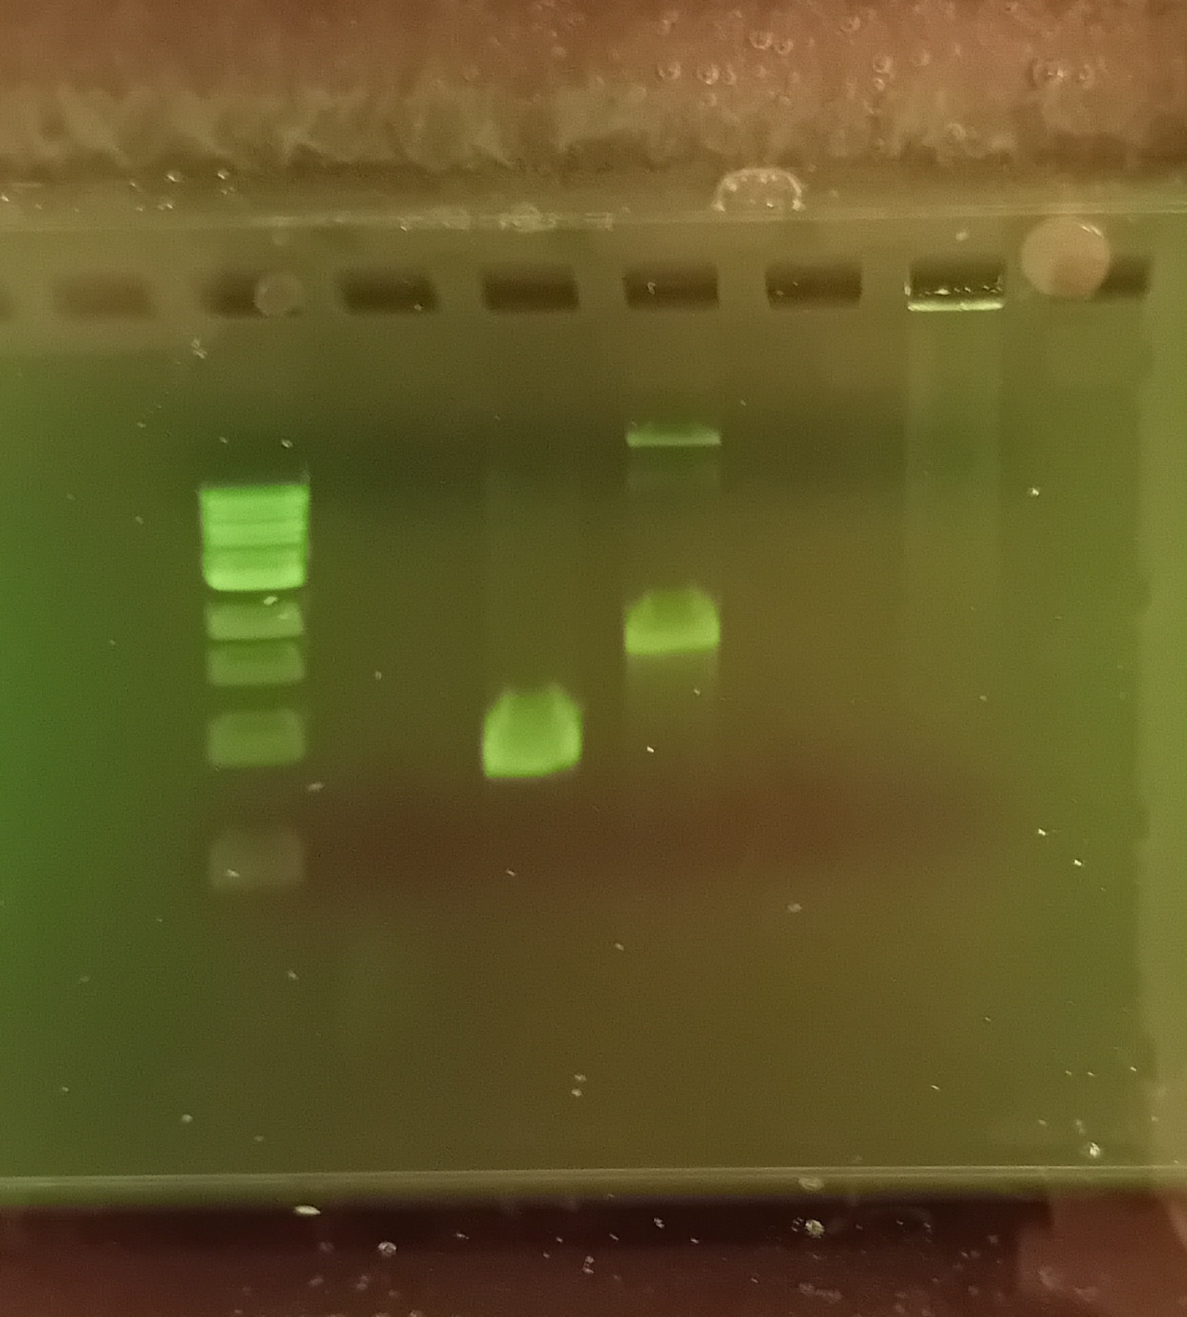
Electrophoresis time
Amgen Biotech Experience
Community of Practice Network Meeting
Marker
Negative Ct.
A-plasmid
R-plasmid
Ligation
Colony
1 2 3 4 5 6
3 kb

Slide 17
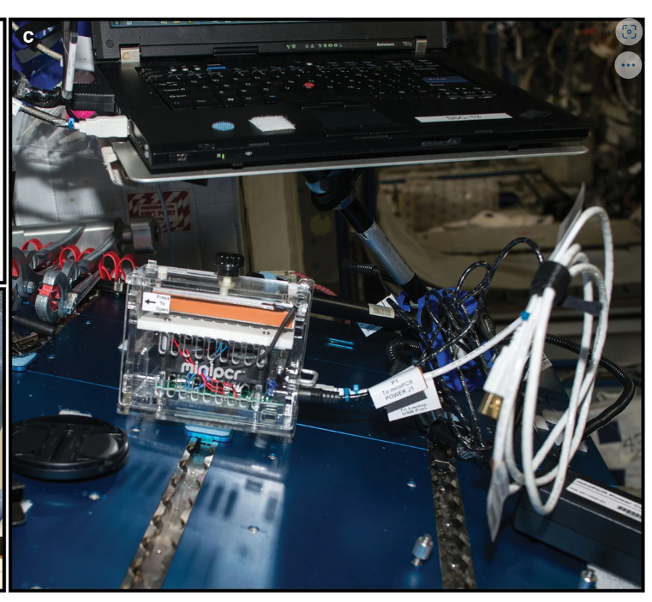
PCR and ISS
Boguraev, AS., Christensen, H.C., Bonneau, A.R. et al.
Successful amplification of DNA aboard
the International Space Station.
npj Microgravity 3, 26 (2017).
https://doi.org/10.1038/s41526-017-0033-9
We describe DNA amplification aboard the International Space Station (ISS) through the use of a miniaturized miniPCR system. Target sequences in plasmid, zebrafish genomic DNA, and bisulfite-treated DNA were successfully amplified under a variety of conditions. … Our findings establish proof of concept for targeted detection of DNA sequences during spaceflight and lay a foundation for future uses ranging from environmental monitoring to on-orbit diagnostics.
https://rdcu.be/d0Mg2

Slide 18
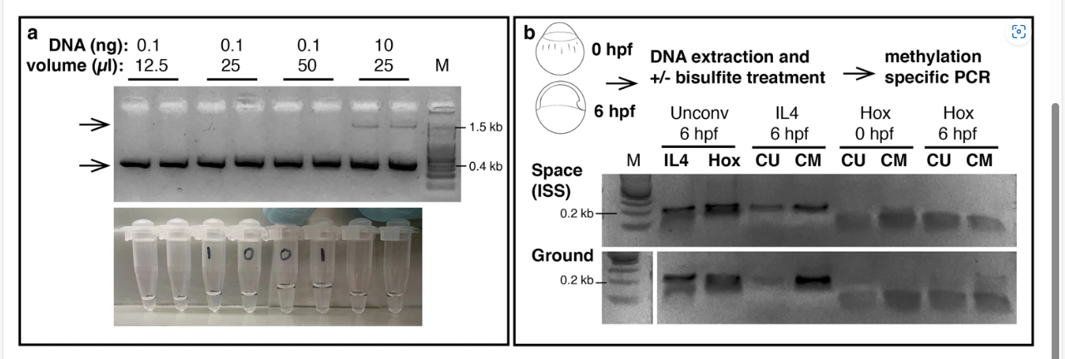
PCR and ISS
https://rdcu.be/d0Mg2

Slide 19
Summary
Easy set-up (20 / 70 / 10 / 20 = 2 hours)
Multiple opportunities to gets hands-on with PCR
Group size needn’t limit your use of MO
Engaging link to ISS (and of course COVID-times)
If you haven’t booked your loan, contact hubs ASAP
Don’t forget to Google “Biorad PCR song”

